Slide 1
Radical Green
CARBON NEUTRAL DESIGN:
MINING LEEDTM FOR CARBON
Professor Terri Meyer Boake
Associate Director | School of Architecture | University of Waterloo
Past President Society of Building Science Educators
Member OAA Committee for Sustainable Built Environment
Steering Committee for the National Academy of Environmental Design

Slide 2
GREEN is the
NEW
BLACK

Slide 3
A continuation of Preparing for the 2030 Challenge:
if you attended the OAA Convention in Toronto in 2009, this presentation will build upon the basic premise presented
a brief introduction will reintroduce those essential concepts
the balance of the material contained in the presentation will be new
this is to allow people that did not attend the introductory lecture to participate
newly included, looking for carbon in LEED 2009

Slide 4
Global Warming and Sustainable Design:
A priority has been placed, above and beyond current trends in Sustainable Design, on the reduction of GHG emissions
Buildings account for more than 40% of the GHG
Green, Sustainable and High Performance Buildings are not going far enough, quickly enough in reducing their negative impact on the environment, and certainly not far enough to offset the balance of building that marches on in ignorance
Carbon Neutrality focuses on the relationship between all aspects of “building/s” and CO₂ emissions
Carbon Neutral Design strives to reverse trends in Global Warming

Slide 5
Differentiating Sustainable vs.
Zero Carbon/Carbon Neutral:
Sustainable design is a holistic way of designing buildings to minimize their environmental impact through:
  Reduced dependency on non-renewable resources
  A more bio-regional response to climate and site
  Increased efficiency in the design of the building envelope and energy systems
  A environmentally sensitive use of materials
  Focus on healthy interior environments
  Characterized by buildings that aim to “live lightly on the earth” and
  “Sustainable development is development that meets the needs of the present without compromising the ability of future generations to meet their own needs.”
  United Nations World Commission on Environment and Development

Slide 6
Carbon Neutral is ALL about ENERGY
A Near Zero Energy building produces at least 75% of its required energy through the use of on-site renewable energy. Off-grid buildings that use some non-renewable energy generation for backup are considered near zero energy buildings because they typically cannot export excess renewable generation to account for fossil fuel energy use.
A Carbon Neutral Building derives 100% of its operating energy from non fossil fuel based renewable resources.

Slide 7

Why Assess Carbon Neutrality?
Holistic Sustainable design does not target GHG and Global warming
Assessing carbon is complex, but necessary
The next important goal to reverse the effects of global warming and reduce CO² emissions it to make our buildings “carbon neutral”
“architecture2030” is focused on raising the stakes in sustainable design to challenge designers to reduce their carbon emissions
by 50% by the year 2030
www.architecture2030.org

Slide 8

2030’s Fossil Fuel Reduction Standard:
The fossil fuel reduction standard for all new buildings shall be increased to:
  60% in 2010
  70% in 2015
  80% in 2020
  90% in 2025
  Carbon-neutral in 2030 (using no fossil fuel GHG emitting energy to operate).
  2030’s initiative and goals fall outside of any
  Government lead directive.
  This is a RADICAL reduction!
Source: www.architecture2030.org

Slide 9
“The world will not evolve past its current state of crisis by using the same thinking that created the situation.”
– Albert Einstein
…the world of DESIGN needs some Radical thinking!

Slide 10
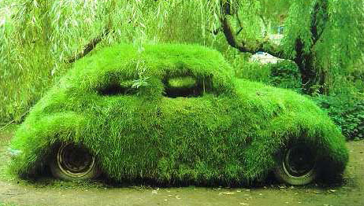
Being less BAD is not GOOD enough
Most Green Building Rating systems are about being LESS BAD....

Slide 11
Radical CONFLICT!??
#1 – GLOBAL WARMING – too much CO₂
#2 – RUNNING OUT OF OIL (oil causes CO₂ )

Slide 12
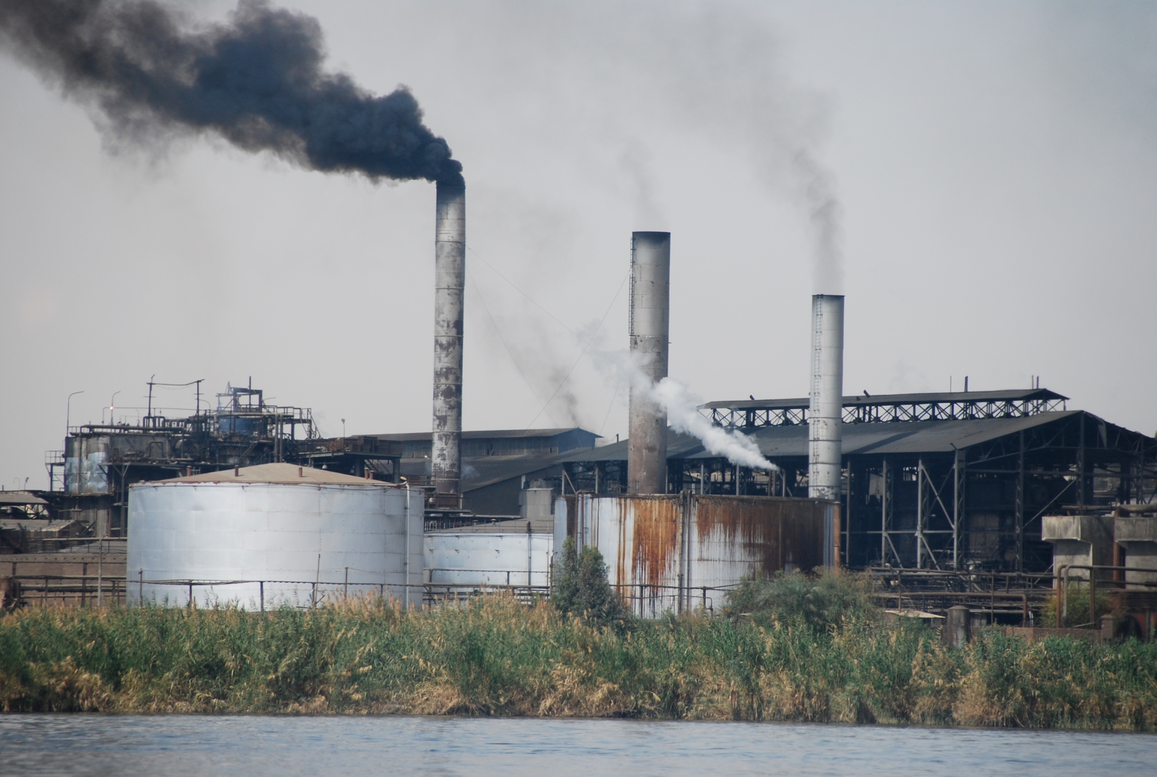
Coal is still plentiful and its widespread use is even more critical in impacting high levels of GHG emissions! It should not be viewed as a reasonable substitute for cheap or no oil! However, developing nations are burning coal as if there was no tomorrow….
If we ran out of OIL right away…
We would solve part of the Global Warming problem….
PROBLEM: there is still LOTS of COAL, and COAL is even dirtier….

Slide 13
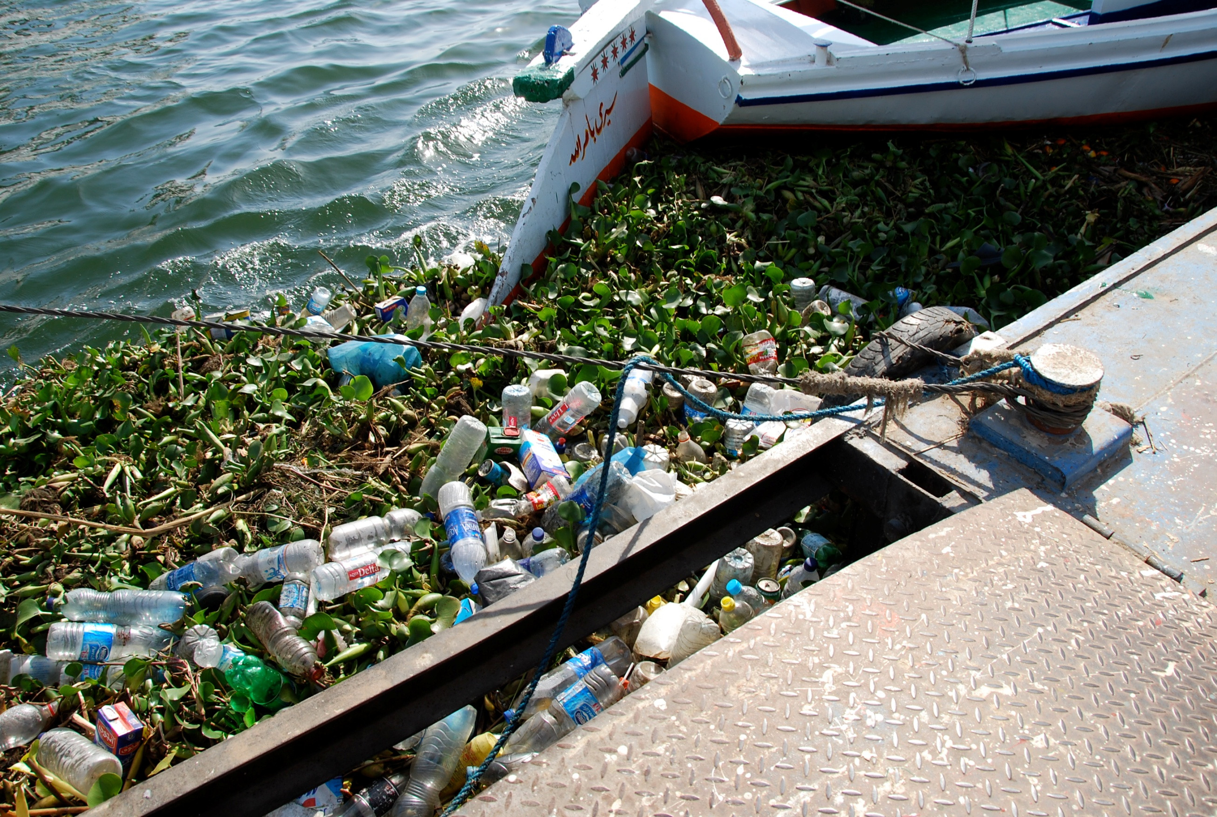
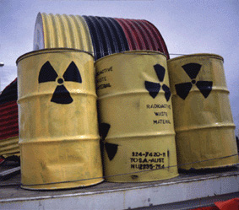
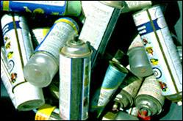
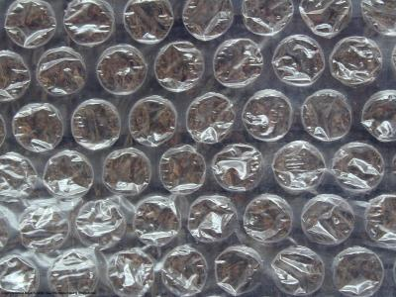
POLLUTION IS AN ACT OF DESIGN
Remember, EVERYTHING that is called 'disposable' was DESIGNED from day one to be garbage--as its PRIMARY and overriding design consideration.”

Slide 14

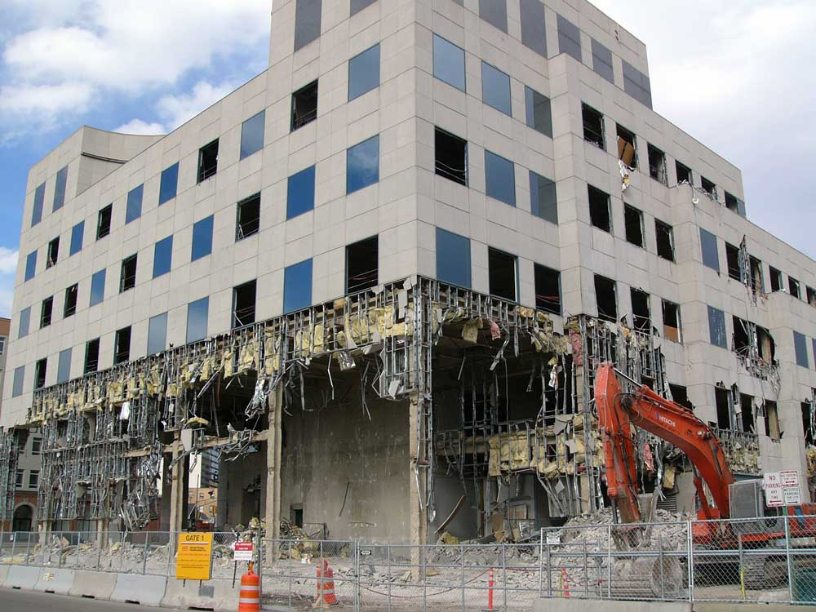

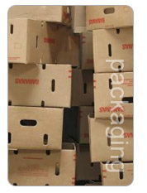


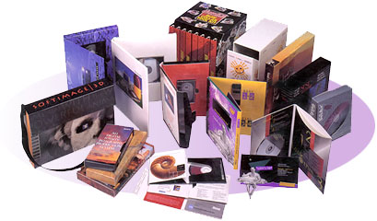

EVEN THIS BUILDING!
this was ALL designed
To be thrown OUT!

Slide 15
Radical PHILOSOPHY!??
WASTE = FOOD
(the human race is the only species to DESIGN things with the INTENTION that they become GARBAGE!)

Slide 16
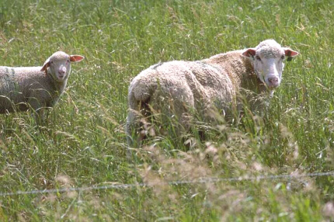

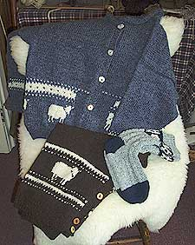

MIMIC NATURAL CYCLES
Design for a closed loop where WASTE becomes FOOD and FEEDS back into a healthy cycle….
compostable end product

Slide 17
Radical PROPOSITION!??
DESIGN FOR DISASSEMBLY
So that we can take things (even buildings!) apart and easily repair or reuse them
REUSE MEANS LESS ENERGY THAN RECYCLE
so select materials for building that can be #1 reused and #2 recycled

Slide 18
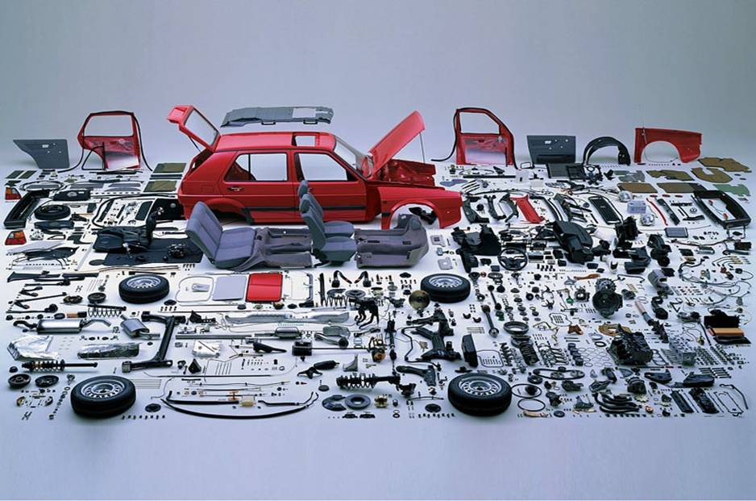
MIMIC OTHER INDUSTRIES
DESIGN BUILDINGS TO COME APART SO THAT THEY CAN BE REPAIRED, REUSED AND RECYCLED – EASILY!

Slide 19

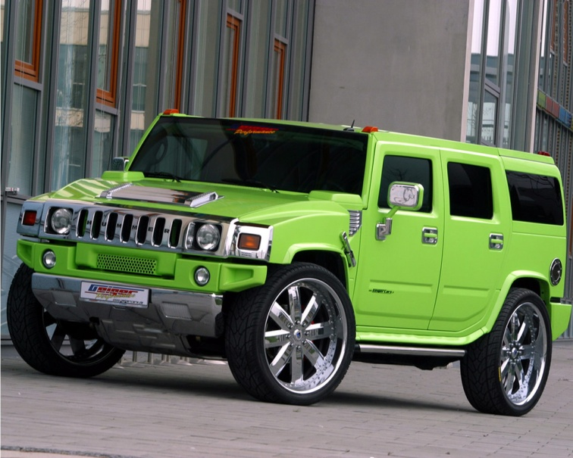
Inconvenient TRUTH
BUILDINGS ARE RESPONSIBLE FOR BETWEEN
40% TO 70% OF WORLD CARBON EMISSIONS
IT IS NOT ALL ABOUT CARS…
This was an important film by former U.S. Vice President Al Gore, but what he did not stress was that...

Slide 20
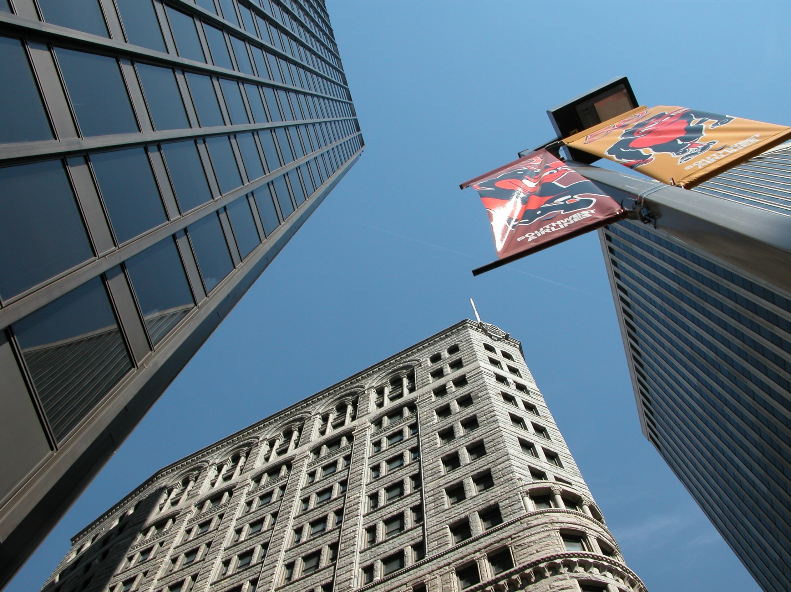
Energy Use by Buildings
Notes:
If one looks at the Energy Consumption patterns in North America it can be seen that Industry and Manufacturing account for 25% of all energy consumed; transportation accounts for 27% of all energy consumed, and buildings account for 48% of all energy consumed. This would include not only the operational energy associated with a building, but also its construction associated energy. If we consider that much transportation energy is spent by people driving to and from work and retail, relationships set out by urban planners, it is easy to see that buildings use far more energy than cars, trucks and oversized SUVs!
It is the Architect that has control over the design of most buildings and thereby is the person that must take charge of ensuring that they are better designed in order to reduce their negative impact on the environment.
It is the energy consumption of buildings that is the key contributor to GHG emissions in North America and the World.

Slide 21
Background
What is 1 tonne of CO₂?
Greenhouse Gas Equivalency
406.6 L of gas not consumed
0.2 cars not used for 1 year
1 tonne CO₂
2.1 barrels of crude oil not consumed
0.3 tonnes of recycled waste
1 person reducing energy use by 20% for 1 year
0.9 acres of forest absorbing carbon
Source: Natural Resources Canada,
RETScreen International v4
Notes:
Ideal gas law → PV=nRT (solve for n/V → moles/L)
Molar mass of CO2 = 44g/mole
Avogadro’s number = 6.023+E23 atoms (or molecules)/mol
All gases have weight. A tonne of gas = a tonne of bricks (just the volume of air is larger because the density of air is less)
The atmospheric air has weight. Barometers measure changes in air pressure (in terms of inches of mercury) which is essential a measure of air weight. As air pressure increases, weight of air increases
Weight of air is about 1.2kg per m3
Earth’s atmosphere is something like 120km tall
Average pressure at sea level is about 15psi (101.3kPa)

Slide 22

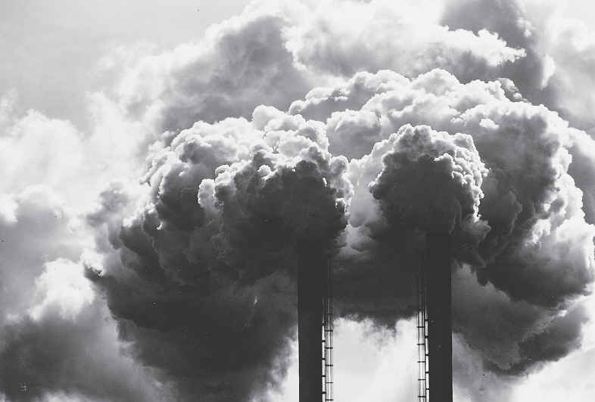
Energy Use in Buildings
Key Terms
Global Warming Potential (GWP)
  A dimensionless term that was developed to compare one Greenhouse Gas (GHG) to another in terms of their ability to trap heat in the Earth’s atmosphere
Carbon Dioxide Equivalency (CO₂e)
  A measure of the equivalent amount of CO₂ that would have the same GWP as a given mixture of CO₂ and other GHGs in the Earth’s atmosphere
Notes:
Most abundant GHG’s:
water vapour
carbon dioxide
methane
nitrous oxide
ozone
CO2 is used as the baseline

Slide 23
CO₂ Production by Country in 1997
“Pre-LEED”
Country CO₂ Produced (tonnes of carbon) Total (millions) Per Capita
U.S. 1,489.6 5.48
China 913.8 0.75
Russia 390.6 2.65
Japan 316.2 2.51
India 279.9 0.29
Germany 227.4 2.77
UK 142.1 2.41
Canada 133.9 4.42
Italy 111.3 1.94
Ukraine 100.4 1.97
Source: Carbon Dioxide Information Analysis Center, Oak Ridge National Laboratory, Tennessee

Slide 24
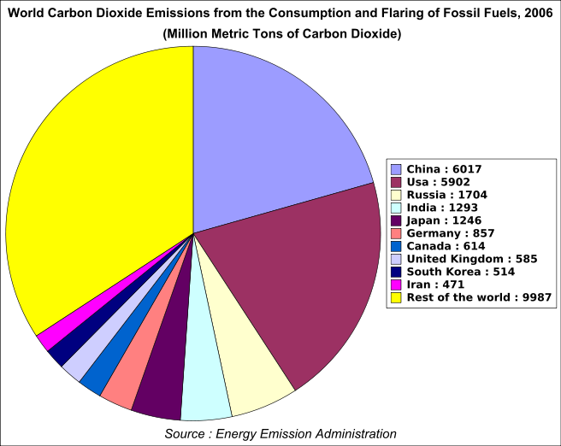
CO₂ Production by Country in 2007
10 Years into LEED
Country CO₂ Produced % total world emissions
metric tonnes
U.S. 5,752 20.2%
China 6,103 21.5%
European Union 1,314 13.8%
Russia 1,564 5.5%
India 1,510 5.3%
Japan 1,293 4.6%
Canada 545 1.9%
The Global situation in the past 10 years has become many times WORSE. China’s emissions INCREASED by 668% in 10 years.
Source: Wikipedia, accessed Sept 3, 2009
China
USA
Canada

Slide 25
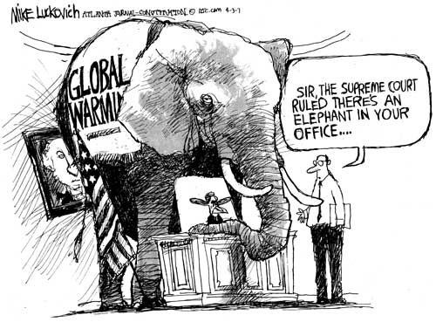
The Elephant in the Room….

Slide 26
Radical REALIZATION
#1 - OUR NORTH AMERICAN LIFESTYLE OF CONSUMPTION IS NOT SUSTAINABLE
#2 – DEVELOPING COUNTRIES (WITH ZILLIONS MORE PEOPLE THAN WE) ARE STRIVING TO BE JUST LIKE US (but only on the surface – call it “Knock Off Architecture”)
HOW DO WE TELL CHINA AND INDIA – DON’T COPY NORTH AMERICAN MODERN ARCHITECTURE AS IT IS NOT GREEN AND IT IS A SUSTAINABLE FAILURE!

Slide 27
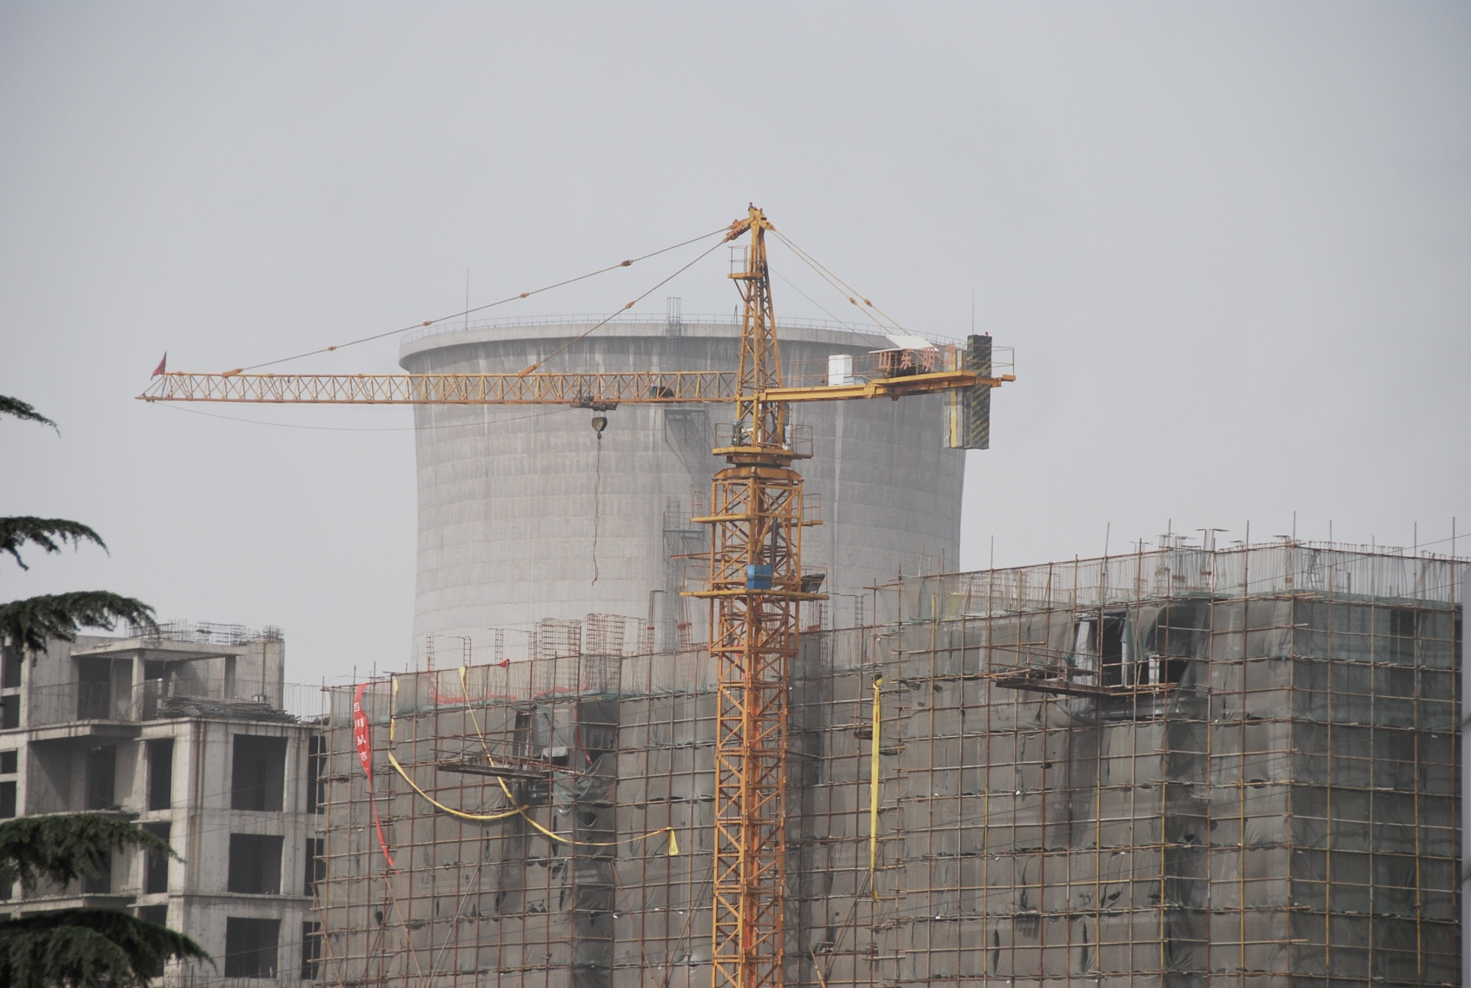
Developing nations are slowly swapping coal for nuclear, rather than rethinking HOW they construct buildings to use less energy. Just like North America….

Slide 28
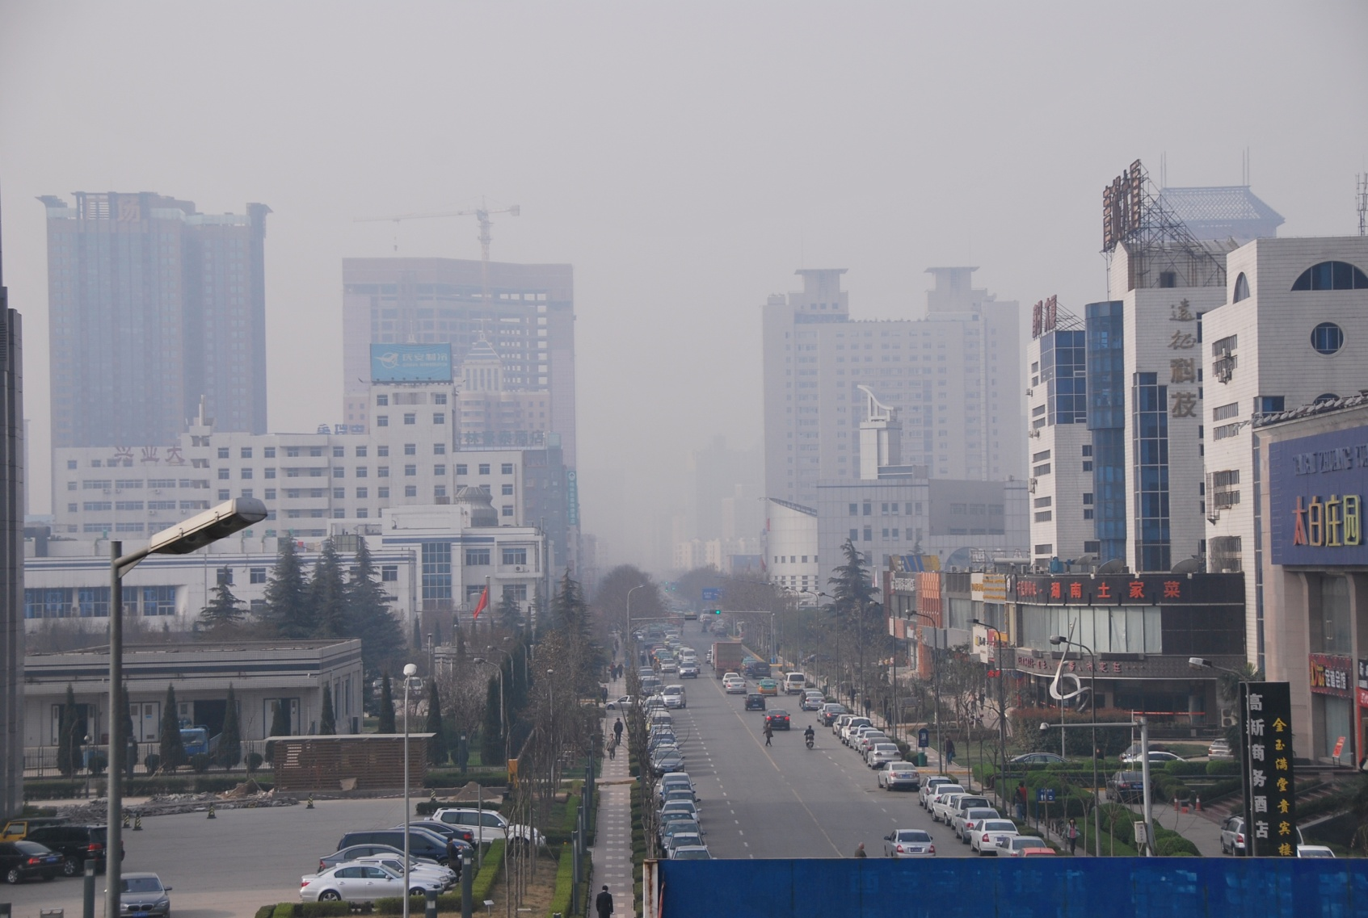
How can you consider natural ventilation as an alternative, when your air looks (AND FEELS) like this?

Slide 29
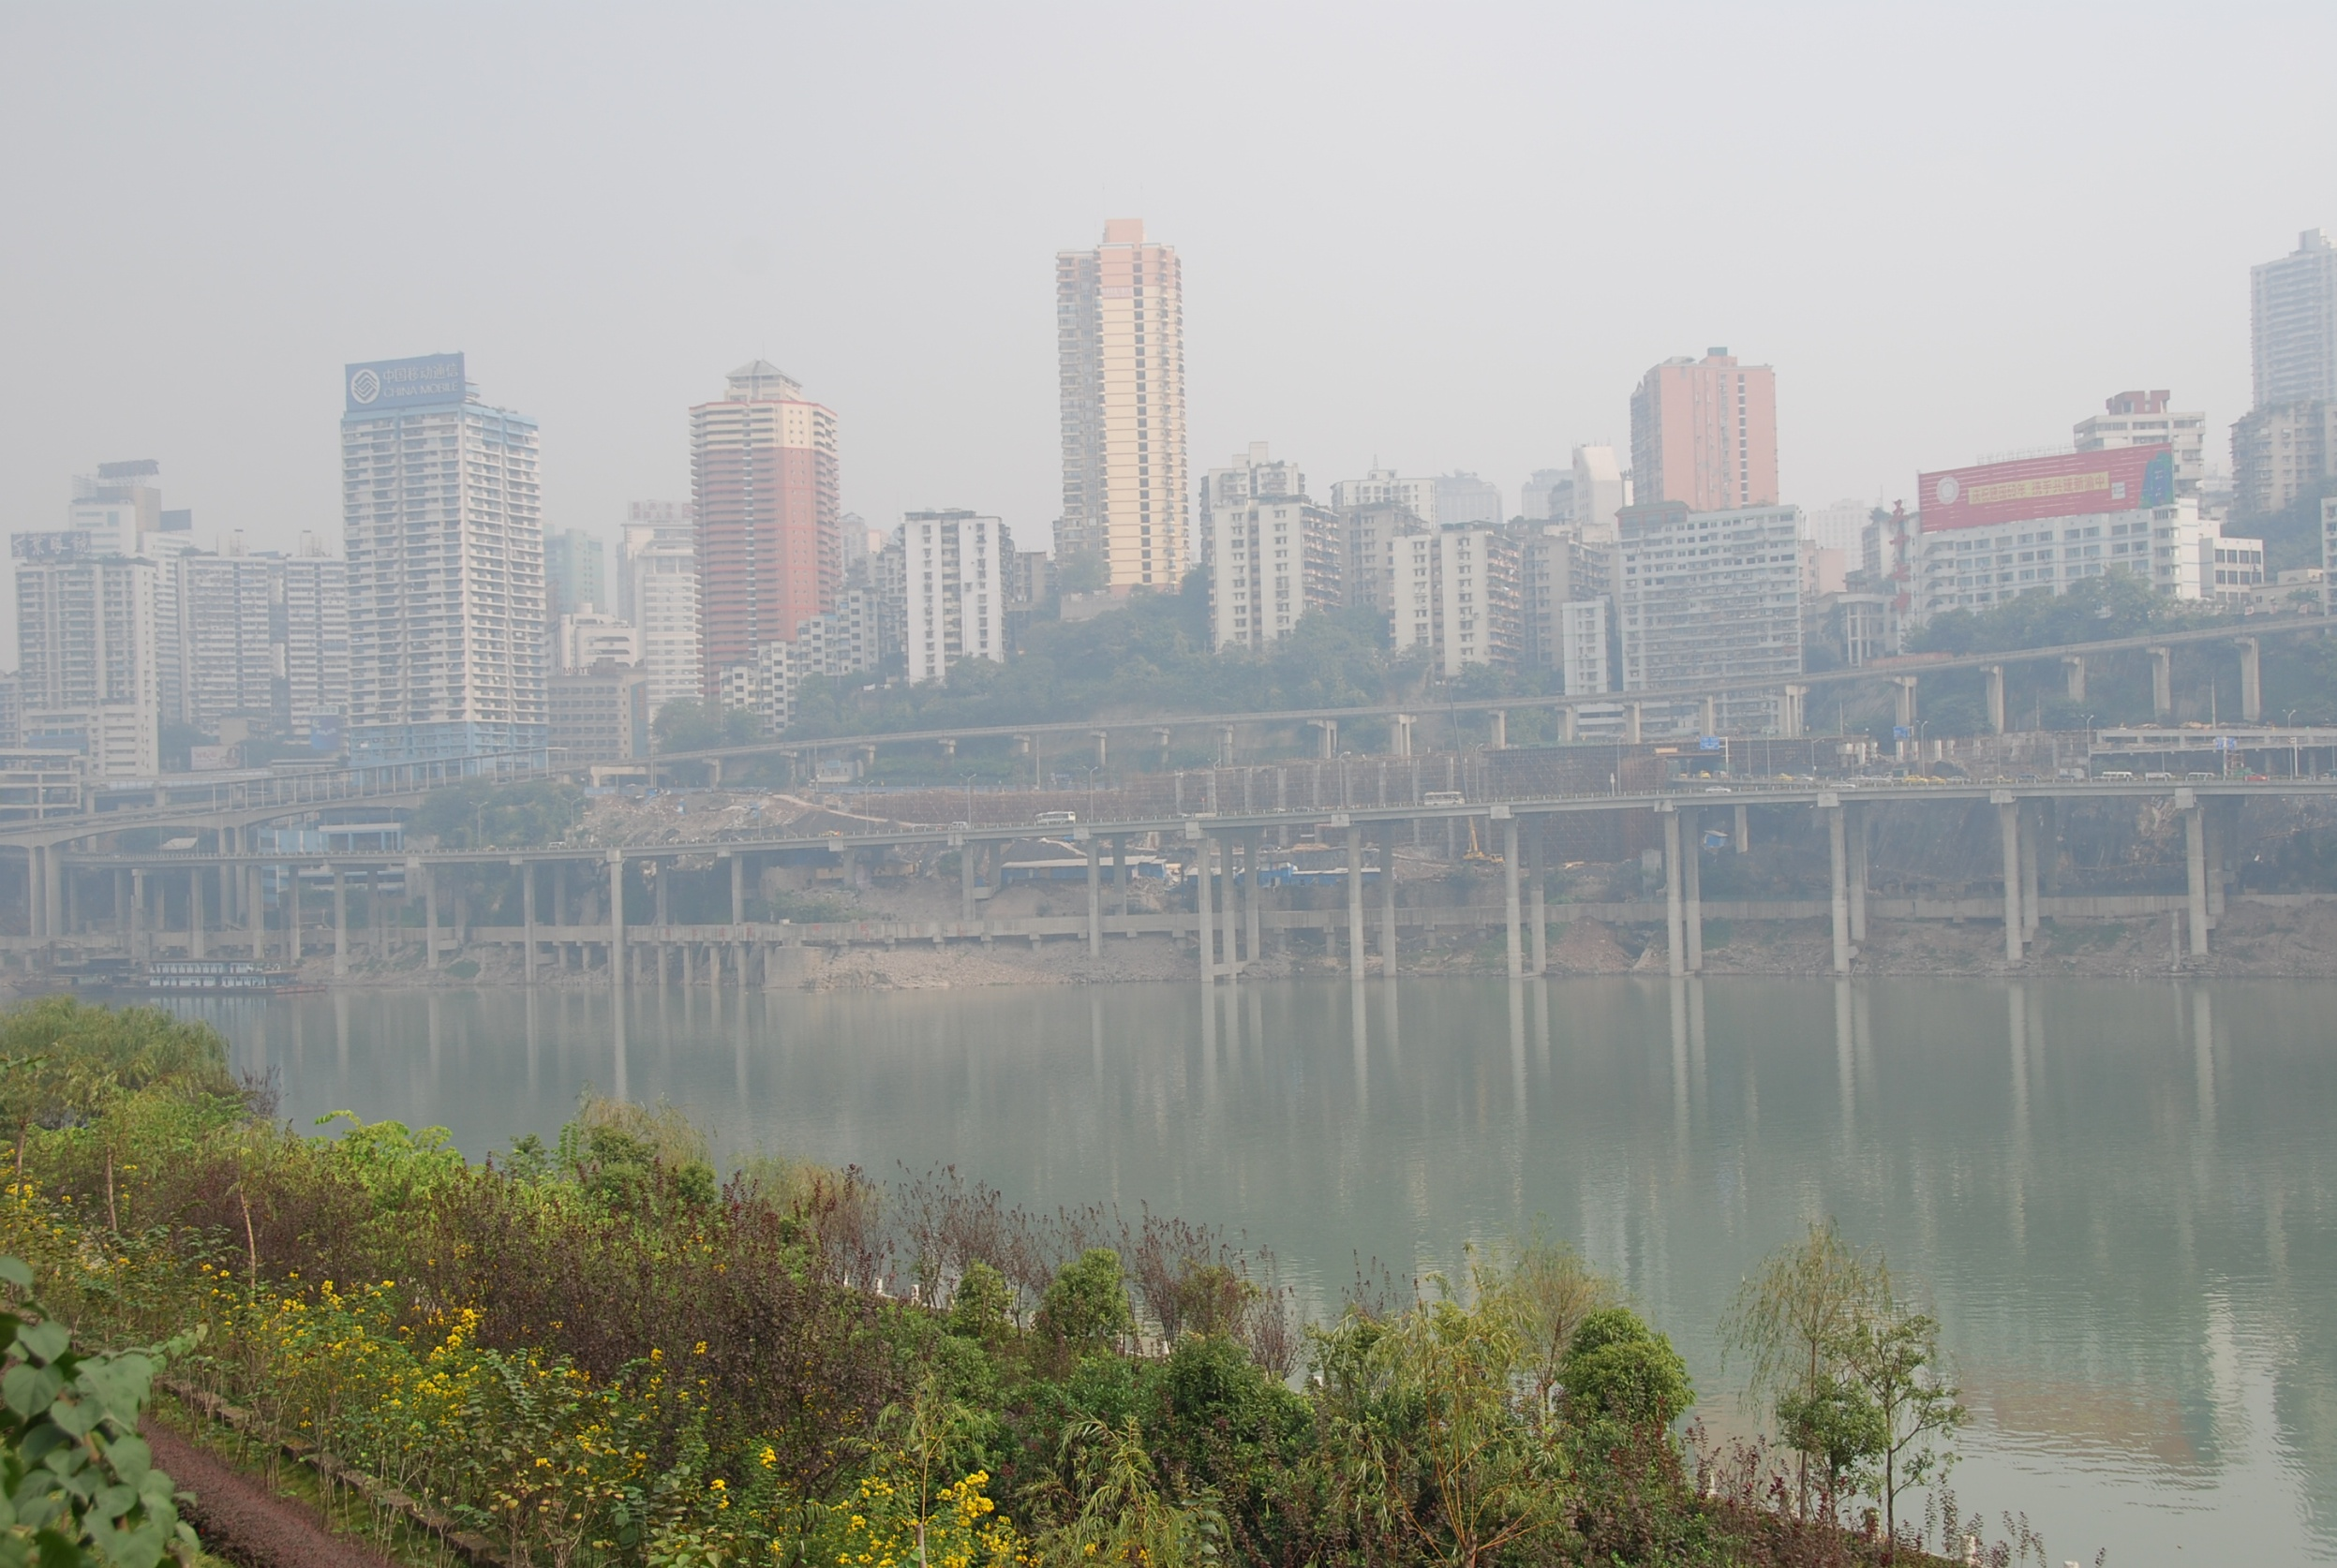
LOW CARBON CITIES AND BUILDINGS ARE NOT POSSIBLE WITHOUT
CLEAN AIR – NO POLLUTION

Slide 30
THE AIR MUST BE CLEAN BECAUSE:
#1 - You need natural ventilation – this is unpleasant and unhealthy if particulate levels are high
#2 - CLOSED WINDOWS make people depend on Air Conditioning. These use energy and make the air hotter by their function. A vicious circle.
#3 - Renewables such as PHOTOVOLTAICS cannot be efficient if the sun cannot reach them
#4 - PARTICULATE BUILD UP makes PV quite ineffective.
Notes:
THE AIR MUST BE CLEAN BECAUSE:
#1 - In a SUB TROPICAL CLIMATE you need natural ventilation – this is unpleasant and unhealthy if particulate levels are high
#2 - CLOSED WINDOWS make people depend on Air Conditioning. These use energy and make the air hotter by their function. A vicious circle.
#3 - Renewables such as PHOTO VOLTAICS cannot be efficient if the sun cannot reach them
#4 - PARTICULATE BUILD UP makes PV quite ineffective.
Particulates are the byproduct of the burning of coal. This is a separate but connected issue to Green House Gas production.

Slide 31
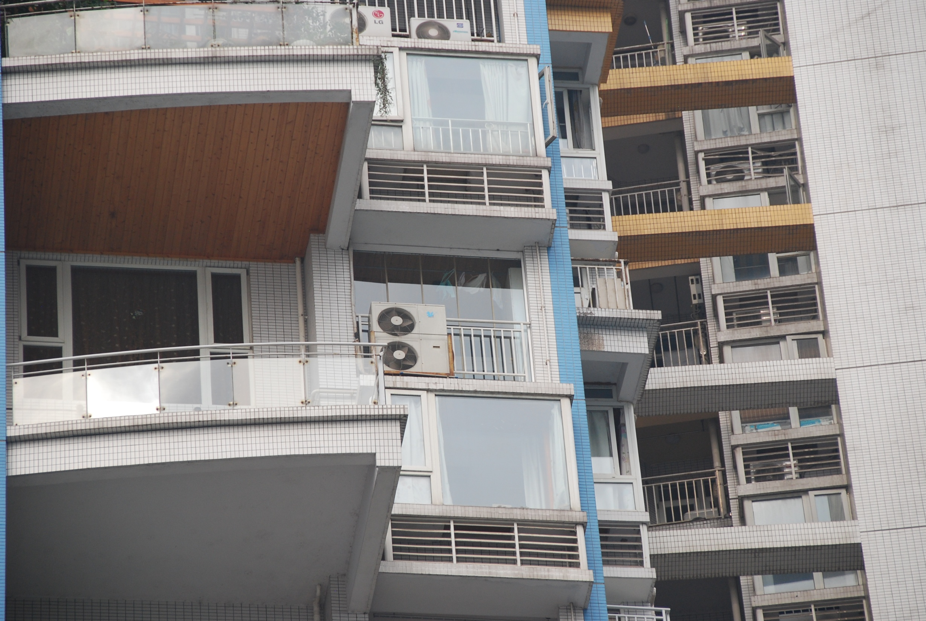
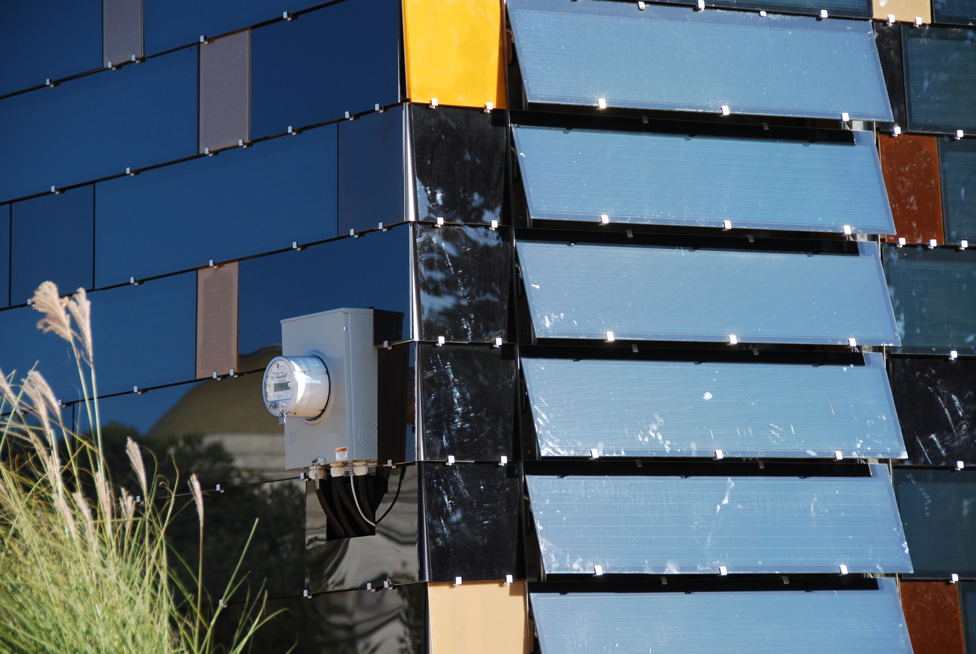
Notes:
New technologies that also boast high efficiencies. These technologies can help you achieve a low carbon architecture, but need pristine environments in order to work.

Slide 32
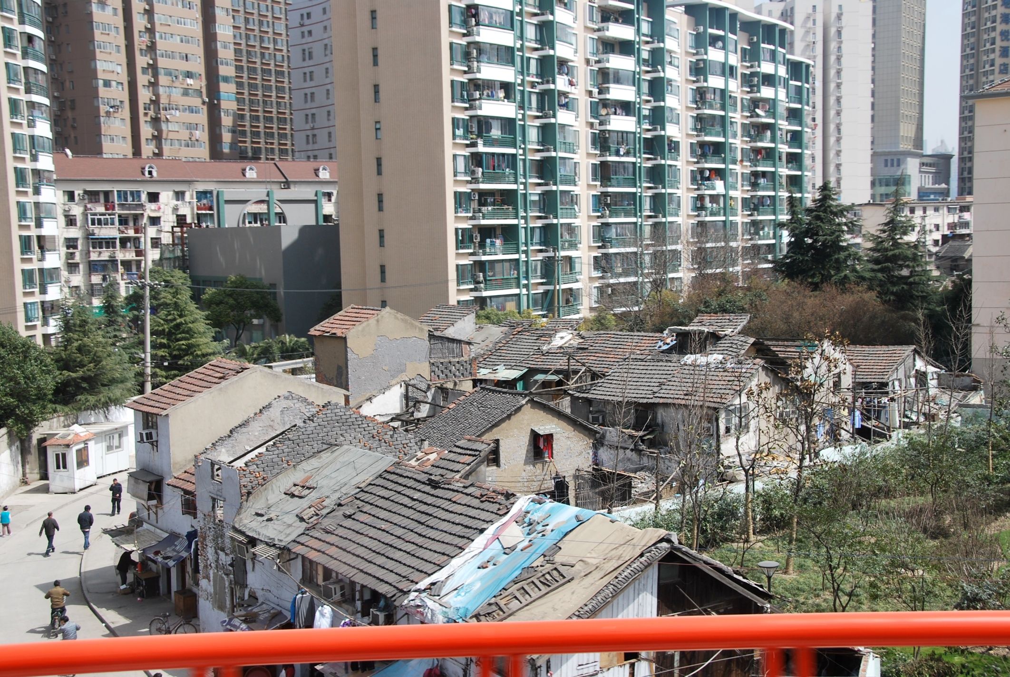
Durability is not an issue as old neighbourhoods are razed to make room for new ones – whose construction quality and energy efficiency is not a priority.

Slide 33
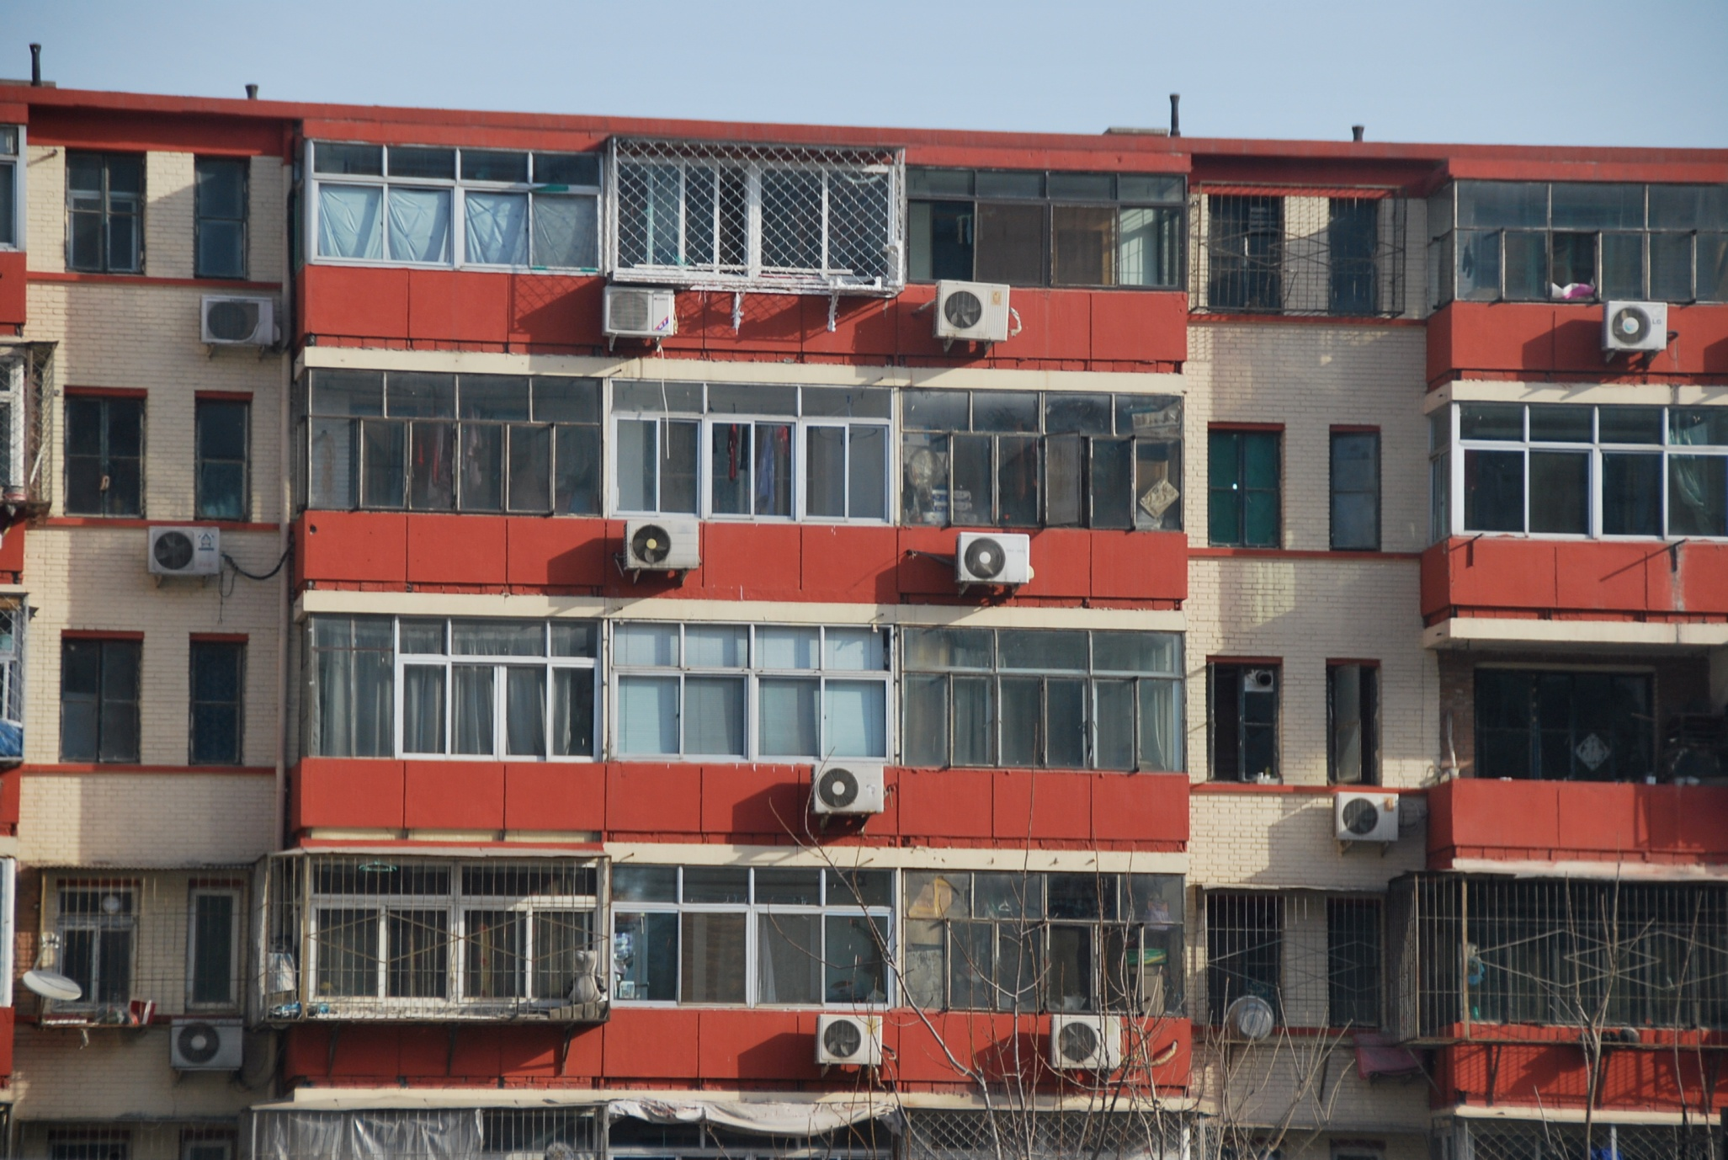
For many climates in the world, the easiest and most effective way to reduce operating energy/GHG would be to eliminate A/C.

Slide 34
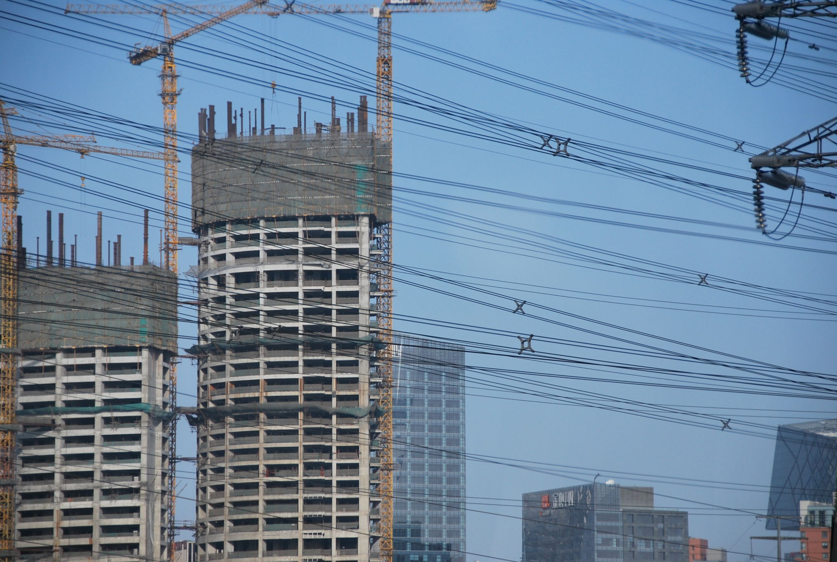
But in spite of GHG awareness, buildings continue to be built with shoddy envelopes, insufficient or no insulation and with a tear down mentality.

Slide 35
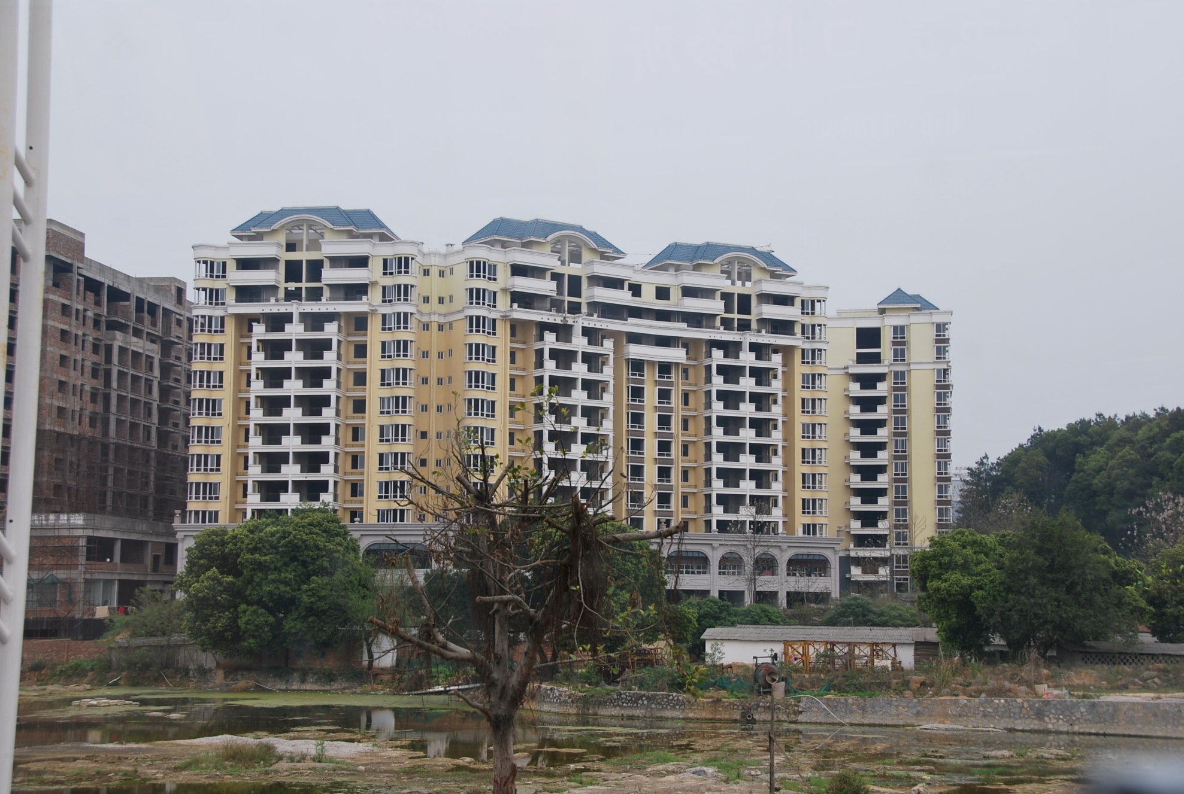
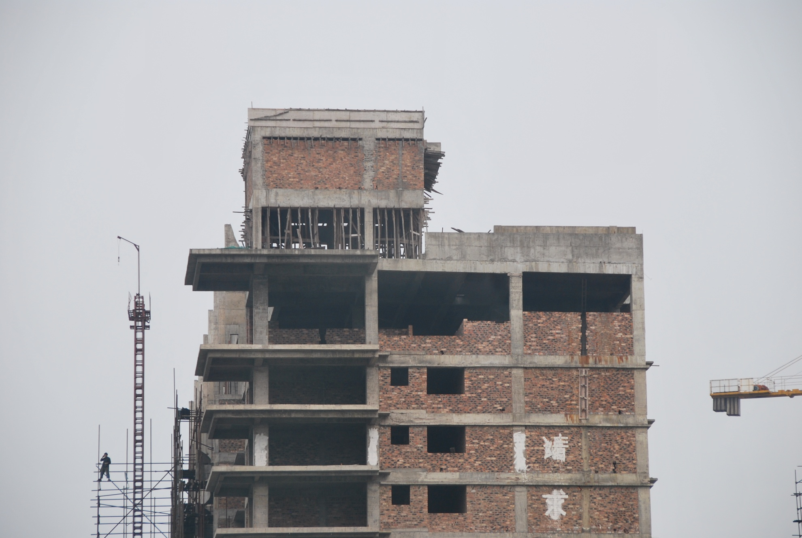
Yet buildings continue to be built with shoddy envelopes, insufficient or no insulation and with a tear down mentality.

Slide 36
Sustainable Design has gone mainstream as a result of LEEDTM
The question remains,
“How effective are current sustainable design practices and rating systems at achieving Greenhouse Gas Reduction?”

Slide 37
And the answer is:
“Really, NOT very…
Most LEEDTM Gold and Platinum buildings earn less than 5/17 of the Energy and Atmosphere credits.
Let’s look at our International Scorecard.

Slide 38
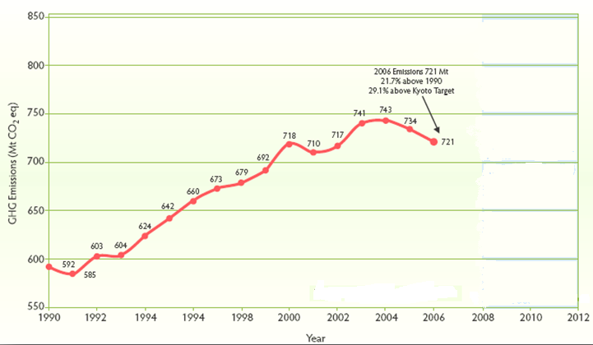
Canada’s GHG Emissions 1996 - 2006
2007 Emissions
747 Mt CO₂e
26.2% above 1990 levels
33.8% above Kyoto Target
Kyoto Commitment Period
(2008-2012)
Kyoto Target:
6% below 1990 Baseline
558.4 Mt

Slide 39

Canada’s Greenhouse Gas Emissions
2009 Rankings in the G8 Climate Scorecard (WWF/Allianz)
Germany
UK
France
Italy
Japan
Russia
U.S.
Canada
The report considered:
The change in each country’s greenhouse gas emissions since 1990
How far each country is from their targets under the Kyoto protocol
Their use of renewable energy sources as a percentage of their total energy use
Their energy policies
Source: CBC News (http://www.cbc.ca/technology/story/2009/07/01/tech-climate-scorecard-wwf.html)

Slide 40
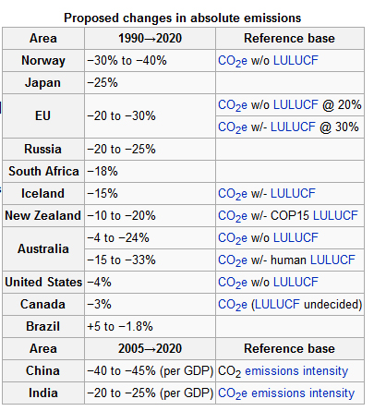
Copenhagen Climate Summit 2009
The outcomes of the climate summit replace the Kyoto targets.
LULUCF = land use, land use change and forestry
http://en.wikipedia.org/wiki/2009_United_Nations_Climate_Change_Conference

Slide 41
Canada’s Copenhagen Targets
To cut carbon emissions by 20% below 2006 levels by 2020.
This is equivalent to 3% below 1990 levels by 2020.
Quebec announced that it would target 20% (over 1990).
Ontario announced that it would target 15% (over 1990).
British Columbia announced that it would target 14% (over 1990).
Alberta announced that it expected to INCREASE emissions by 58%.

Slide 42

Sadly, there is NO Magic Bullet….
Even current high standards of “Green and High Performance Building” are not targeting significant reduction of Energy and GHG emissions.

Slide 43

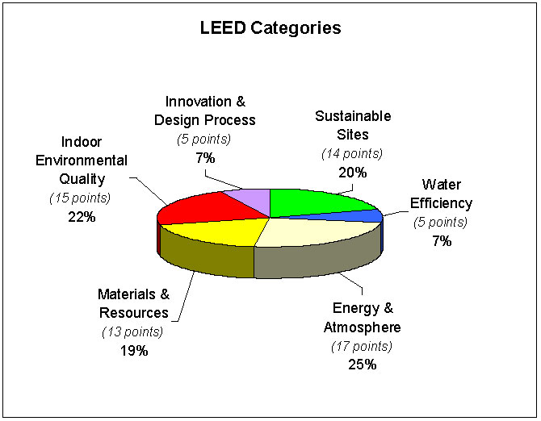

Buildings are accredited by the number of points gained:
26 to 32 point is LEED certified;
33 to 38 points is LEED Silver;
39 to 51 is LEED Gold, and;
LEED Platinum is awarded to projects with 52 or more points.
Note: information based on LEED NC (not 2009)

Slide 44
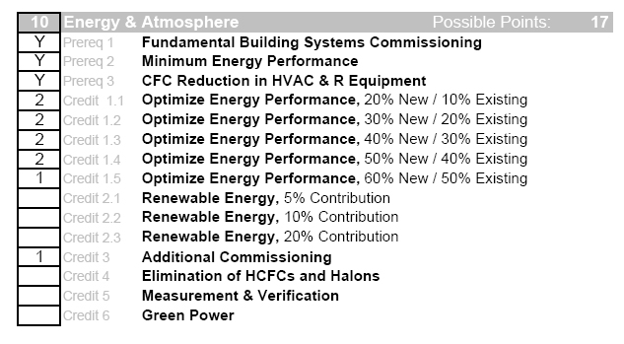
Only 25% of the LEED credits are devoted to energy.
Of those, 10/70 are for optimization.
Maximum reduction is 60%.
Most LEED buildings earn less than 5 of these credits…..
And the first aim of Carbon Neutral Design is to achieve 100% reduction…
It would seem that LEED is perhaps not RADICAL enough to be the only means to tackle the Carbon Problem….
Scorecard for National Works Yard in Vancouver, LEEDTM Gold

Slide 45
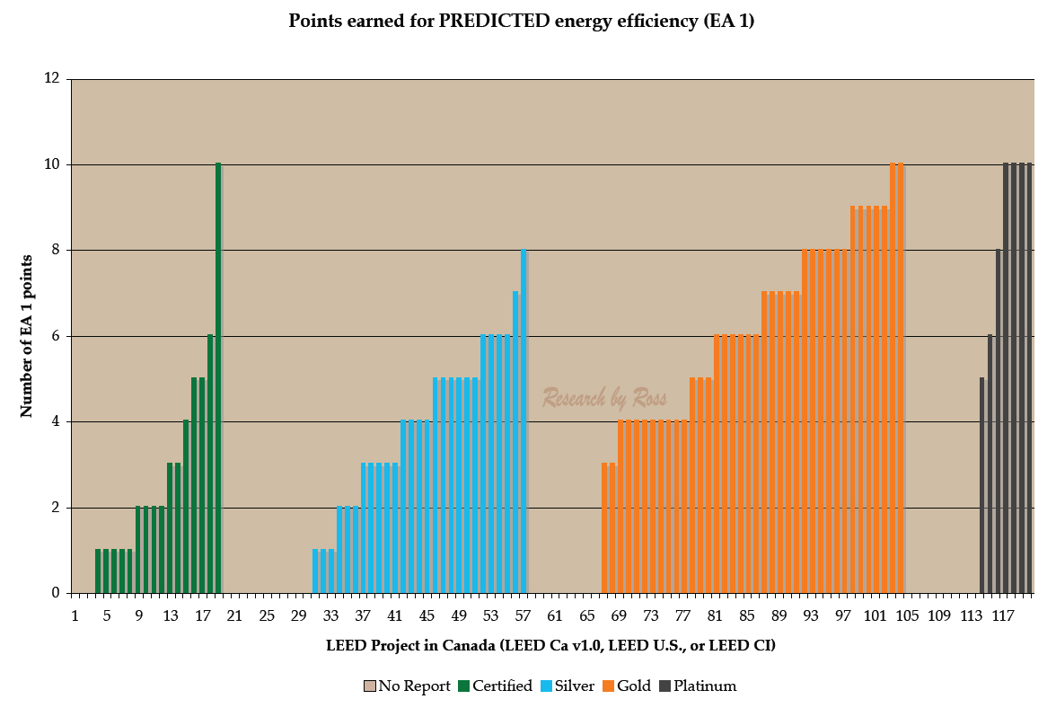
LEED and Predicted Energy Credits
Research conducted by Barbara Ross for her M.Arch. Thesis (2009)
Notes:
as of Oct 2008, there were 120 LEED-certified projects in Canada, CaGBC makes 93 scorecards available online, 4 of these are for projects that got ZERO points under EA 1, the points gained for predicted energy-efficiency for the remaining 89 projects are shown on the chart

Slide 46
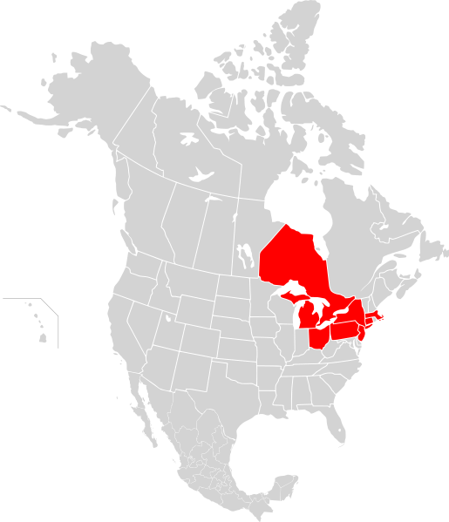
Radical Wake Up Call
The Northeast Blackout of 2003 was a massive widespread power outage that occurred throughout parts of the Northeastern and Midwestern United States, and Ontario, Canada on Thursday, August 14, 2003, at approximately 4:15 pm EDT (20:15 UTC). At the time, it was the most widespread electrical blackout in history. The blackout affected an estimated 10 million people in the Canadian province of Ontario and 45 million people in eight U.S. states.

Slide 47
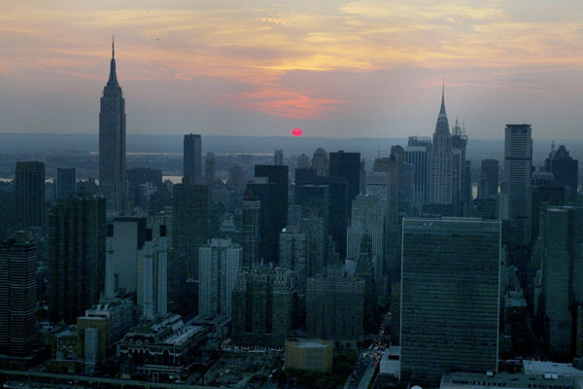
When the sun goes down, it is pretty dark....
http://www.doobybrain.com/wp-content/uploads/2009/08/nyc-blackout-2003.jpg

Slide 48
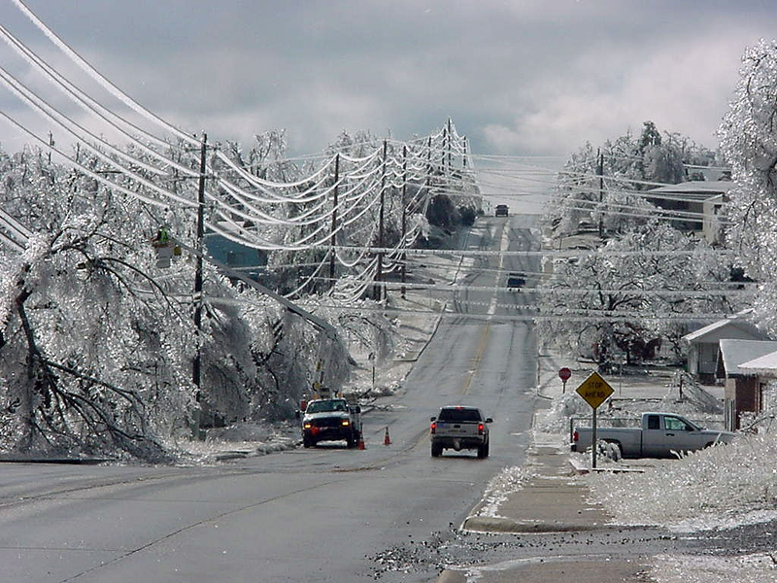
ICE STORM = NO POWER = NO HEAT

Slide 49
Radical PROBLEM!
No power…
Hot August weather… or
Cold January temperatures…
Hooked on electricity, heat and A/C
What buildings/environment/systems “worked”?
What buildings/environment/systems “didn’t” work?

Slide 50
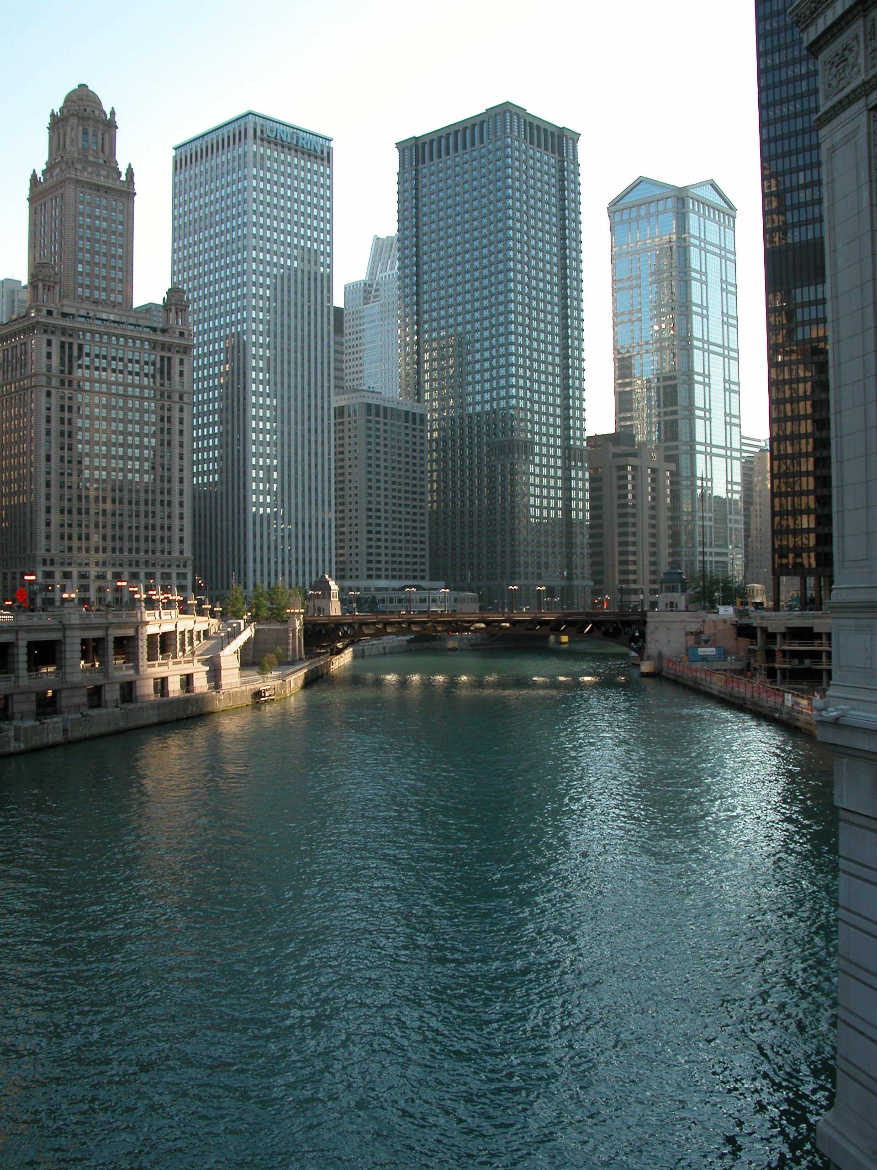
SEALED BUILDINGS CANNOT BREATHE
ELEVATORS AND LIGHTS NEED POWER
MODERN ARCHITECTURE DOES NOT WORK!

Slide 51
Radical AWAKENING!
Grid and energy dependent buildings/environment/systems DID NOT WORK!
OPERABLE WINDOWS WORKED!
NATURAL VENTILATION WORKED!
SHADE WORKED!
SUNLIGHT WORKED!
DAYLIT SPACES WORKED!
WALKABLE NEIGHBOURHOODS WORKED!
BICYCLES WORKED!

Slide 52
Radical THOUGHT!??
MAYBE WE SHOULD BEGIN TO DESIGN OUR BUILDINGS/ENVIRONMENTS IN REVERSE!
Start with a basic UNPLUGGED building

Slide 53
Four Key Steps:
RADICAL STEPS!
#1 - start by UNPLUGGING the building
Then…
#2 – heat only with the sun
#3 – cool only with the wind and shade
#4 – light only with daylight
USE the ARCHITECTURE first, and THEN mechanical systems only to supplement what you cannot otherwise provide.
#5 – USE RENEWABLE CLEAN ENERGY BEFORE HOOKING UP TO NATURAL GAS, OIL OR THE REGULAR ELECTRICAL GRID (with all of its nastiness – including CO₂)
THIS WILL DRASTICALLY REDUCE YOUR ENERGY NEEDS

Slide 54
Radical IS Passive…
PASSIVE DESIGN is where the building uses the SUN, WIND and LIGHT to heat, cool and light
ARCHITECTURALLY

Slide 55
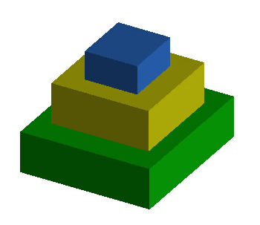
Reduce loads: Passive Strategies
The tiered approach to reducing carbon for HEATING:
First reduce the overall energy required, then maximize the amount of energy required for mechanical heating that comes from renewable sources.
Source: Lechner. Heating, Cooling, Lighting.
Mechanical Heating
Tier 3
Passive Solar Heating
Tier 2
Maximize Heat Retention
Tier 1

Slide 56
Passive Heating Strategies:
Maximize Heat Retention
Super insulated envelope (as high as double current standards)
Tight envelope / controlled air changes
Provide thermal mass inside of thermal insulation to store heat
Top quality windows with high R-values – up to triple glazed with argon fill and low-e coatings on two surfaces
Premise – what you don’t “lose” you don’t have to create or power…. So make sure that you keep it! (…NEGAwatts)

Slide 57
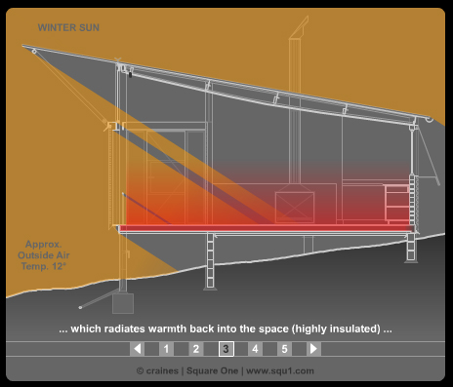
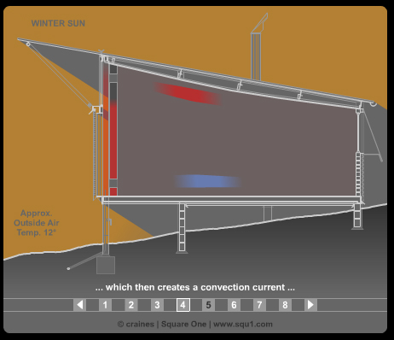
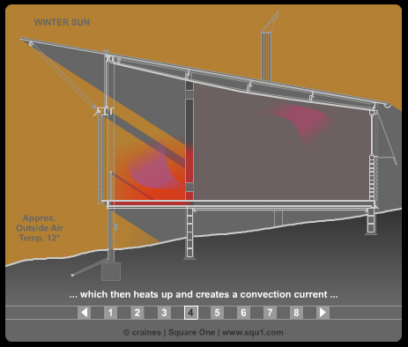
Passive Heating Strategies:
Maximize Solar Gain
primarily south facing windows
proportion windows to suit thermal mass and size of room(s)
Direct Gain
3 MAIN STRATEGIES:
Direct Gain
Thermal Storage Wall
Sunspace
Source: Square One Archives (http://squ1.com/archive/)
Trombe Wall
Sun Space

Slide 58
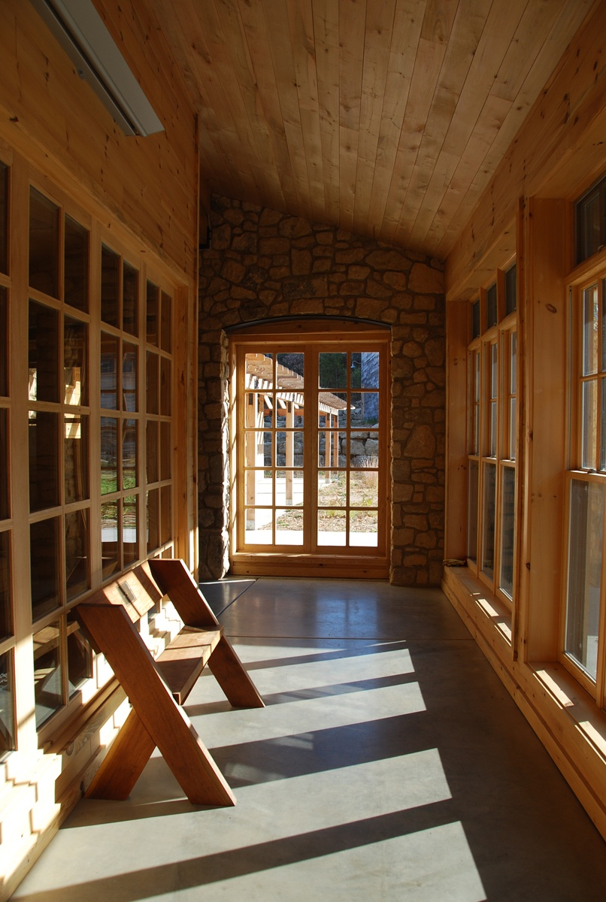
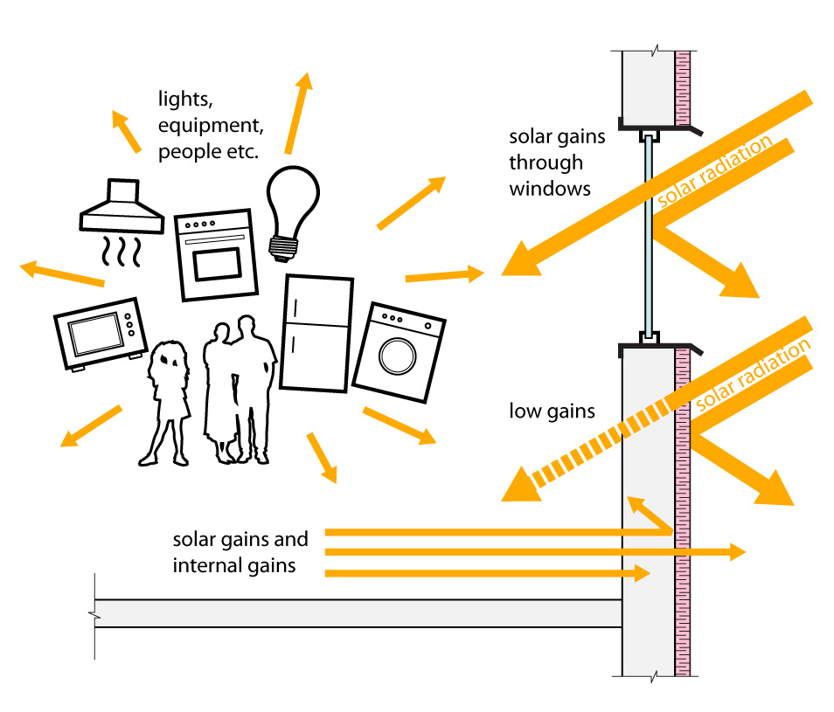
Thermal Mass is Critical!
To ensure comfort to the occupants….
People are 80% water so if they are the only thermal sink in the room, they will be the target.
And to store the FREE energy for slow release distribution….
Aldo Leopold Legacy Center:
Concrete floors complement the insulative wood walls

Slide 59
Reduce loads: Passive Strategies
The tiered approach to reducing carbon for COOLING:
Maximize the amount of energy required for mechanical cooling that comes from renewable sources.
Source: Lechner. Heating, Cooling, Lighting.
Mechanical Cooling
Tier 3
Passive Cooling
Tier 2
Heat Avoidance
Tier 1

Slide 60
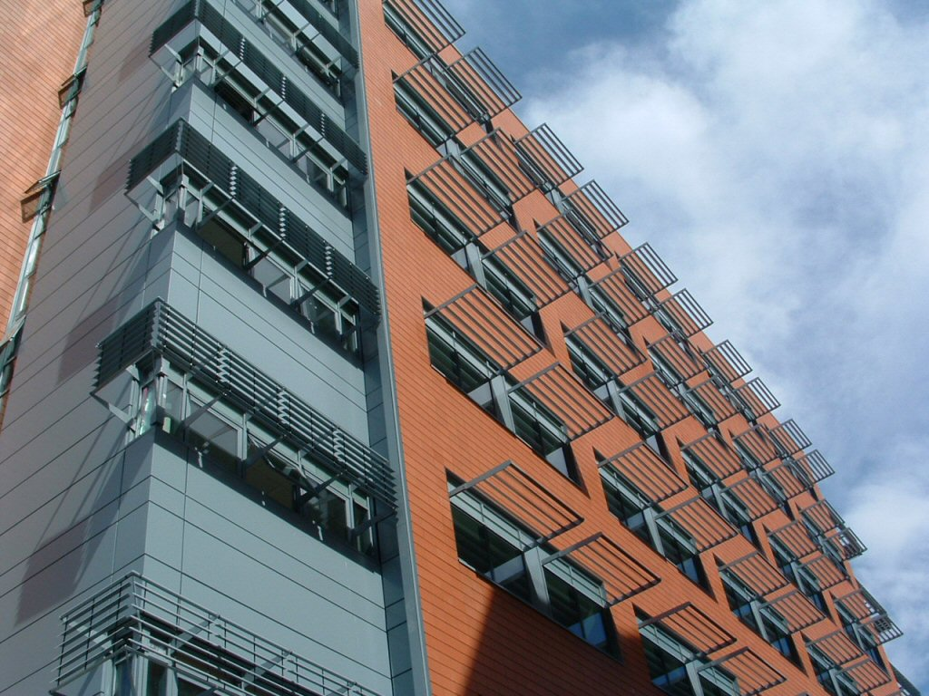
Passive Cooling Strategies:
Heat Avoidance
shade windows from the sun during hot months
design materials and plantings to cool the local microclimate
locate trees and trellis’ to shade east and west façades during morning and afternoon low sun
If you don’t invite the heat in, you don’t have to get rid of it…..

Slide 61
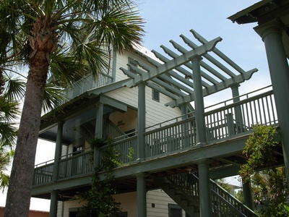
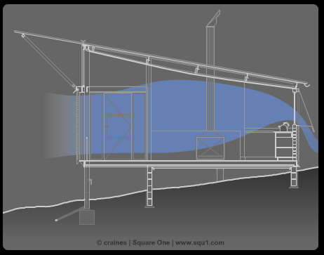
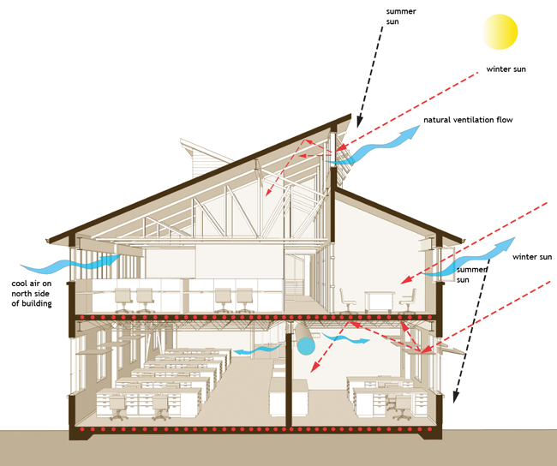
Passive Cooling Strategies:
Ventilation
design for maximum ventilation
keep plans as open as possible for unrestricted air flow
use easily operable windows at low levels with high level clerestory windows to induce stack effect cooling

Slide 62
Reduce loads: Daylighting
The tiered approach to reducing carbon with DAYLIGHTING:
Use energy efficient fixtures!
Maximize the amount of energy/electricity required for artificial lighting that comes from renewable sources.
Source: Lechner. Heating, Cooling, Lighting.
Efficient artificial Lighting w/ sensors
Tier 3
Glare, color, reflectivity and material concerns
Tier 2
Orientation and planning of building to allow light to reach maximum no. of spaces
Tier 1

Slide 63
The Global Warming Pie....
These values look at Secondary Energy Use by Sector in Canada (2006)
(energy used by the final consumer i.e. operating energy)

Slide 64
Energy vs Greenhouse Gas Emissions
In BUILDINGS, for the sake of argument
ENERGY CONSUMPTION = GHG EMISSIONS
BUILDING ENERGY IS COMPRISED OF
EMBODIED ENERGY
+
OPERATING ENERGY

Slide 65
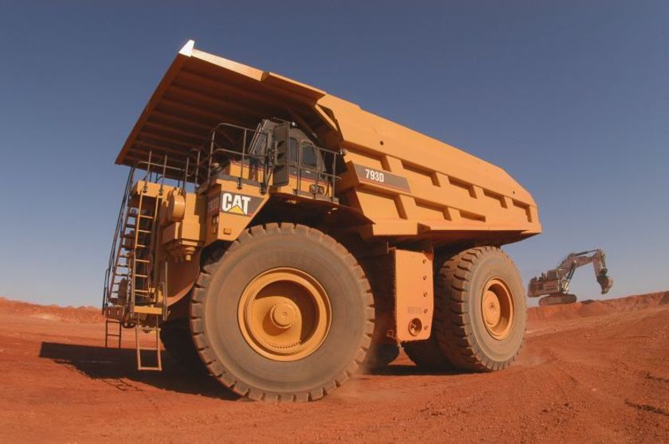
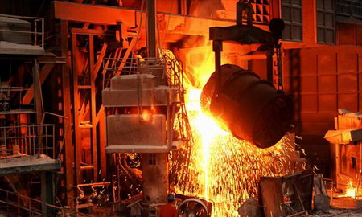

Energy Use in Buildings
Embodied Energy
  Initial Embodied Energy: Non-renewable energy consumed in the acquisition of raw materials, their processing, manufacturing, transportation to site, and construction
  Recurring Embodied Energy: Non-renewable energy consumed to maintain, repair, restore, refurbish or replace materials, components, or systems during life of building

Slide 66
Initial Embodied Energy of Building Materials
Per Unit Mass
Steel with recycled content can vary from about 10.0 to 25.0 MJ/kg
Embodied Energy (MJ/kg)
- Timber (air dried): 0.3 MJ/kg
- Plywood: 10.4 MJ/kg
Source: University of Wellington, NZ, Center for Building Performance Research (2004)
Notes:
Typical Concrete Mix:
Cement: 375kg/m3 (16%)
Water: 180 kg/m3 (8%)
Aggregates (fine + coarse): 1800 kg/m3 (76%)
Total: 2355 kg/m3 (150lb/ft3)
The CO2 emissions due to calcination are formed when the raw materials (mostly limestone and clay) are heated to over 2500°F and CO2 is liberated from the decomposed limestone. Also CO2 released in order to produce the energy (heat) to make cement

Slide 67
Embodied Carbon Dioxide of Building Materials
Per Unit Mass
Steel with recycled content can be as low as 0.5 kg of CO₂ eq./kg
Concrete (25% flyash): 0.1 kg of CO₂ eq./kg
Embodied CO₂ (kg of CO₂ eq./kg)
Timber (glulam): 0.8 kg of CO₂ eq./kg
Source: University of Bath, UK, Inventory of Carbon and Energy (2008)
Notes:
Typical Concrete Mix:
Cement: 375kg/m3 (16%)
Water: 180 kg/m3 (8%)
Aggregates (fine + coarse): 1800 kg/m3 (76%)
Total: 2355 kg/m3 (150lb/ft3)
The CO2 emissions due to calcination are formed when the raw materials (mostly limestone and clay) are heated to over 2500°F and CO2 is liberated from the decomposed limestone. Also CO2 released in order to produce the energy (heat) to make cement

Slide 68
The Life Cycle of a Material
Life-Cycle Assessment (LCA)
  The main goal of a LCA is to quantify energy and material use as well as other environmental parameters at various stages of a product’s life-cycle including: resource extraction, manufacturing, construction, operation, and post-use disposal
Life-Cycle Inventory (LCI) Database
  A database that provides a cradle-to-grave accounting of the energy and material flows into and out of the environment that are associated with producing a material. This database is a critical component of a Life-Cycle Assessment

Slide 69

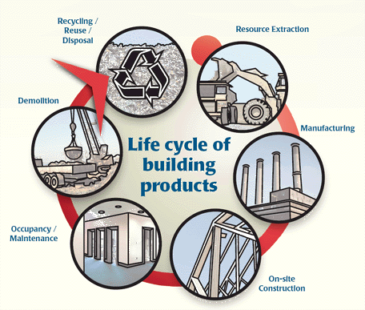
Life Cycle Assessment Methodology
Embodied Energy
  ATHENA® Impact Estimator for Buildings
  The only North American specific software tool that evaluates whole buildings and assemblies based on internationally recognized LCA methodology
  Non-profit organization that has been around for more than 10 years
  One of the most comprehensive LCI databases in the world with over $2 million spent on database development
  Considers the life-cycle impacts of:
    Material manufacturing including resource extraction
    and recycled content
    Related transportation
    On-site construction
    Regional variation in energy use, transportation, and
    other factors
    Building type and assumed lifespan
    Maintenance, repair, and replacement effects
    Demolition and disposal
    Operating energy emissions and pre-combustion effects
Source: The ATHENA Institute http://www.athenasmi.org/tools/impactEstimator/index.html
Notes:
Note that the Impact Estimator is a purchase product. The Athena EcoCalculator give a rough version of the impact for a defined series of building types and locations and is free for download. http://www.athenasmi.org/tools/ecoCalculator/

Slide 70
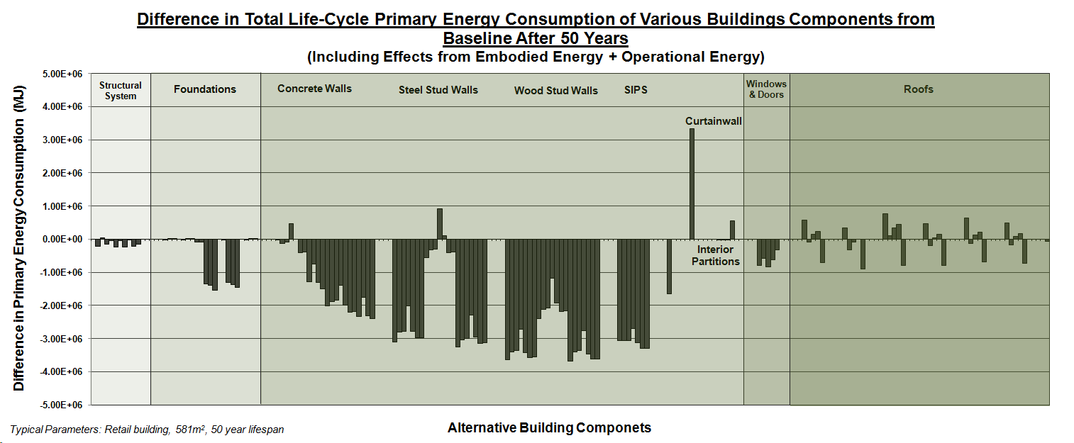
Energy in Common Building Components
Energy in Common Building Components
Difference in Total Life-Cycle Energy Consumption of Various Building Components from Baseline After 50 Years
7
1
2
3
4
5
6
8
9

Slide 71
Energy in Common Building Components
Energy in Common Building Components
Difference in Total Life-Cycle Energy Consumption of Various Building Components from Baseline After 50 Years
7
1
2
3
4
5
6
8
9
Annual Operating Energy = 9.67E+05 MJ
Approx. 3 months operating energy
Approx. 3.6 years operating energy

Slide 72

Energy in Common Building Components
Initial Embodied Energy vs. Recurring Embodied Energy of a Typical Canadian Office Building Constructed from Wood
Finishes, Envelope, & Services dominate the embodied energy over the building’s lifespan
645%
286%
126%
The embodied energy of the structural system is relatively small
(0.06% after 50 years)
Source: Cole , R. & Kernan, P. (1996). Life-Cycle Energy Use in Office Buildings. Building and Environment, 31 (4), 307-317

Slide 73

Energy Use in Buildings
Orders of Environmental Impact
Primary Energy Consumption for Typical Hot-Rolled Steel Retail Building After 50 Years
100x
10x
Reduce 50 year operating energy by 99%
Embodied energy of structure
1x
Log Scale

Slide 74

Energy Use in Buildings
Orders of Environmental Impact
Total Energy Breakdown of Typical Hot-Rolled Steel Retail Building After 50 Years
(other building types are similar)
Energy & GWP due to structure is less than 1% of total after 50 yrs
* GWP: Beams & Columns = 0.75%
Notes:
GWP
Operating Energy: 91.42%
Total Embodied Energy: 8.58%
Windows & Doors: 1.62%
Foundations: 2.05%
Beams & Columns: 0.75%
Enclosure: 4.16%

Slide 75

Energy Use in Buildings
Orders of Environmental Impact
Primary Energy Consumption vs. Time for Hot-Rolled Steel Retail Building (other building types are similar)

Slide 76
Embodied Energy Findings
In conventional buildings, the building envelope (walls and roof), building services, and building finishes contribute the most towards the total embodied life-cycle energy (and total embodied GWP) when looking at the Embodied Energy of the Entire Building, including Structure.
To lower GHG, choice of materials for structures and components needs to reflect:
issues of DURABILITY
ability of material to assist PASSIVE DESIGN
local sourcing to reduce TRANSPORTATION
Cradle to Cradle concepts
ability of material to be 1st REUSED and 2nd RECYCLED

Slide 77

Energy Use in Buildings: Operating Energy
  Amount of energy that is consumed by a building to satisfy the demand for heating, cooling, lighting, ventilation, equipment, etc.
Total Commercial/Institutional Secondary Energy
Use by Activity Type in Canada (2006)
Source: Natural Resources Canada, 2006
Notes:
Trends in Greenhouse Gas (GHG) emissions closely parallel energy use

Slide 78
Energy Use in Buildings: Operating Energy
Total Commercial/Institutional Secondary Energy Use by
End Use in Canada (2006)
Source: Natural Resources Canada, 2006
Notes:
Trends in Greenhouse Gas (GHG) emissions closely parallel energy use

Slide 79
Operating Energy of Building
Landscape
+ Site
Disturbance vs. sequestration
80% of the problem!
Embodied Carbon in Building Materials
Renewables + Site Generation
People, “Use” + Transportation
Counting Carbon costs….
+ purchased offsets

Slide 80




The Goal is Reduction
HOT-HUMID
TEMPERATE
HOT-ARID
COLD
CLIMATE AS THE STARTING POINT
FOR RETHINKING ARCHITECTURAL DESIGN

Slide 81
Four Key Steps – IN ORDER:
#1 - REDUCE loads/demand first (conservation, passive design, daylighting, shading, orientation, etc.)
#2 - Meet loads efficiently and effectively (energy efficient lighting, high-efficiency MEP equipment, controls, etc.)
#3 - Use renewables to meet energy needs (doing the above steps before will result in the need for much smaller renewable energy systems, making carbon neutrality achievable.)
#4 - Use purchased Offsets as a last resort when all other means have been looked at on site, or where the scope of building exceeds the site available resources.
REDUCING OPERATING ENERGY

Slide 82
Climate as the Starting Point for
ENERGY REDUCTIVE DESIGN

Slide 83

Carbon Reduction: The Tier Approach
…and the Mechanical Systems won’t be small enough to be powered by renewable energy
…or the Passive Systems won’t work
REDUCING OPERATING ENERGY
Basic Building Design MUST be Climate Responsive
Image: Norbert Lechner, “Heating, Cooling, Lighting”

Slide 84
Radically Rethinking our Expectations
Change needed to reduce operating energy related carbon is DRASTIC
Current reduction goals look to limit the increase in Global Temperature
We really need to reverse the trend
We need to start to think about design in an entirely new way, not just modify current practices
START BY UNPLUGGING THE BUILDING
THEN ADD BACK WHAT YOU REALLY NEED TO BE COMFORTABLE

Slide 85
Radical POTENTIAL!!
COMFORT ZONE
WHAT IS IT?
WHAT DOES IT HAVE TO DO WITH
GREEN BUILDING + ZERO CARBON?

Slide 86


Designing to the Comfort Zone vs. Comfort Point:
This famous illustration is taken from “Design with Climate”, by Victor Olgyay, published in 1963.
THE COMFORT ZONE
REDUCING OPERATING ENERGY
This is the finite point of expected comfort for 100% mechanical heating and cooling.
To achieve CN, we must work within the broader area AND DECREASE the “line” to 18C – point of calculation of heating degree days.

Slide 87
Passive Bio-climatic Design: COMFORT ZONE
Comfort expectations MUST be reassessed to allow for the wider “zone” that is characteristic of buildings that are not exclusively controlled via mechanical systems.
Creation of new “buffer spaces” to make a hierarchy of comfort levels within buildings. Some spaces may have little or no mechanical “assist”.
Require higher occupant involvement to adjust the building to modify the temperature and air flow.

Slide 88

Begin with Passive Strategies for Climate Control to Reduce Energy Requirements
HEATING
COOLING

Slide 89

Bio-climatic Design:
Design must first acknowledge regional, local and microclimate impacts on the building and site.
COLD
TEMPERATE
HOT-ARID
HOT-HUMID
Image: 1963 “Design With Climate”, Victor Olgyay.

Slide 90

The climate regions of Canada
Even within Canada, there exist variations in climate, enough to require very different envelope design practices and regulations. This mostly concerns insulation and water penetration, as well as humidity concerns.
Notes:
The climate regions of Canada
Although Olgyay assigned to the majority of Canada the simple designation of “cool”, our climate has very clear subdivisions that take into account the differences that we see in the high humidity of our coastal regions, dryness of the Prairies, permafrost issues of the Arctic and other variations within these areas.
These different climates are enough to require very different envelope design practices and regulations. This mostly concerns insulation and water penetration, as well as humidity concerns.
What this means is that we must be careful when assessing the suitability of a design strategy for a specific location and climate region, that it responds properly to its specific parameters.

Slide 91

Heating and Cooling Degree Days
This map shows the annual sum of heating degree days (an indicator of building heating needs). Data for period 1941 to 1970. Determine if the climate is heating or cooling dominated …this will set out your primary strategy.
Notes:
Heating and Cooling Degree Days
This map shows the annual sum of heating degree days (an indicator of building heating needs). Data for period 1941 to 1970.
Determine if the climate is heating or cooling dominated as this will set out your primary strategy.
Heating degree days is the sum of all of the temperature deviations below 18C for an entire (typical) year.
Cooling degree days is the sum of all of the temperature deviations above 18C for an entire (typical) year.
If the number is high, it means that the problem is more severe. We will design our buildings to address the most severe condition the most rigorously and the less severe condition to the best solution possible.

Slide 92

Cooling Degree Days for Ontario
http://www.utoronto.ca/imap/collections/climate_and_biota/maps/Coann5.jpg
Cooling degree days is the sum of all of the temperature deviations above 18C for an entire (typical) year. If the number is high, it means that the problem is more severe, if the number is low, then it is more probable to design the ARCHITECTURE in a way to eliminate or reduce mechanical requirements.

Slide 93
Climate as the Starting Point for a
Climate Responsive Design
PASSIVE STRATEGIES

Slide 94
Bio-climatic Design: HOT-ARID
Where very high summer temperatures with great fluctuation predominate with dry conditions throughout the year. Cooling degrees days greatly exceed heating degree days.
RULES:
Solar avoidance : keep DIRECT SOLAR GAIN out of the building
avoid daytime ventilation
promote nighttime flushing with cool evening air
achieve daylighting by reflectance and use of LIGHT non-heat absorbing colours
create a cooler MICROCLIMATE by using light / lightweight materials
respect the DIURNAL CYCLE
use heavy mass for walls and DO NOT INSULATE
Traditional House in Egypt

Slide 95
Bio-climatic Design: HOT-HUMID
Where warm to hot stable conditions predominate with high humidity throughout the year. Cooling degrees days greatly exceed heating degree days.
RULES:
SOLAR AVOIDANCE : large roofs with overhangs that shade walls and to allow windows open at all times
PROMOTE VENTILATION
USE LIGHTWEIGHT MATERIALS that do not hold heat and that will not promote condensation and dampness (mold/mildew)
eliminate basements and concrete
use STACK EFFECT to ventilate through high spaces
use of COURTYARDS and semi-enclosed outside spaces
use WATER FEATURES for cooling
House in Seaside, Florida

Slide 96
Bio-climatic Design: TEMPERATE
The summers are hot and humid, and the winters are cold. In much of the region the topography is generally flat, allowing cold winter winds to come in form the northwest and cool summer breezes to flow in from the southwest. The four seasons are almost equally long.
RULES:
BALANCE strategies between COLD and HOT-HUMID
maximize flexibility in order to be able to modify the envelope for varying climatic conditions
understand the natural benefits of SOLAR ANGLES that shade during the warm months and allow for heating during the cool months
IslandWood Residence, Seattle, WA

Slide 97

Bio-climatic Design: COLD
Where winter is the dominant season and concerns for conserving heat predominate all other concerns. Heating degree days greatly exceed cooling degree days.
RULES:
First INSULATE
exceed CODE requirements (DOUBLE??)
minimize infiltration (build tight to reduce air changes)
Then INSOLATE
ORIENT AND SITE THE BUILDING PROPERLY FOR THE SUN
maximize south facing windows for easier control
fenestrate for DIRECT GAIN
apply THERMAL MASS inside the building envelope to store the FREE SOLAR HEAT
create a sheltered MICROCLIMATE to make it LESS cold
YMCA Environmental Learning Centre, Paradise Lake, Ontario

Slide 98


The Controversial “Cover” of Greensource Magazine
A “sustainable” Chicago residential skyscraper – going for LEED
http://greensource.construction.com/green_building_projects/2010/1001_Aqua-Tower.asp
Notes:
“The 9-inch-thick balcony slabs thin out as they extend from the cladding line to the edge of the cantilever. This profile helps in drainage, notes structural engineer, David Eckmann of Magnusson Klemencic in Chicago, and keeps rainwater off the face of the building. The thin concrete slabs do tend to lose heat in the winter, Gang acknowledges. The architects and their consultants investigated adding thermal breaks between the indoor and outdoor concrete slabs, but this strategy proved too difficult to achieve for this project. Gang maintains, however, that in terms of overall energy use, the heat loss in the winter is offset by savings in air-cooling in the summer owing to the concrete canopies, the glazing, and the natural ventilation.” Jeanne Gang, Architect

Slide 99

Buildings that are purporting to be “sustainable” routinely ignore key issues of detailing ESSENTIAL to achieve energy efficiency – in this building, continuous thermal bridges at every slab edge and 90% wall glazing – 6 different kinds of glazing to make up for the inefficiency caused by the basic design….

Slide 100




http://greensource.construction.com/green_building_projects/2010/1001_Aqua-Tower.asp
Heating degree days 6,479 F
Cooling degree days 782F

Slide 101
Graphic Interpretations of Climate Data
To truly design to climatic concerns you need to go well beyond Heating and Cooling Degree Days values
http://www.energy-design-tools.aud.ucla.edu/
Climate Consultant 4 is a free tool available from the above address.
You will need to download .epw climate data for your city from this website
http://apps1.eere.energy.gov/buildings/energyplus/cfm/weather_data.cfm

Slide 102

Graphic Interpretations of Climate Data

Slide 103

Climate Data for Toronto
Ignore snow data
Data taken from Climate Consultant 4

Slide 104

The Comfort Zone

Slide 105


Slide 106

Ground temperature is helpful if looking for geoexchange, preheating or precooling air intake.

Slide 107

The Comfort Zone?

Slide 108
The Carbon Neutral Comfort Zone?

Slide 109


Slide 110

Looking at general wind velocity will help to determine if micro scale wind turbines will be of any use.

Slide 111

Wind Wheel
The Wind Wheel is unique to Climate Consultant. It displays for each wind direction the Wind Velocity and Frequency of Occurrence along with concurrent Dry Bulb Temperature and Relative Humidity. The outer ring shows the percentage of hours when the wind comes from each direction. On the next ring the height and color of the bars shows the average temperature of the wind coming from that direction (light blue is in the comfort zone, blue is cool or cold, and red is warm or hot). The next smaller ring shows average humidity (light green is comfortable, yellow is dry, and green is humid). The innermost circle shows the wind velocities that come from each direction; the tallest brown triangle is the maximum velocity for that period, medium brown is the average velocity, and the smallest light brown triangle is the minimum velocity. Hours when there is zero wind speed do not appear on this chart. The graphic key to all this information is summarized in the icon in the lower right labeled Wind Speed, RH, Temp, and Hours. One of the most interesting options in Wind Wheel is to animate any set of days or months and watch how wind direction and velocity changes. Static averages for each day, or for any set of days or months can also be plotted.

Slide 112


Slide 113


Slide 114

Wind info can be downloaded at http://www.windatlas.ca/
http://ontario.hazards.ca/maps/windroses/windrosesites-e.html

Slide 115


Slide 116

Mining LEEDTM for Carbon:
Energy Effective Design and LEEDTM Credits
We will dissect this Platinum + Carbon Neutral Building
To see how LEEDTM credits can be used as a
spring point to elevate to Carbon Neutral

Slide 117
Comparing Carbon Neutral to LEEDTM
LEEDTM is a holistic assessment tool that looks at the overall sustainable nature of buildings within a prescribed rating system to provide a basis for comparison – with the hopes of changing the market
Projects are ranked from Certified to Platinum on the basis of credits achieved in the areas of Sustainable Sites, Energy Efficiency, Materials and Resources, Water Efficiency, Indoor Environmental Quality and Innovation in Design Process
LEEDTM does not assess the Carbon value of a building, its materials, use of energy or operation
Most LEED Gold and Platinum buildings earn a maximum of 5/17 of the Energy and Atmosphere Credits!

Slide 118

Existing Carbon Neutral/Zero Energy Buildings
The list on http://zeb.buildinggreen.com/ has not grown in 2 years.

Slide 119

Aldo Leopold Legacy Center
Baraboo, Wisconsin
The Kubala Washatko Architects
LEEDTM Platinum 2007
Technical information from Prof. Michael Utzinger, University of Wisconsin-Milwaukee

Slide 120

Aldo Leopold Center LEEDTM Analysis
12/14 Sustainable Sites
5/5 Water Efficiency
17/17 Energy and Atmosphere
7/13 Materials and Resources
15/15 Indoor Environmental Quality
5/5 Innovation and Design Process
61/69 Total
For more detailed info on the Leopold Center, visit
http://www.aldoleopold.org/legacycenter/carbonneutral.html
and
http://leedcasestudies.usgbc.org/overview.cfm?ProjectID=946

Slide 121
Operating Energy of Building
Landscape
+ Site
Disturbance vs. sequestration
80% of the problem!
Embodied Carbon in Building Materials
Renewables + Site Generation
People, “Use” + Transportation
Counting Carbon costs….
+ purchased offsets

Slide 122
Leopold Approach to Carbon Neutral Design
  Design a Net Zero (Operating Energy) Building
  Apply Carbon Balance to Building Operation
  (Ignore Carbon Emissions due to
  Construction)
  Include Carbon Sequestration in Forests
  Managed by Aldo Leopold Foundation
  Design to LEEDTM Platinum (as well)

Slide 123

Climate Analysis as the Starting Point

Slide 124

Site Analysis to Determine Solar Potential

Slide 125


The South elevation is designed to capture energy.
The North elevation is designed for thermal resistance, daylighting and ventilation.

Slide 126

The buildings were arranged in a U shape around a solar meadow that ensured access to sun for passive solar heating and energy collection.

Slide 127


Architectural Design Strategies
Start with bioclimatic design
Program Thermal Zones
All perimeter zones (no interior zones – skin load dominated building)
Daylight all occupied zones
Natural ventilation in all occupied zones
Double code insulation levels
Passive solar heating
Shade windows during summer
Passive Heating
Passive Cooling

Slide 128
Energy and Atmosphere, 17 of 17 possible points:
EA Credit 1
  EA Prerequisite 1, Fundamental Building Systems Commissioning
  EA Prerequisite 2, Minimum Energy Performance
  EA Prerequisite 3, CFC Reduction in HVAC&R Equipment
  EA Credit 1.1a, Optimize Energy Performance, 15% New 5% Existing
  EA Credit 1.1b, Optimize Energy Performance, 20% New 10% Existing
  EA Credit 1.2a, Optimize Energy Performance, 25% New 15% Existing
  EA Credit 1.2b, Optimize Energy Performance, 30% New 20% Existing
  EA Credit 1.3a, Optimize Energy Performance, 35% New 25% Existing
  EA Credit 1.3b, Optimize Energy Performance, 40% New 30% Existing
  EA Credit 1.4a, Optimize Energy Performance, 45% New 35% Existing
  EA Credit 1.4b, Optimize Energy Performance, 50% New 40% Existing
  EA Credit 1.5a, Optimize Energy Performance, 55% New 45% Existing
  EA Credit 1.5b, Optimize Energy Performance, 60% New 50% Existing
  EA Credit 2.1, Renewable Energy, 5%
  EA Credit 2.2, Renewable Energy, 10%
  EA Credit 2.3, Renewable Energy, 20%
  EA Credit 3, Additional Commissioning
  EA Credit 4, Ozone Depletion
  EA Credit 5, Measurement and Verification
  EA Credit 6, Green Power
Operating energy
OPTIMIZE = REDUCTION
This needs to be the main area of focus for low Carbon design.

Slide 129

Thermal Zones ~ Perimeter Zones
Keep the buildings thin to allow for maximum daylight and use of solar for passive heating with operable windows to make natural ventilation work.

Slide 130



Wall types and insulation levels are varied as a function of orientation and exposure

Slide 131


Slide 132


Slide 133


Passive Solar Heating
Passive heating is used to minimize the energy needed for radiant floor heating
The concrete floor in the hall is used with direct gain to store heat
Large doors are opened to allow transfer to occupied spaces
Daytime
Nighttime

Slide 134

Glazing study for fixed vs operable and orientation

Slide 135



Passive Cooling:
Shade Windows During Summer
Summer sun
May 9, 2007
3:45 pm CDT
Summer sun
Winter sun
Winter sun
Basic first tier principle of HEAT AVOIDANCE.

Slide 136


Facades are fine tuned for orientation – overhang length and window size varies

Slide 137


Natural Ventilation
Natural ventilation strategy based on NO A/C provision for the building
Operable windows
Flow through strategy
Insect screens to keep out pests

Slide 138


Earth Duct for Air Pretreatment
Installation of large earth ducts to preheat and precool the air.

Slide 139



Radiant Heating and Cooling
Concrete floor slabs are used for heating and cooling.
Diagram of radiant cooling system.
Diagram showing radiant heating system.

Slide 140



Three Season Hall
A large room designed NOT to be used in the winter when the weather is too severe to allow heating by a combination of passive + fireplace. Cuts down on energy requirements overall.

Slide 141
Energy and Atmosphere, 17 of 17 possible points:
EA Credit 2 and Credit 6
  EA Prerequisite 1, Fundamental Building Systems Commissioning
  EA Prerequisite 2, Minimum Energy Performance
  EA Prerequisite 3, CFC Reduction in HVAC&R Equipment
  EA Credit 1.1a, Optimize Energy Performance, 15% New 5% Existing
  EA Credit 1.1b, Optimize Energy Performance, 20% New 10% Existing
  EA Credit 1.2a, Optimize Energy Performance, 25% New 15% Existing
  EA Credit 1.2b, Optimize Energy Performance, 30% New 20% Existing
  EA Credit 1.3a, Optimize Energy Performance, 35% New 25% Existing
  EA Credit 1.3b, Optimize Energy Performance, 40% New 30% Existing
  EA Credit 1.4a, Optimize Energy Performance, 45% New 35% Existing
  EA Credit 1.4b, Optimize Energy Performance, 50% New 40% Existing
  EA Credit 1.5a, Optimize Energy Performance, 55% New 45% Existing
  EA Credit 1.5b, Optimize Energy Performance, 60% New 50% Existing
  EA Credit 2.1, Renewable Energy, 5%
  EA Credit 2.2, Renewable Energy, 10%
  EA Credit 2.3, Renewable Energy, 20%
  EA Credit 3, Additional Commissioning
  EA Credit 4, Ozone Depletion
  EA Credit 5, Measurement and Verification
  EA Credit 6, Green Power
If Optimization has not been exhausted, it is very unlikely that Renewable Energy will be adequate to power the mechanical systems.
Renewables + Site Generation

Slide 142


#1 - Net Zero Energy Design
Establish solar budget:
3,000 photovoltaic array;
50,000 kWh per year
Set maximum building
energy demand to fall
within solar budget:
8,600 Sq. Ft. building;
5.7 kWh per SF per year
Renewables + Site Generation
A $US250,000 PV array was included at the outset of the project budget and the building was designed to operate within the amount of electricity that this would generate.

Slide 143


Almost every square inch of roof was used for PV and solar hot water array mounting.

Slide 144


Ground Source Heat Pumps
Super insulate hot water runs to minimize heat losses.

Slide 145
Sustainable Sites, 12 of 14 possible points:
SS Credit 3
  SS Prerequisite 1, Erosion & Sedimentation Control
  SS Credit 1, Site Selection
  SS Credit 3, Brownfield Redevelopment
  SS Credit 4.2, Alternative Transportation, Bicycle Storage & Changing Rooms
  SS Credit 4.3, Alternative Transportation, Alternative Fuel Refueling Stations
  SS Credit 4.4, Alternative Transportation, Parking Capacity
  SS Credit 5.1, Reduced Site Disturbance, Protect or Restore Open Space
  SS Credit 5.2, Reduced Site Disturbance, Development Footprint
  SS Credit 6.1, Stormwater Management, Rate and Quantity
  SS Credit 6.2, Stormwater Management, Treatment
  SS Credit 7.1, Landscape & Exterior Design to Reduce Heat Islands, Non-Roof
  SS Credit 7.2, Landscape & Exterior Design to Reduce Heat Islands, Roof
  SS Credit 8, Light Pollution Reduction
Landscape
+ Site
Landscape
+ Site
Greening an existing brownfield can add plant materials to a site that are capable of sequestering carbon.

Slide 146
Sustainable Sites, 12 of 14 possible points:
SS Credit 4
  SS Prerequisite 1, Erosion & Sedimentation Control
  SS Credit 1, Site Selection
  SS Credit 3, Brownfield Redevelopment
  SS Credit 4.2, Alternative Transportation, Bicycle Storage & Changing Rooms
  SS Credit 4.3, Alternative Transportation, Alternative Fuel Refueling Stations
  SS Credit 4.4, Alternative Transportation, Parking Capacity
  SS Credit 5.1, Reduced Site Disturbance, Protect or Restore Open Space
  SS Credit 5.2, Reduced Site Disturbance, Development Footprint
  SS Credit 6.1, Stormwater Management, Rate and Quantity
  SS Credit 6.2, Stormwater Management, Treatment
  SS Credit 7.1, Landscape & Exterior Design to Reduce Heat Islands, Non-Roof
  SS Credit 7.2, Landscape & Exterior Design to Reduce Heat Islands, Roof
  SS Credit 8, Light Pollution Reduction
People, “Use” + Transportation
Alternative transportation reduces the GHG associated with travel to and from the building.

Slide 147
Sustainable Sites, 12 of 14 possible points:
SS Credit 5
  SS Prerequisite 1, Erosion & Sedimentation Control
  SS Credit 1, Site Selection
  SS Credit 3, Brownfield Redevelopment
  SS Credit 4.2, Alternative Transportation, Bicycle Storage & Changing Rooms
  SS Credit 4.3, Alternative Transportation, Alternative Fuel Refueling Stations
  SS Credit 4.4, Alternative Transportation, Parking Capacity
  SS Credit 5.1, Reduced Site Disturbance, Protect or Restore Open Space
  SS Credit 5.2, Reduced Site Disturbance, Development Footprint
  SS Credit 6.1, Stormwater Management, Rate and Quantity
  SS Credit 6.2, Stormwater Management, Treatment
  SS Credit 7.1, Landscape & Exterior Design to Reduce Heat Islands, Non-Roof
  SS Credit 7.2, Landscape & Exterior Design to Reduce Heat Islands, Roof
  SS Credit 8, Light Pollution Reduction
Landscape
+ Site
These credits can add plant materials to a site that are capable of sequestering carbon or repair existing natural landscape. Disturbance of the soil releases carbon into the atmosphere.

Slide 148
Sustainable Sites, 12 of 14 possible points:
SS Credit 7
  SS Prerequisite 1, Erosion & Sedimentation Control
  SS Credit 1, Site Selection
  SS Credit 3, Brownfield Redevelopment
  SS Credit 4.2, Alternative Transportation, Bicycle Storage & Changing Rooms
  SS Credit 4.3, Alternative Transportation, Alternative Fuel Refueling Stations
  SS Credit 4.4, Alternative Transportation, Parking Capacity
  SS Credit 5.1, Reduced Site Disturbance, Protect or Restore Open Space
  SS Credit 5.2, Reduced Site Disturbance, Development Footprint
  SS Credit 6.1, Stormwater Management, Rate and Quantity
  SS Credit 6.2, Stormwater Management, Treatment
  SS Credit 7.1, Landscape & Exterior Design to Reduce Heat Islands, Non-Roof
  SS Credit 7.2, Landscape & Exterior Design to Reduce Heat Islands, Roof
  SS Credit 8, Light Pollution Reduction
Landscape
+ Site
Heat island reduction lowers summer temperatures and reduces cooling load. (Impossible to quantify…) If plantings are used to do this, they can sequester carbon as well.
Operating energy

Slide 149


Material choice matters.
Material choice can reduce your building’s embodied carbon footprint.
Where did the material come from?
Is it local?
Did it require a lot of energy to extract it or to get it to your building?
Can it be replaced at the source?
Was it recycled or have significant post consumer recycled content?
Can it be recycled or reused easily; i.e. with minimal additional energy?
Is the material durable or will it need to be replaced (lifecycle analysis)?
Select the right material for the right end use
Foster’s GLA – may claim to be high performance, but it uses many high energy materials.
Green on the Grand, Canada’s first C-2000 building chose to import special windows from a distance rather than employ shading devices to control solar gain and glare.

Slide 150

Transportation choice matters.
Average CO2 emissions per tonne-km are substantially lower for rail and waterborne transport than for road and air.
A consideration when shipping heavy structural materials, windows, doors, curtain wall.

Slide 151

Materials and Resources, 7 of 13 possible points:
MR Credit 4
  MR Prerequisite 1, Storage & Collection of Recyclables
  MR Credit 2.1, Construction Waste Management, Divert 50%
  MR Credit 2.2, Construction Waste Management, Divert 75%
  MR Credit 4.1, Recycled Content: 5% (post-consumer + 1/2 post-industrial)
  MR Credit 4.2, Recycled Content: 10% (post-consumer + 1/2 post-industrial)
  MR Credit 5.1, Local/Regional Materials, 20% Manufactured Locally
  MR Credit 5.2, Local/Regional Materials, of 20% Above, 50% Harvested Locally
  MR Credit 7, Certified Wood
Embodied Carbon in Building Materials
Many of the MR credits will impact embodied carbon but it is not currently part of the calculation.

Slide 152

t
The Life of Steel:
Year of entry:
1st life as:
Credit: Sylvie Boulanger CISC
1994
1
Cars
1979
2
Appliances
1964
3
Cans
1949
4
Chairs
1934
5
Building
1919
6
Tanks
1909
7
Bridge

Slide 153

Materials and Resources, 7 of 13 possible points:
MR Credit 5
  MR Prerequisite 1, Storage & Collection of Recyclables
  MR Credit 2.1, Construction Waste Management, Divert 50%
  MR Credit 2.2, Construction Waste Management, Divert 75%
  MR Credit 4.1, Recycled Content: 5% (post-consumer + 1/2 post-industrial)
  MR Credit 4.2, Recycled Content: 10% (post-consumer + 1/2 post-industrial)
  MR Credit 5.1, Local/Regional Materials, 20% Manufactured Locally
  MR Credit 5.2, Local/Regional Materials, of 20% Above, 50% Harvested Locally
  MR Credit 7, Certified Wood
Embodied Carbon in Building Materials
People, “Use” + Transportation
The Leopold Foundation had a most unusual circumstance, owning their own Forest. However it is not that difficult to source materials locally.

Slide 154

Materials and Resources, 7 of 13 possible points:
MR Credit 7
  MR Prerequisite 1, Storage & Collection of Recyclables
  MR Credit 2.1, Construction Waste Management, Divert 50%
  MR Credit 2.2, Construction Waste Management, Divert 75%
  MR Credit 4.1, Recycled Content: 5% (post-consumer + 1/2 post-industrial)
  MR Credit 4.2, Recycled Content: 10% (post-consumer + 1/2 post-industrial)
  MR Credit 5.1, Local/Regional Materials, 20% Manufactured Locally
  MR Credit 5.2, Local/Regional Materials, of 20% Above, 50% Harvested Locally
  MR Credit 7, Certified Wood
Embodied Carbon in Building Materials
Simply using wood is thought to be helpful in GHG as wood sequesters carbon. But this only makes sense if wood is the best or most local choice. Other materials may work better for different building types, uses, Fire code restrictions, etc.

Slide 155

#2 - Site Harvested Lumber:
Embodied Carbon in Building Materials
The building was designed around the size and quantity of lumber that could be sustainably harvested from the Leopold Forest.

Slide 156


Reuse to reduce impact
Reuse of a building, part of a building or elements reduces the carbon impact by avoidance of using new materials.
Make the changes necessary to improve the operational carbon footprint of an old building, before building new.
Is there an existing building or Brownfield site that suits your needs?
Can you adapt a building or site with minimal change?
Design for disassembly (Dfd) and eventual reuse to offset future carbon use
The School of Architecture at Waterloo is a reused factory on a remediated Brownfield site.
All of the wood cladding at the YMCA Environmental Learning Center, Paradise Lake, Ontario was salvaged from the demolition of an existing building.

Slide 157
Materials and Resources, other opportunities
MR Credit 1
  MR 1.1 Building Reuse: Maintain 75% of Existing Walls, Floors, and Roof
  MR1.2 Building Reuse: Maintain 95% of Existing Walls, Floors, and Roof
  MR1.3 Building Reuse: Maintain 50% of Interior Non-Structural Elements
Embodied Carbon in Building Materials
People, “Use” + Transportation
Reuse SIGNIFICANT building elements in order to reduce the need for extraction and processing of new materials
This saves a significant amount of embodied carbon
This also saves associated transportation energy as all of this material does not need to be transported to the building site (again)

Slide 158
Materials and Resources, other opportunities
MR Credit 3
  MR Credit 3.1 Resource Reuse 5%
  MR Credit 3.2 Resource Reuse 10%
Embodied Carbon in Building Materials
Reuse materials in order to reduce the need for extraction and processing of new materials
This is very helpful in the reuse of demolished structures
Structural steel can be easily reused
Wood can be reused for flooring

Slide 159
Indoor Environmental Quality, 15 of 15 possible points: EQ Prerequisite 2
  EQ Prerequisite 1, Minimum IAQ Performance
  EQ Prerequisite 2, Environmental Tobacco Smoke (ETS) Control
  EQ Credit 1, Carbon Dioxide (CO2) Monitoring
  EQ Credit 2, Increase Ventilation Effectiveness
  EQ Credit 3.1, Construction IAQ Management Plan, During Construction
  EQ Credit 3.2, Construction IAQ Management Plan, Before Occupancy
  EQ Credit 4.1, Low-Emitting Materials, Adhesives & Sealants
  EQ Credit 4.2, Low-Emitting Materials, Paints
  EQ Credit 4.3, Low-Emitting Materials, Carpet
  EQ Credit 4.4, Low-Emitting Materials, Composite Wood
  EQ Credit 5, Indoor Chemical & Pollutant Source Control
  EQ Credit 6.1, Controllability of Systems, Perimeter
  EQ Credit 6.2, Controllability of Systems, Non-Perimeter
  EQ Credit 7.1, Thermal Comfort, Comply with ASHRAE 55-1992
  EQ Credit 7.2, Thermal Comfort, Permanent Monitoring System
  EQ Credit 8.1, Daylight & Views, Daylight 75% of Spaces
  EQ Credit 8.2, Daylight & Views, Views for 90% of Spaces
COMMON SENSE
This requirement presents a huge impediment in Foreign countries.

Slide 160
Indoor Environmental Quality, 15 of 15 possible points: EQ Credit 8
  EQ Prerequisite 1, Minimum IAQ Performance
  EQ Prerequisite 2, Environmental Tobacco Smoke (ETS) Control
  EQ Credit 1, Carbon Dioxide (CO2) Monitoring
  EQ Credit 2, Increase Ventilation Effectiveness
  EQ Credit 3.1, Construction IAQ Management Plan, During Construction
  EQ Credit 3.2, Construction IAQ Management Plan, Before Occupancy
  EQ Credit 4.1, Low-Emitting Materials, Adhesives & Sealants
  EQ Credit 4.2, Low-Emitting Materials, Paints
  EQ Credit 4.3, Low-Emitting Materials, Carpet
  EQ Credit 4.4, Low-Emitting Materials, Composite Wood
  EQ Credit 5, Indoor Chemical & Pollutant Source Control
  EQ Credit 6.1, Controllability of Systems, Perimeter
  EQ Credit 6.2, Controllability of Systems, Non-Perimeter
  EQ Credit 7.1, Thermal Comfort, Comply with ASHRAE 55-1992
  EQ Credit 7.2, Thermal Comfort, Permanent Monitoring System
  EQ Credit 8.1, Daylight & Views, Daylight 75% of Spaces
  EQ Credit 8.2, Daylight & Views, Views for 90% of Spaces
Operating energy

Slide 161

Passive Lighting Strategies:
use energy efficient light fixtures (and effectively!)
use occupant sensors combined with light level sensors
aim to only have lights switch on only when daylight is insufficient
provide electricity via renewable means: wind, PV, CHP
Lights on due to occupant sensors when there is adequate daylight – WASTES ENERGY!

Slide 162
Passive Lighting Strategies:
Orientation and building planning
start with solar geometry
understand context, sky dome, adjacent buildings and potential overshadowing
be able to differentiate between sunlight (heat) and daylight (seeing)
understand occupancy/use requirements
maximize areas served by daylight
explore different glazing strategies: side, clerestory, top
consider light shelves and reflected light

Slide 163


Passive Lighting Strategies:
Glare, color, reflectivity and materials
incorporate light dynamics
avoid glare
understand the function of material selection; ie. reflectivity and surface qualities
balance color and reflectivity with amount of daylight provided

Slide 164


Daylight All Occupied Zones
Electric lights are only ON when there is insufficient daylight.
You need a THIN plan to make this work. Depth from window cannot exceed 5 m.

Slide 165

“Double-Skin Façades: Integrated Planning.” Oesterle, Lieb, Lutz, Heusler. Prestel, 2001. p.80
Amount of light determined by height of room, window design, head height, sill height + colour of surfaces and presence of furniture
LEED daylight credit requires a minimum Daylight Factor of 2%

Slide 166


Watch out for finish colours. The natural colour of the wood made the left hand space more difficult to light naturally.

Slide 167

Innovation and Design Process, 5 of 5 possible points
  ID Credit 1.1, Innovation in Design "Exemplary Performance, EAc6"
  ID Credit 1.2, Innovation in Design "Exemplary Performance, EAc2"
  ID Credit 1.3, Innovation in Design "Carbon Neutral Building Operation"
  ID Credit 1.4, Innovation in Design "Exemplary Performance, MRc5.1"
  ID Credit 2, LEED® Accredited Professional
Achieving carbon neutrality will pretty well guarantee ID credits for excesses in other categories.

Slide 168
What is new in LEED 2009?

Slide 169
LEED 2009 and Carbon
General Changes:
• Total point score out of 110 rather than 70
• Credit weightings have changed, increasing some, lowering others
• Merger of two-part credits when only difference was threshold (e.g., MR Credit 4.1 and 4.2 are now MR Credit 4 with two different threshold levels)

Slide 170

LEED 2009 Credit Distribution

Slide 171

LEED NC Credit Distribution

Slide 172
LEED 2009 Credit Comparison
The most obvious change in the system is the increase in percentage of points for Energy & Atmosphere and Sustainable Sites.

Slide 173

LEED 2009 vs LEED Credit Distribution

Slide 174

LEED 2009 Awards

Slide 175


Sustainable Sites

Slide 176

Sustainable Sites
Landscape
+ Site

Slide 177

Sustainable Sites
People, “Use” + Transportation
Landscape
+ Site

Slide 178

Sustainable Sites
Landscape
+ Site
Operating energy
Potential here to assist occupants in maintaining low operating energy
Operating energy

Slide 179


Water Efficiency
Direct impact of water credits on carbon not very clear.

Slide 180

Water Efficiency
Direct impact of water credits on carbon not very clear. Landscape aspects might assist in lowering heat island as this pertains to the selection of indigenous species and site disturbance.

Slide 181


Energy and Atmosphere
Direct impact of the increase in points devoted to both energy efficiency and energy sources is very important for carbon. Also increased incentive for Green Power as well as Measurement and Verification.

Slide 182

Energy and Atmosphere
Operating energy

Slide 183

Energy and Atmosphere
Operating energy

Slide 184


Materials and Resources
Not much has changed in this section that will impact carbon.

Slide 185

Materials and Resources
Embodied Carbon in Building Materials

Slide 186


Indoor Environmental Quality

Slide 187

Indoor Environmental Quality
Ventilation can help to avert use of Air Conditioning for cooling.

Slide 188


Indoor Environmental Quality

Slide 189


Indoor Environmental Quality
Pro Passive Design
Operating energy

Slide 190


Innovation in Design + Regional Priority

Slide 191
Innovation in Design
Focusing on carbon can earn you quite a few of these credits.

Slide 192

Regional Priority
Embodied Carbon in Building Materials
Not sure yet what the Regional Credit might do for carbon.

Slide 193
Calculating Carbon

Slide 194
How much Carbon – numeric validation?
Zero Carbon requires designers to numerically validate the effectiveness of their approaches. ZERO IS A NUMBER!
Carbon Footprint calculators are available online to look at your personal carbon emissions
Carbon Estimators are available online to begin to assess the impact of buildings
Carbon Calculators are available for purchase that will work with BIM systems and provide a fairly accurate feedback mechanism
Carbon can be calculated by other methods, more project specific

Slide 195
The Carbon Neutral Design Project Web Site

Slide 196

The Carbon Neutral Design Project
Curriculum materials project
Society of Building Science Educators www.sbse.org
Funded by the American Institute of Architects
Web site dedicated to
- explaining carbon neutral design
- examination of building case studies
- exploration of carbon calculation tools/software
- exposition of teaching materials at the University level
www.aia.org/carbonneutraldesignproject

Slide 197


Slide 198


Slide 199







Slide 200
Remaining “Wicked Problems”

Slide 201
#1 – Building Size and Shape
Most carbon neutral or ZED buildings to date are small
No ZED buildings at a large scale to examine or emulate
Buildings must be designed with a thin plan to allow for daylighting
Tall buildings will have limited roof area for the installation of PV arrays
Solar potential of wall areas needs to be studied

Slide 202
#2 - Location
Most current ZED buildings have been constructed in rural areas
Rural areas have a higher potential for solar harvesting, wind harvesting, installation of renewables, fresh air, carbon sequestration through use of the property/green space
Urban areas will have severe issues with overshadowing and other limits on the installation of renewables
Urban areas have limited site area

Slide 203
#3 – Natural Ventilation
A key way to reduce the energy required to power a building is via the elimination of A/C
Not all buildings can tolerate the resulting humidity or fluctuations in interior environment that can result from no A/C
Urban environments can be too “dirty” for natural ventilation
Urban environments can be too noisy for natural ventilation

Slide 204
#4 – Severe climates
Severe climates will require more energy to heat and cool buildings
Northern climates have limited solar potential for both daylighting and passive heating
Hot-humid climates may require additional energy to bring interior environments to a state of reasonable comfort

Slide 205
#5 – Fee structures
The bottom line in reduction is to consider building less
Fees are normally based as a percentage of construction cost
Disincentive to reduce scope of building as it reduces income
Need to find a way to link fees to energy savings
Need to have additional fees to properly engineer the synchronized systems of carbon neutral buildings

Slide 206

Smaller is better
Simple!…less building results in less embodied carbon; i.e. less carbon from materials used in the project, less requirements for heating, cooling and electricity….
Re-examine the building program to see what is really required
How is the space to be used?
Can the program benefit from more inventive double uses of spaces?
Can you take advantage of outdoor or more seasonally used spaces?
How much building do you really need?
INFERENCE OF LIFESTYLE CHANGES!
Source: http://www.cycleoflife.ca/kids/education.htm
Calculating your “ecological footprint”
… can naturally extend to an understanding of your “carbon footprint”

Slide 207

#6 – Integrated Design
Carbon Neutral cannot be done without the highest level of early and continued cooperation amongst the client, architect and engineers
http://www.greenhome.org/policy/makers/how_p.html

Slide 208

Contact Information
Terri Meyer Boake, BES, BArch, MArch, LEED AP
Associate Director, School of Architecture, University of Waterloo | Past President Society of Building Science Educators
tboake@uwaterloo.ca
A pdf of this presentation will be found at:
www.architecture.uwaterloo.ca/faculty_projects/terri/

