Slide 1
Radical Green
PART ONE:
THE RATIONALE FOR HIGH LEVEL GREEN DESIGN
Professor Terri Meyer Boake
Associate Director | School of Architecture | University of Waterloo
President Society of Building Science Educators
Member OAA Committee for Sustainable Built Environment
Notes:
Radical Green
Part One:
The Rationale for High Level Green Design
Professor Terri Meyer Boake
Associate Director | School of Architecture | University of Waterloo
President Society of Building Science Educators
Member OAA Committee for Sustainable Built Environment

Slide 2
“The world will not evolve past its current state of crisis by using the same thinking that created the situation.”
– Albert Einstein
…the world of DESIGN needs some Radical thinking!
Notes:
“The world will not evolve past its current state of crisis by using the same thinking that created the situation.”
– Albert Einstein
…the world of DESIGN needs some Radical thinking!

Slide 3
Radical CONFLICT!??
#1 – GLOBAL WARMING – too much CO₂
#2 – RUNNING OUT OF OIL (oil causes CO₂ )
Notes:
Are we in the middle of a Radical Global CONFLICT!??
#1 – GLOBAL WARMING – too much CO₂
#2 – RUNNING OUT OF OIL (oil causes CO₂ )

Slide 4
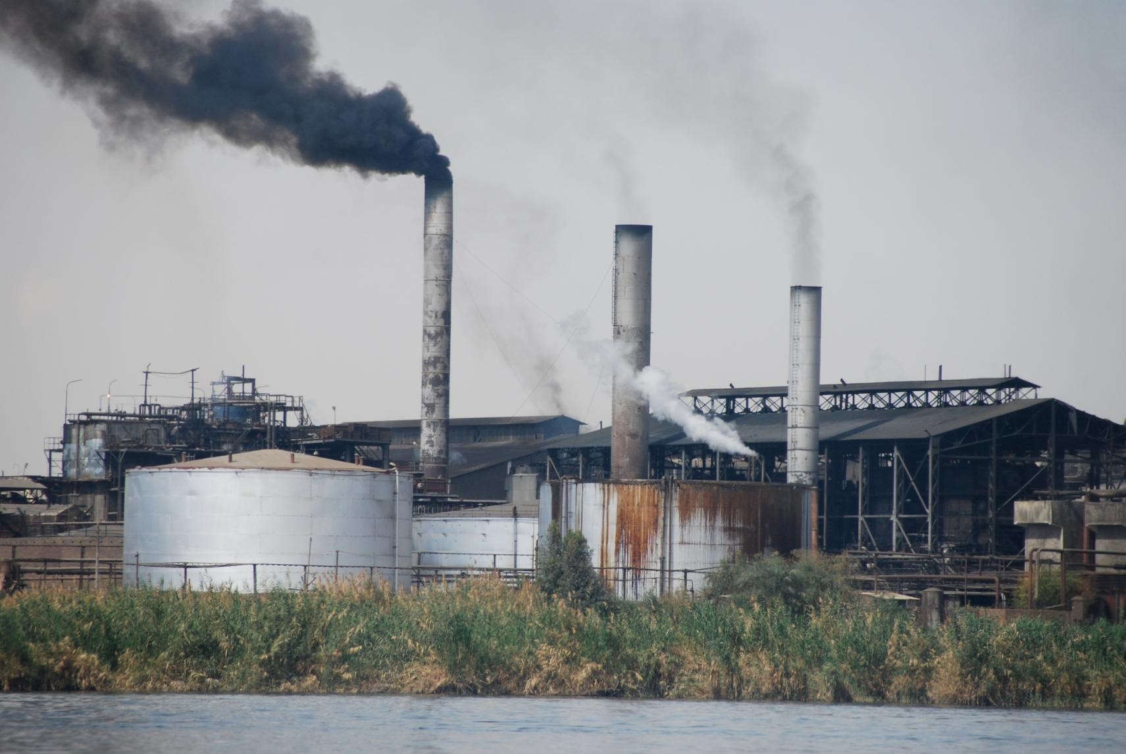
If we ran out of OIL right away…
We would solve part of the Global Warming problem….
PROBLEM: there is still LOTS of COAL, and COAL is even dirtier….
Coal is still plentiful and its widespread use is even more critical in impacting high levels of GHG emissions! It should not be viewed as a reasonable substitute for cheap or no oil!
Notes:
If we ran out of oil right away we would solve part of the Global Warming Problem.
Problem is that there is still lots of coal, and coal is even dirtier than burning gas and oil.
Coal is still plentiful and its widespread use is even more critical in impacting high levels of green house gas emissions! Coal should NOT be viewed as a reasonable substitute for cheap or no oil, no matter how plentiful it is!

Slide 5
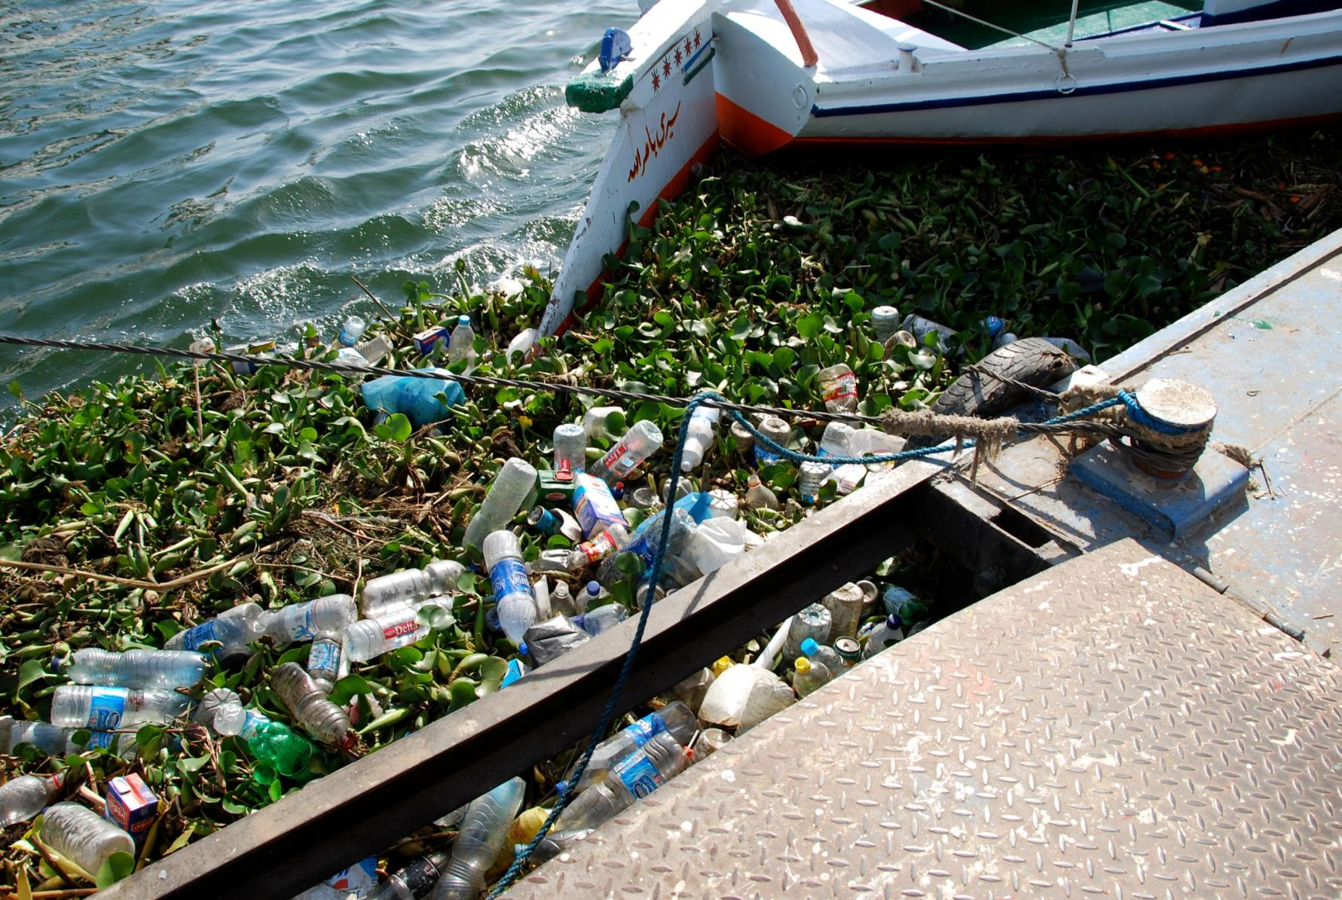
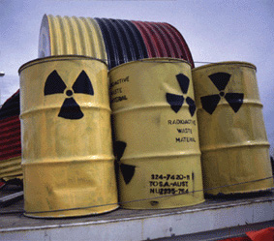
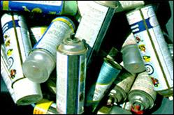
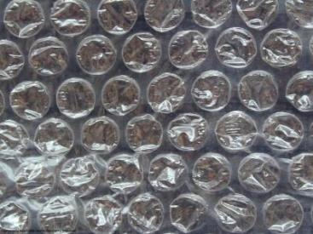
POLLUTION IS AN ACT OF DESIGN
Remember, EVERYTHING that is called 'disposable' was DESIGNED from day one to be garbage--as its PRIMARY and overriding design consideration.”
Notes:
POLLUTION IS AN ACT OF DESIGN
Remember, EVERYTHING that is called 'disposable' was DESIGNED from day one to be garbage--as its PRIMARY and overriding design consideration.”

Slide 6
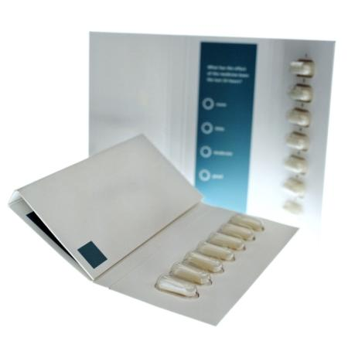
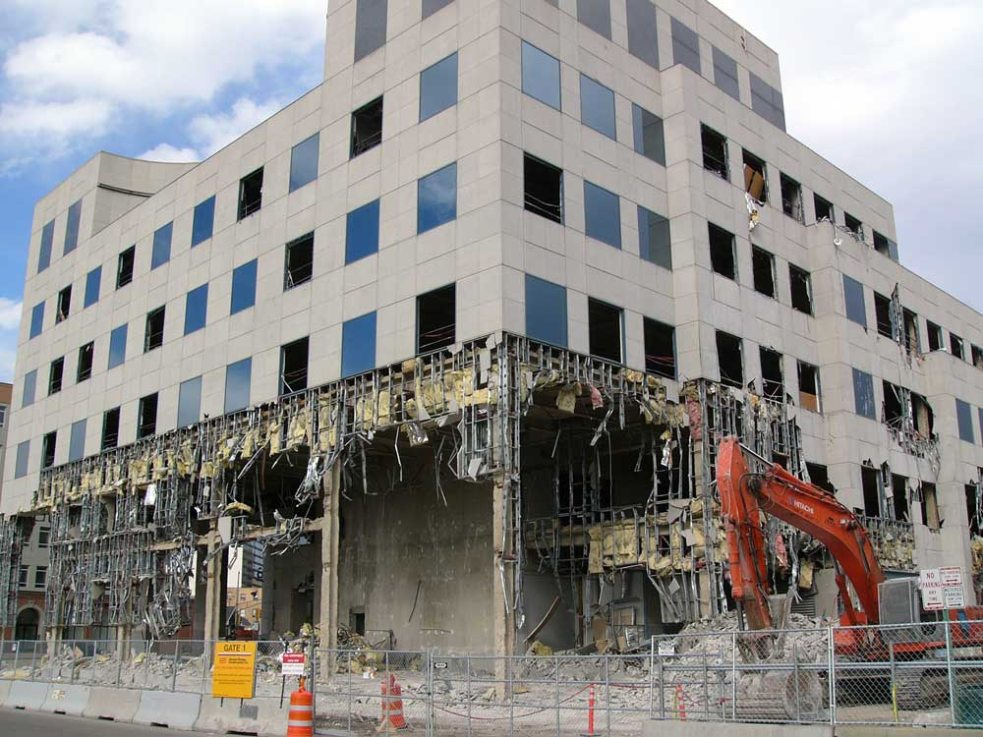
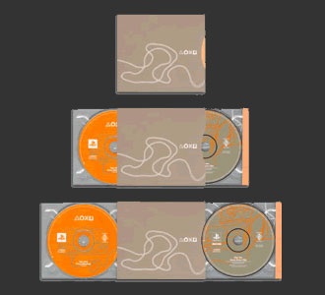
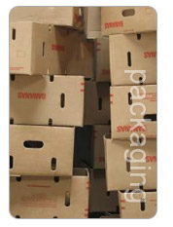

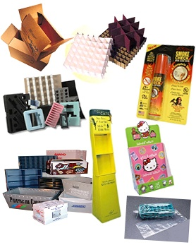
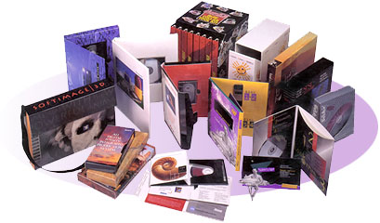

EVEN THIS BUILDING!
this was ALL designed
To be thrown OUT!
Notes:
This was all designed
To be thrown out
Even this building!

Slide 7
Radical PHILOSOPHY!??
WASTE = FOOD
(the human race is the only species to DESIGN things with the INTENTION that they become GARBAGE!)
Notes:
Radical PHILOSOPHY!??
WASTE = FOOD
(the human race is the only species to DESIGN things with the INTENTION that they become GARBAGE!)

Slide 8
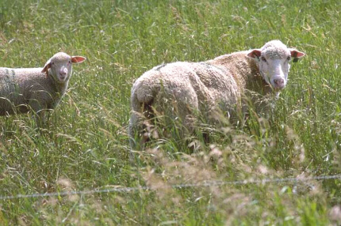

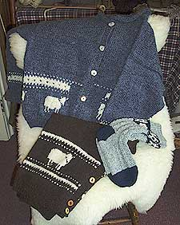

MIMIC NATURAL CYCLES
Design for a closed loop where WASTE becomes FOOD and FEEDS back into a healthy cycle….
compostable end product
Notes:
We should Mimic Natural Cycles
Design for a closed loop where WASTE becomes FOOD and FEEDS back into a healthy cycle
In this case, a compostable end product.

Slide 9
Radical PROPOSITION!??
DESIGN FOR DISASSEMBLY
So that we can take things (even buildings!) apart and easily repair or reuse them
REUSE MEANS LESS ENERGY THAN RECYCLE
Notes:
Radical PROPOSITION!??
DESIGN FOR DISASSEMBLY
So that we can take things (even buildings!) apart and easily repair or reuse them
REUSE MEANS LESS ENERGY THAN RECYCLE

Slide 10
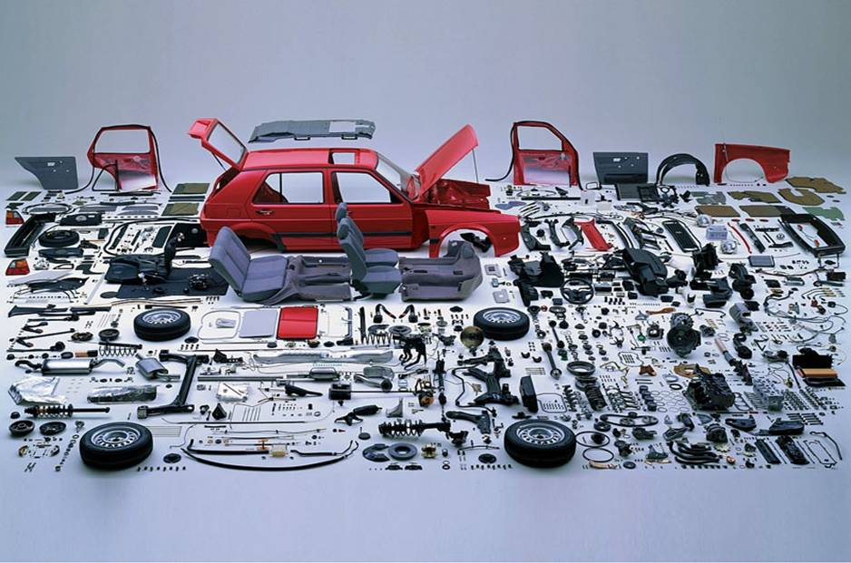
MIMIC OTHER INDUSTRIES
DESIGN BUILDINGS TO COME APART SO THAT THEY CAN BE REPAIRED, REUSED AND RECYCLED – EASILY!
Notes:
Architecture should mimic other industries
DESIGN BUILDINGS TO COME APART SO THAT THEY CAN BE REPAIRED, REUSED AND RECYCLED – EASILY!

Slide 11
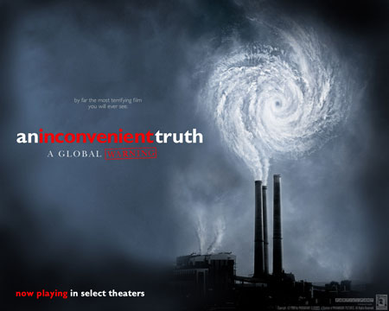
Inconvenient TRUTH
BUILDINGS ARE RESPONSIBLE FOR BETWEEN
40% TO 70% OF WORLD CARBON EMISSIONS
Important film by former U.S.
Vice President Al Gore.
Notes:
Inconvenient Truth was an important documentary film created by former U.S. Vice President Al Gore.
Buildings account for somewhere between 40% and 70% of greenhouse gas emissions. How much depends on whether you include transportation associated emissions that result from dispersed urban settlement patterns.

Slide 12
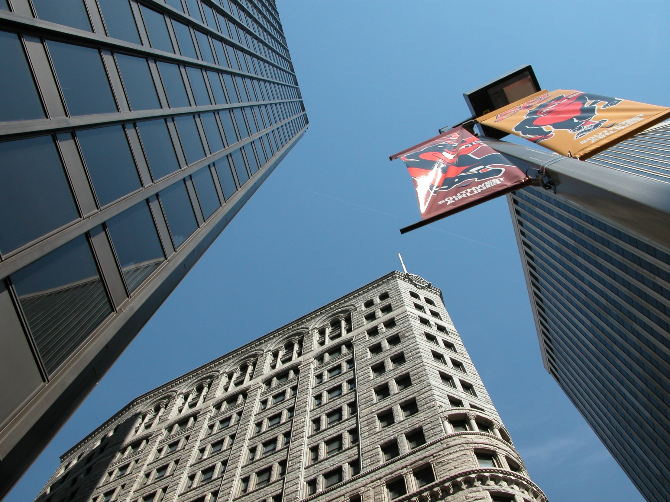
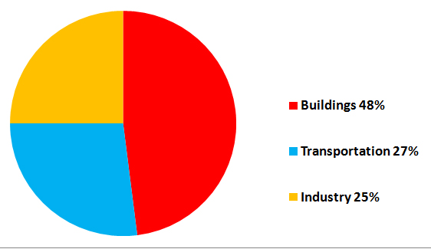
Energy Use in the United States
Buildings use more energy than cars and trucks!
Notes:
If one looks at the Energy Consumption patterns in North America it can be seen that Industry and Manufacturing account for 25% of all energy consumed; transportation accounts for 27% of all energy consumed, and buildings account for 48% of all energy consumed. This would include not only the operational energy associated with a building, but also its construction associated energy. If we consider that much transportation energy is spent by people driving to and from work and retail, relationships set out by urban planners, it is easy to see that buildings use far more energy than cars, trucks and oversized SUVs!
It is the Architect that has control over the design of most buildings and thereby is the person that must take charge of ensuring that they are better designed in order to reduce their negative impact on the environment.
It is the energy consumption of buildings that is the key contributor to GHG emissions in North America and the World.

Slide 13
CO₂ Production by Country in 1997
Country CO₂ Produced (tonnes of carbon) Total (millions) Per Capita
U.S. 1,489.6 5.48
China 913.8 0.75
Russia 390.6 2.65
Japan 316.2 2.51
India 279.9 0.29
Germany 227.4 2.77
UK 142.1 2.41
Canada 133.9 4.42
Italy 111.3 1.94
Ukraine 100.4 1.97
Source: Carbon Dioxide Information Analysis Center, Oak Ridge National Laboratory, Tennessee
Notes:
This is the CO2 production by country measured in 1997.
The United States was the biggest user on a per capita basis with 5.48 tonnes of carbon per capita.
China had only 0.75 tonnes of carbon per capita. Still China was producing more than half the amount of Green House Gas as the United States on an annual basis.

Slide 14
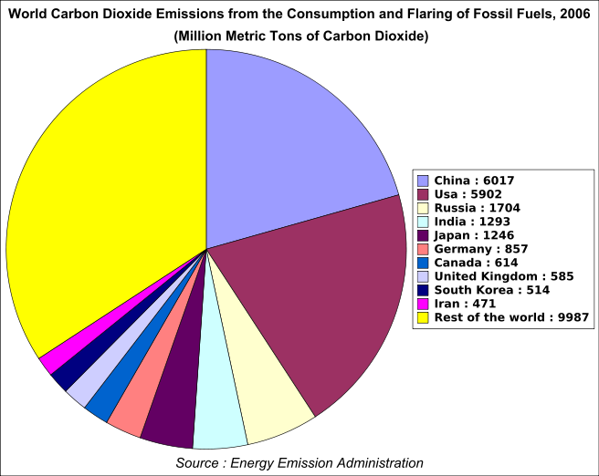
CO₂ Production by Country in 2006
Country CO₂ Produced % total world emissions
metric tonnes
U.S. 5,752 20.2%
China 6,103 21.5%
European Union 1,314 13.8%
Russia 1,564 5.5%
India 1,510 5.3%
Japan 1,293 4.6%
Canada 545 1.9%
The Global situation in the past 10 years has become many times WORSE. China’s emissions INCREASED by 668% in 10 years.
Source: Wikipedia, accessed Sept 3, 2009
Notes:
If we look at the GHG emissions in 2006, we can see that China has increased its output by 668%, and is now responsible for more emissions than the United States, even though their per capita rate is still less.
Much of this is due to the burning of coal and the construction of large quantities of new buildings that mimic the bad design of the Modern Period in Western Architecture. This is a consumptive style of design that North America is trying to correct and make more sustainable, however slowly.

Slide 15

The Leap to Zero Carbon:
Preparing for the 2030 Challenge
Part Two:
Defining the FIRST STEPS to Carbon Neutral Design
Solving the GHG Problem
Professor Terri Meyer Boake
Associate Director | School of Architecture | University of Waterloo
President Society of Building Science Educators
Member OAA Committee for Sustainable Built Environment
Notes:
The Leap to Zero Carbon:
Preparing for the 2030 Challenge
Part Two:
Defining the FIRST STEPS to Carbon Neutral Design
Solving the GHG Problem

Slide 16

Fossil Fuel Reduction Standard:
The fossil fuel reduction standard for all new buildings shall be increased to:
  60% in 2010
  70% in 2015
  80% in 2020
  90% in 2025
  Carbon-neutral in 2030 (using no fossil fuel GHG emitting energy to operate).
Source: www.architecture2030.org
Notes:
An important organization called architecture2030 has outlined the goals for carbon reduction for buildings in North America. Numerous agencies, governments and cities have signed on to this goal.
It states that the fossil fuel reduction standard for all new buildings shall be increased to:
60% in 2010
70% in 2015
80% in 2020
90% in 2025
Carbon-neutral in 2030 (using no fossil fuel GHG emitting energy to operate).
The emphasis is on operating energy as it is the simplest to design for, control and measure. It is also 80% of the problem when it comes to buildings. Embodied energy is estimated to account for around 20% of the GHG from buildings. Transportation is even more difficult to pinpoint as it is connected with the location of the residence of the user of the building. As operational energy is the most significant, it has been chosen as the initial point of focus.

Slide 17
Operating Energy of Building
Landscape
+ Site
Disturbance vs. sequestration
80% of the problem!
Embodied Carbon in Building Materials
Renewables + Site Generation
People, “Use” + Transportation
Counting Carbon costs….
+ purchased offsets
Notes:
If you look at the Carbon problem as a balancing act, the “problems” are on the left hand side of the dotted line and the “solutions” are on the right hand side of the dotted line. The problems are operating energy, embodied energy and people, their use of the building and transportation.
Renewable energy and site generated energy and the natural production of oxygen by plants are the only means that we have to balance or OFFSET the carbon produced by the building.
The landscape and site can either generate or absorb carbon. Disturbing the site and soil releases carbon into the atmosphere. Planting trees and growing plants can absorb carbon.
The operating energy is 80% of the problem illustrated on the left hand side of the slide. So unless we reduce it significantly, there is little chance that renewables and site generation can possibly be used to offset or balance the amount.
Offsets can be purchased. This is referred to as carbon trading. Realistically there is a limit to how many carbon credits can be created for sale, so we are better off to aim our designs to avoid needing to use these.
Many companies are attempting to sequester carbon by shooting it into the ground. But again, this is not a good solution as it will escape again if disturbed. We are better off to fix the solution to our global problem through GOOD DESIGN.

Slide 18
Four Key Steps – IN ORDER:
#1 - Reduce loads/demand first (conservation, passive design, daylighting, shading, orientation, etc.)
#2 - Meet loads efficiently and effectively (energy efficient lighting, high-efficiency MEP equipment, controls, etc.)
#3 - Use renewables to meet energy needs (doing the above steps before will result in the need for much smaller renewable energy systems, making carbon neutrality achievable.)
#4 - Use purchased Offsets as a last resort when all other means have been looked at on site, or where the scope of building exceeds the site available resources.
REDUCING OPERATING ENERGY
Notes:
The approach that I am advocating to BEGIN to design for Carbon Neutral is very much a BACK TO BASICS idea. Good Design must start to appreciate how Architecture was done BEFORE MECHANICAL SYSTEMS were available. It needs to respect vernacular and indigenous design that was previously very successful by only using basic materials and low energy strategies. The Four Key Steps to the reduction of Operating Energy to facilitate reaching a Carbon Neutral status are – IN ORDER:
#1 - Reduce loads/demand first (through conservation, passive design, daylighting, shading, orientation, etc.)
#2 - Meet loads efficiently and effectively (through energy efficient lighting, high-efficiency mechanical, electrical and plumbing equipment, controls, etc.)
#3 - Use renewables (such as PV, wind and geothermal systems) to meet energy needs (doing the above steps before will result in the need for much smaller renewable energy systems, making carbon neutrality achievable.)
#4 - Use purchased Offsets as a last resort when all other means have been looked at on site, or where the scope of building exceeds the site available resources.

Slide 19
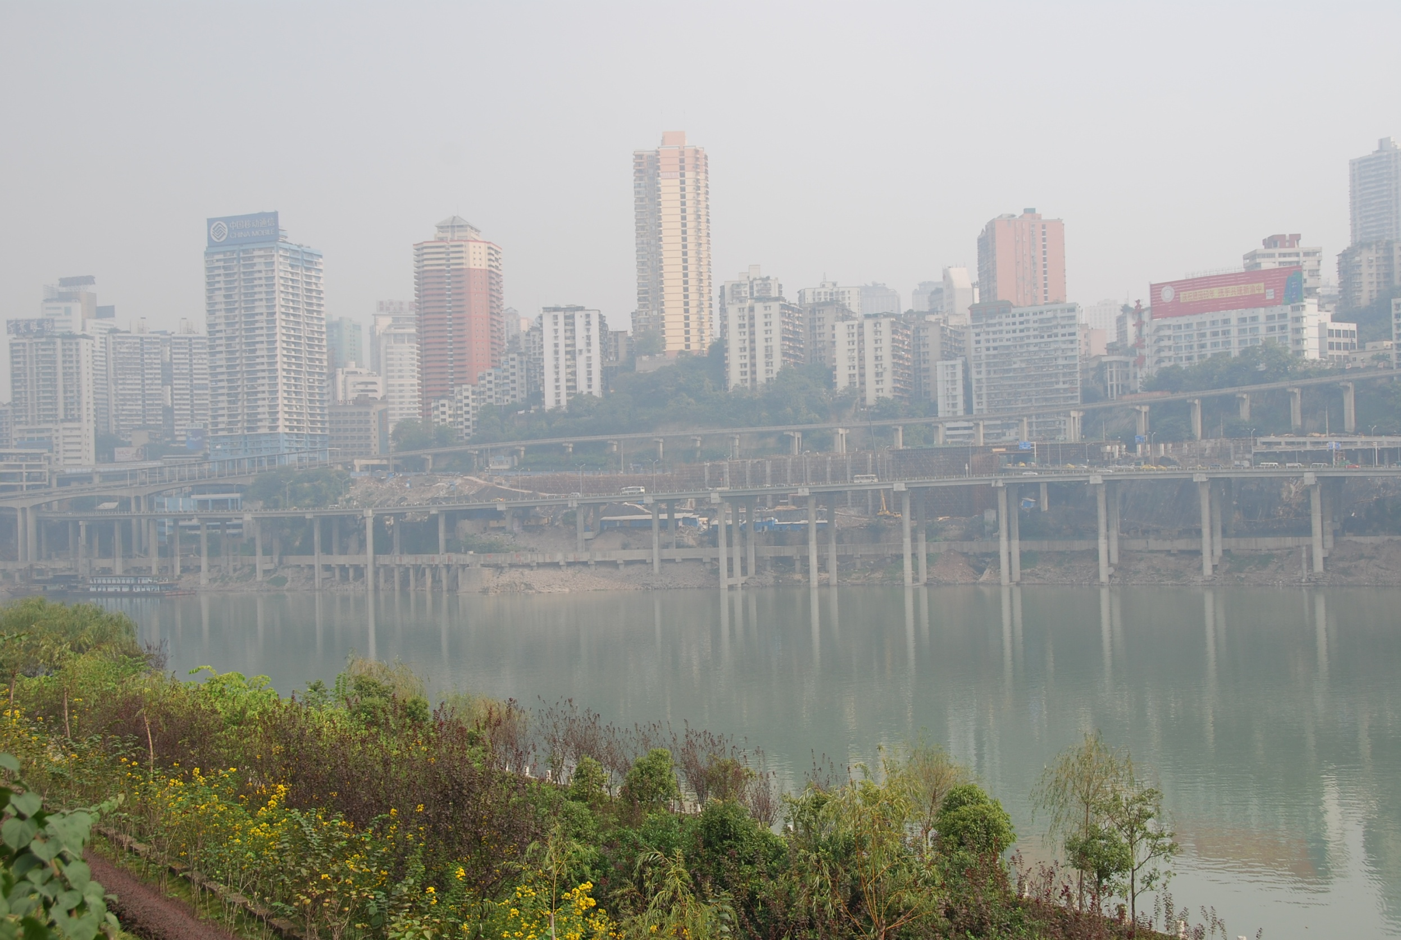
LOW CARBON CITIES AND BUILDINGS ARE NOT POSSIBLE WITHOUT
CLEAN AIR – NO POLLUTION

Slide 20
THE AIR MUST BE CLEAN BECAUSE:
#1 - You need natural ventilation – this is unpleasant and unhealthy if particulate levels are high
#2 - CLOSED WINDOWS make people depend on Air Conditioning. These use energy and make the air hotter by their function. A vicious circle.
#3 - Renewables such as PHOTOVOLTAICS cannot be efficient if the sun cannot reach them
#4 - PARTICULATE BUILD UP makes PV quite ineffective.
Notes:
THE AIR MUST BE CLEAN BECAUSE:
#1 - In a SUB TROPICAL CLIMATE you need natural ventilation – this is unpleasant and unhealthy if particulate levels are high
#2 - CLOSED WINDOWS make people depend on Air Conditioning. These use energy and make the air hotter by their function. A vicious circle.
#3 - Renewables such as PHOTO VOLTAICS cannot be efficient if the sun cannot reach them
#4 - PARTICULATE BUILD UP makes PV quite ineffective.
Particulates are the byproduct of the burning of coal. This is a separate but connected issue to Green House Gas production.

Slide 21
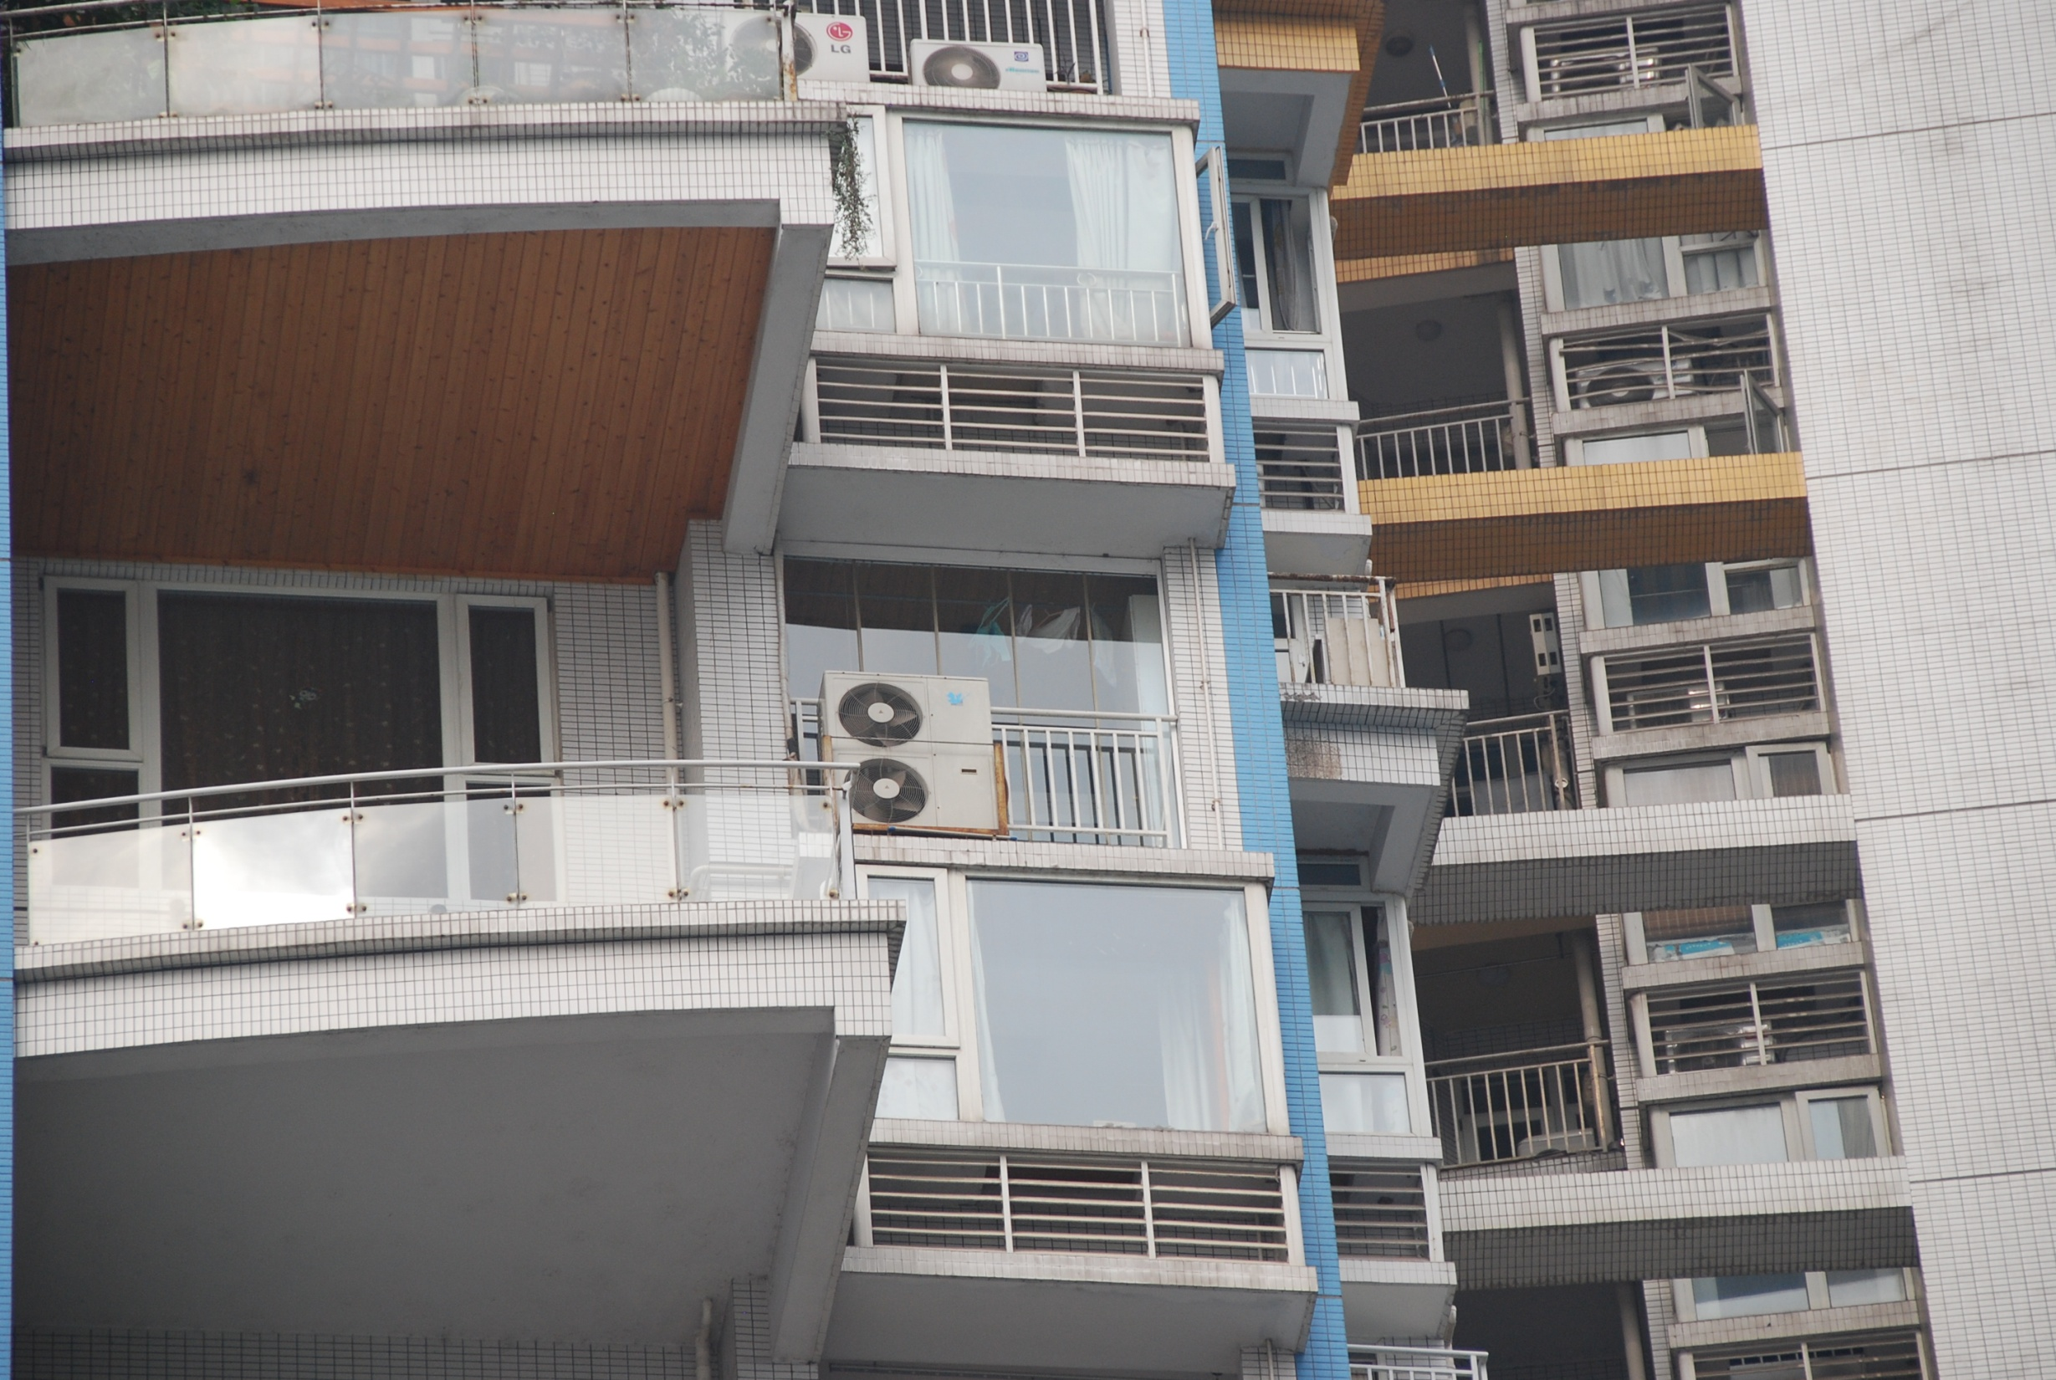
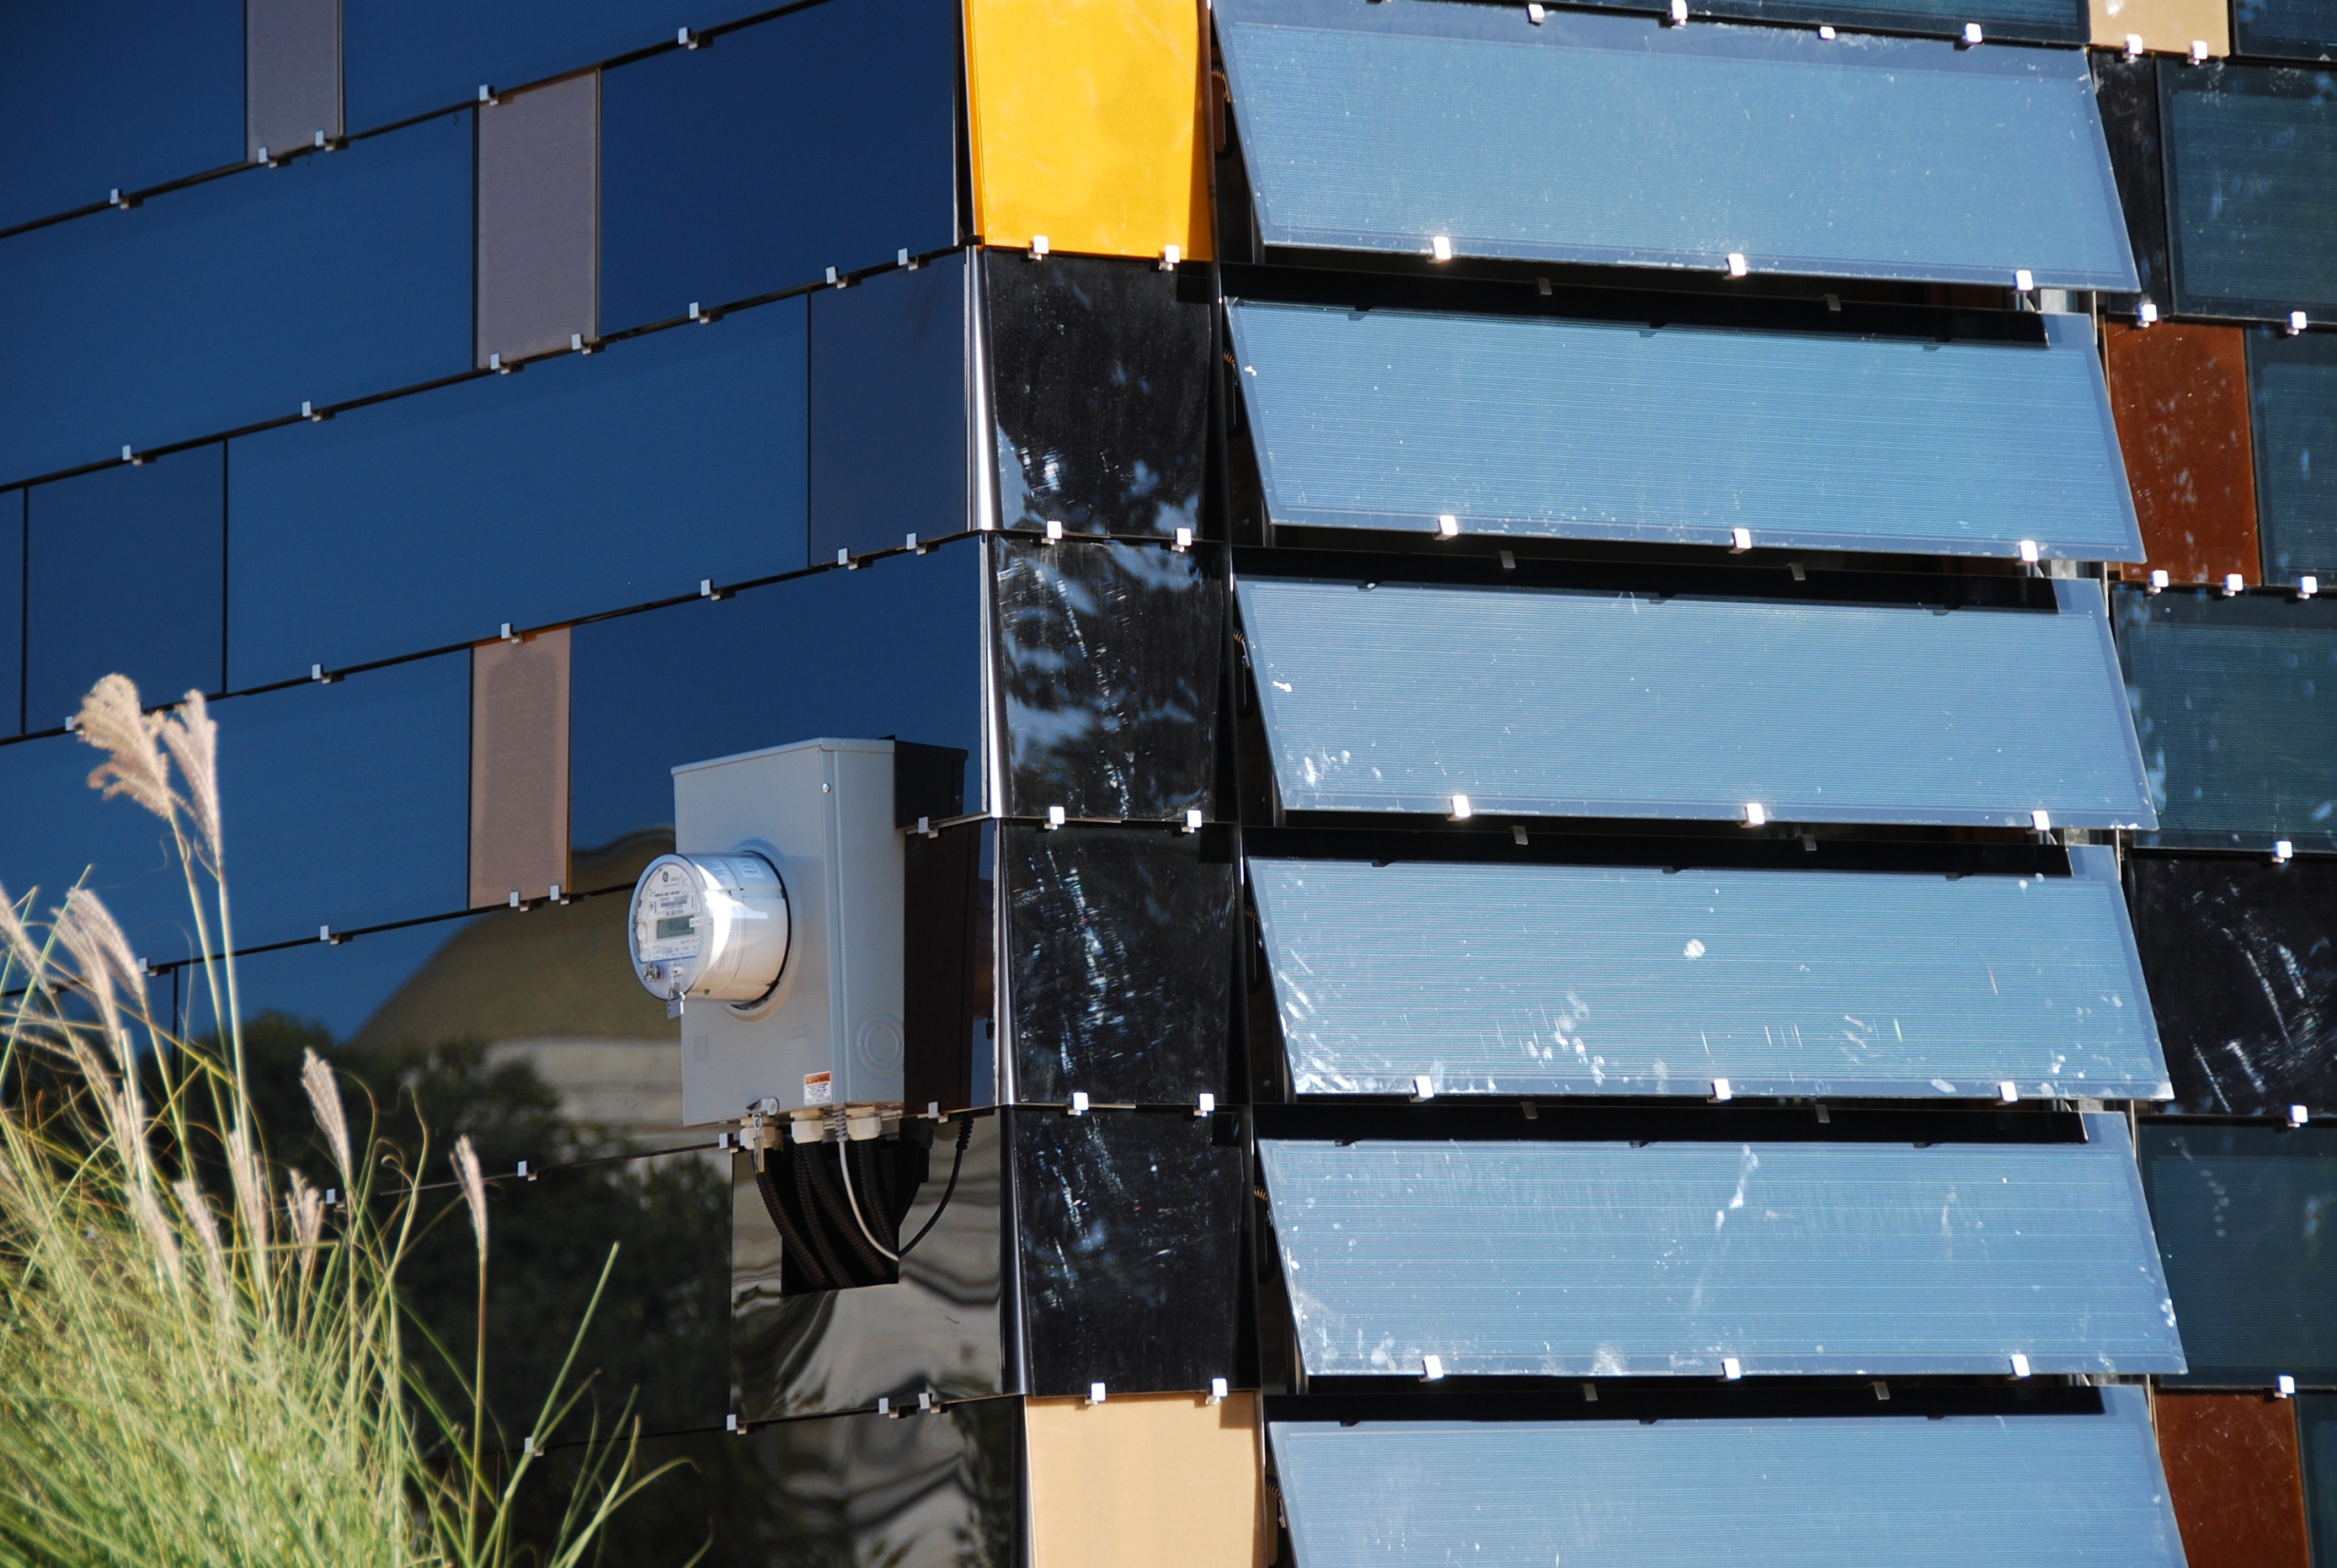
Notes:
I have a sense that you would prefer to replace the status quo with new technologies that also boast high efficiencies. These technologies can help you achieve a low carbon architecture, but need pristine environments in order to work.

Slide 22
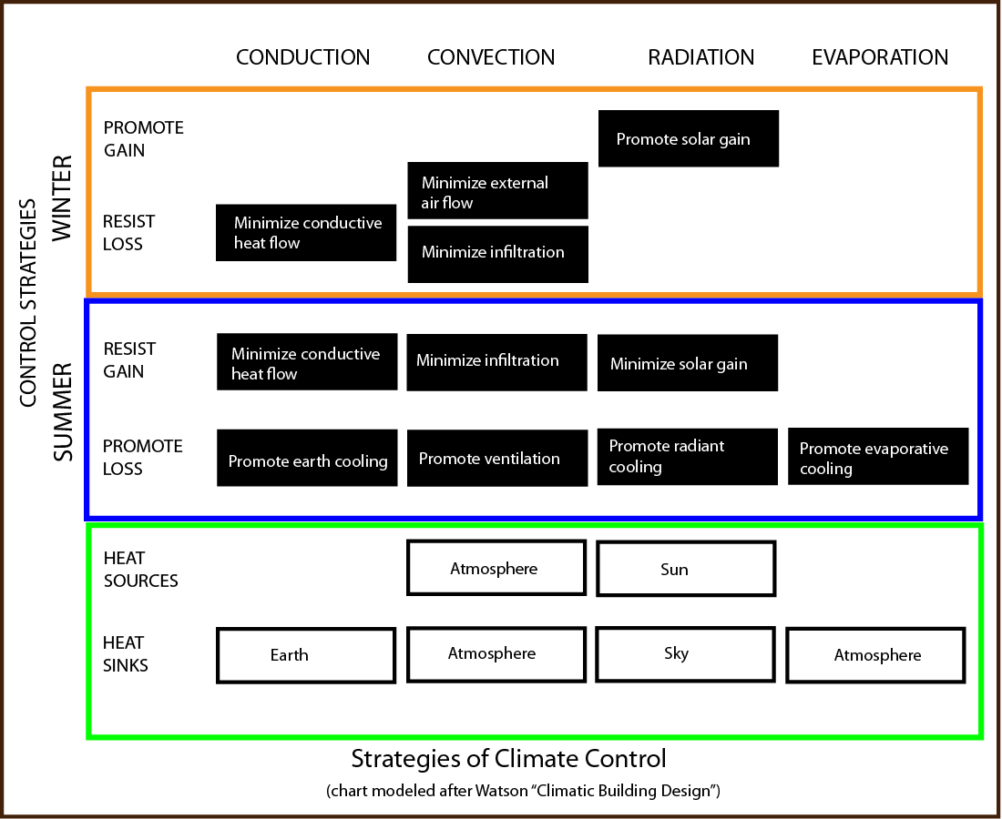
Begin with Passive Strategies for Climate Control to Reduce Energy Requirements
HEATING
REDUCING OPERATING ENERGY
COOLING
Notes:
The chart above outlines the basic passive strategies that can be used for climate control to reduce energy requirements.
If we consider winter to be the heating season, we have to both promote solar gain and resist heat loss from our buildings.
If we consider summer to be the cooling season, we have to both resist solar gain and promote heat loss – precisely the opposite of the winter condition.
The sun, the wind, the earth and the atmosphere are used very naturally to achieve this.

Slide 23
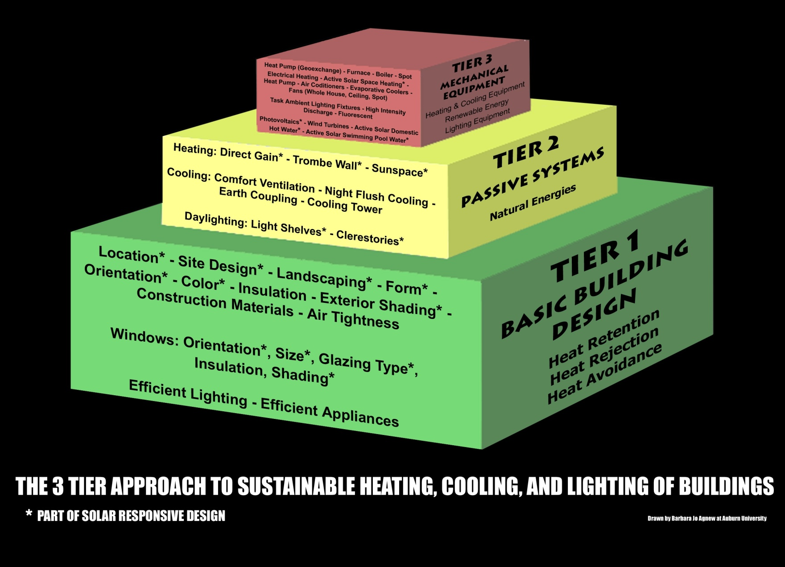
Carbon Reduction: The Tier Approach
…and the Mechanical Systems won’t be small enough to be powered by renewable energy
…or the Passive Systems won’t work
REDUCING OPERATING ENERGY
Basic Building Design MUST be Climate Responsive
Image: Norbert Lechner, “Heating, Cooling, Lighting”
Notes:
Carbon Reduction works with the tiered approach to design.
Click the slide.
Tier one asks that we get the basic building design to be climate responsive.
Click the slide.
Tier two adds passive systems for heating and cooling. These will not work if the basic design is wrong.
Click the slide.
Tier three adds mechanical systems. If these cannot be very very small, they will not be able to be powered by the renewable energy available on or around the site.

Slide 24
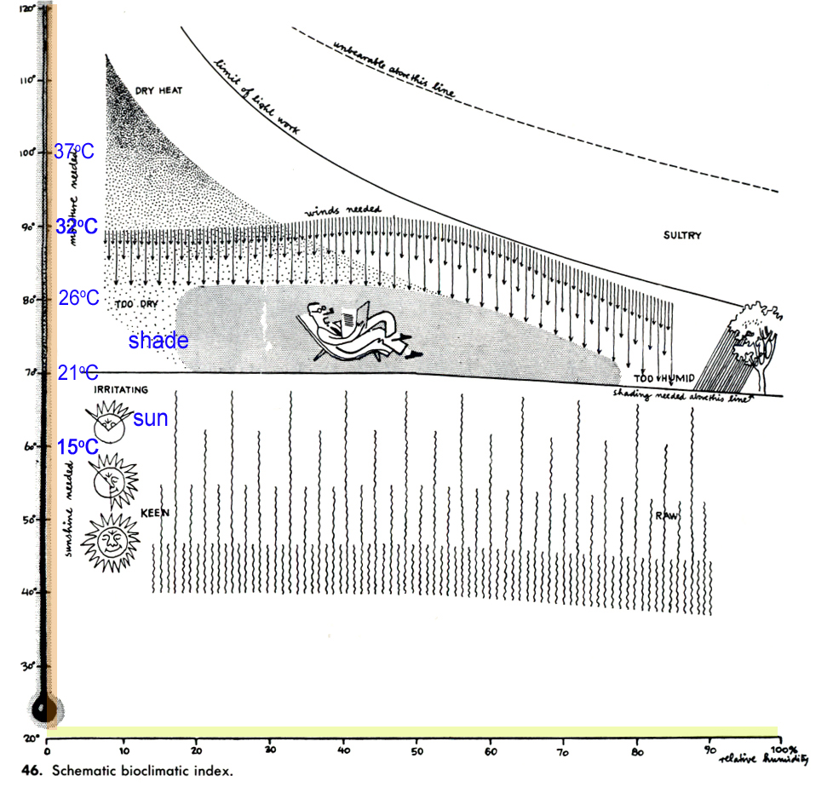

Designing to the Comfort Zone vs. Comfort Point:
This famous illustration is taken from “Design with Climate”, by Victor Olgyay, published in 1963.
REDUCING OPERATING ENERGY
This is the finite point of expected comfort for 100% mechanical heating and cooling.
To achieve CN, we must work within the broader area AND DECREASE the “line” to 18C – point of calculation of heating degree days.
Notes:
Designing to the Comfort Zone vs. Comfort Point:
This famous illustration is taken from “Design with Climate”, by Victor Olgyay, published in 1963.
The red square is the finite point of expected comfort for 100% mechanical heating and cooling.
To achieve Carbon Neutral, we must work within the broader area AND DECREASE the “line” to 18C – which is the point of calculation of heating and cooling degree days.
This readjusts the idea of a COMFORT POINT to that of a ZONE OF ACCEPTABLE COMFORT.
We cannot possibly reduce our operating energy requirements unless people can become more adaptable. They need to learn to open and shut windows. Put on a sweater or take it off. They need to learn to modify their clothes or style of dress to allow the building temperature to fluctuate. This will save a lot of energy.

Slide 25
Passive Bio-climatic Design: COMFORT ZONE
Comfort expectations may have to be reassessed to allow for the wider “zone” that is characteristic of buildings that are not exclusively controlled via mechanical systems.
Creation of new “buffer spaces” to make a hierarchy of comfort levels within buildings.
Require higher occupant involvement to adjust the building to modify the temperature and air flow.
Notes:
Passive Bio-climatic Design: COMFORT ZONE
Comfort expectations may have to be reassessed to allow for the wider “zone” that is characteristic of buildings that are not exclusively controlled via mechanical systems.
This requires the creation of new “buffer spaces” to make a hierarchy of comfort levels within buildings.
This in turn requires higher occupant involvement to adjust the building to modify the temperature and air flow.
Comfort must be adjusted to respect the FOUR basic climate types.

Slide 26
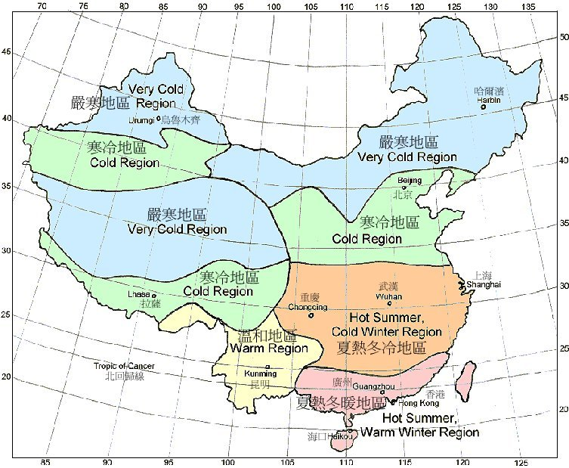
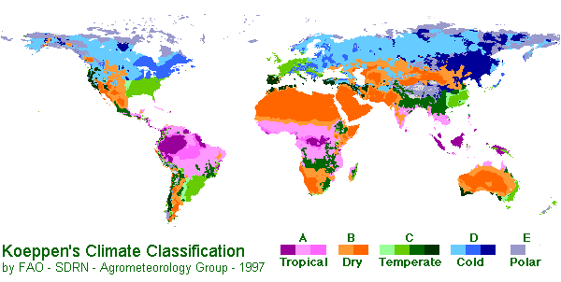
Bio-climatic Design:
Design must first acknowledge regional, local and microclimate impacts on the building and site.
COLD (very cold)
TEMPERATE (warm)
HOT-ARID
HOT-HUMID
http://www.arch.hku.hk/~cmhui/teach/65747-Xd.htm
Notes:
Bio-climatic Design:
Design must first acknowledge regional, local and microclimate impacts on the building and site.
COLD (very cold)
TEMPERATE (warm)
HOT-ARID
HOT-HUMID
Click slide.
If we can understand the bioclimatic requirements for our own country then we can begin to effectively borrow appropriate solutions from others around the world with similar climates.

Slide 27
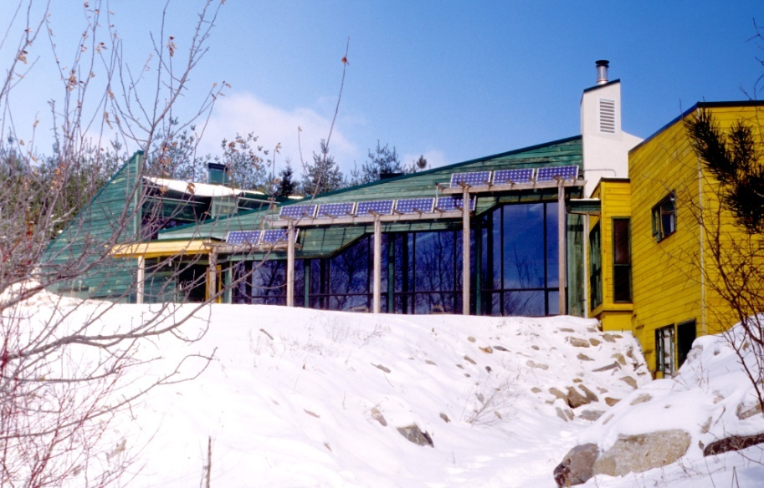
Bio-climatic Design: COLD
Where winter is the dominant season and concerns for conserving heat predominate all other concerns. Heating degree days greatly exceed cooling degree days.
RULES:
First INSULATE
exceed CODE requirements (DOUBLE??)
minimize infiltration (build tight to reduce air changes)
Then INSOLATE
ORIENT AND SITE THE BUILDING PROPERLY FOR THE SUN
maximize south facing windows for easier control
fenestrate for DIRECT GAIN
apply THERMAL MASS inside the building envelope to store the FREE SOLAR HEAT
create a sheltered MICROCLIMATE to make it LESS cold
YMCA Environmental Learning Centre, Paradise Lake, Ontario
Notes:
Bio-climatic Design: COLD
This zone exists where winter is the dominant season and concerns for conserving heat predominate all other concerns. Heating degree days greatly exceed cooling degree days.
RULES:
First INSULATE
exceed CODE requirements (DOUBLE the insulation amount or thickness)
minimize infiltration (build tight to reduce air changes)
Then INSOLATE (let the sun shine in and heat up your thermal mass)
ORIENT AND SITE THE BUILDING PROPERLY FOR THE SUN
maximize south facing windows for easier control
fenestrate for DIRECT GAIN
apply THERMAL MASS inside the building envelope to store the FREE SOLAR HEAT
create a sheltered MICROCLIMATE to make it LESS cold

Slide 28
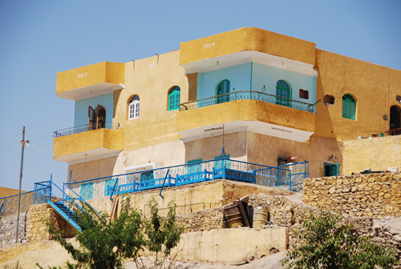
Bio-climatic Design: HOT-ARID
Where very high summer temperatures with great fluctuation predominate with dry conditions throughout the year. Cooling degrees days greatly exceed heating degree days.
RULES:
Solar avoidance : keep DIRECT SOLAR GAIN out of the building
avoid daytime ventilation
promote nighttime flushing with cool evening air
achieve daylighting by reflectance and use of LIGHT non-heat absorbing colours
create a cooler MICROCLIMATE by using light / lightweight materials
respect the DIURNAL CYCLE
use heavy mass for walls and DO NOT INSULATE
Traditional House in Egypt
Notes:
Bio-climatic Design: HOT-ARID
This zone exists where very high summer temperatures with great fluctuation predominate with dry conditions throughout the year. Cooling degrees days greatly exceed heating degree days.
RULES:
Solar avoidance : keep DIRECT SOLAR GAIN out of the building
avoid daytime ventilation
promote nighttime flushing with cool evening air
achieve daylighting by reflectance and use of LIGHT non-heat absorbing colours
create a cooler MICROCLIMATE by using light / lightweight materials
respect the DIURNAL CYCLE
use heavy mass for walls and DO NOT INSULATE

Slide 29
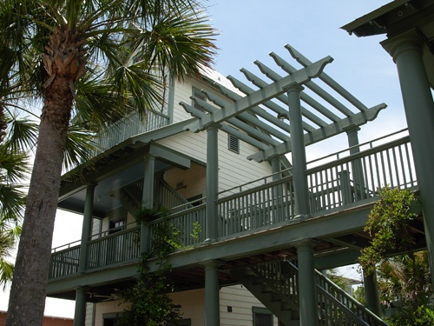
Bio-climatic Design: HOT-HUMID
Where warm to hot stable conditions predominate with high humidity throughout the year. Cooling degrees days greatly exceed heating degree days.
RULES:
SOLAR AVOIDANCE : large roofs with overhangs that shade walls and to allow windows open at all times
PROMOTE VENTILATION
USE LIGHTWEIGHT MATERIALS that do not hold heat and that will not promote condensation and dampness (mold/mildew)
eliminate basements and concrete
use STACK EFFECT to ventilate through high spaces
use of COURTYARDS and semi-enclosed outside spaces
use WATER FEATURES for cooling
House in Seaside, Florida
Notes:
Bio-climatic Design: HOT-HUMID
This zone exists where warm to hot stable conditions predominate with high humidity throughout the year. Cooling degrees days greatly exceed heating degree days.
RULES:
SOLAR AVOIDANCE : large roofs with overhangs that shade walls and to allow windows open at all times
PROMOTE VENTILATION
USE LIGHTWEIGHT MATERIALS that do not hold heat and that will not promote condensation and dampness (mold/mildew)
eliminate basements and concrete
use STACK EFFECT to ventilate through high spaces
use of COURTYARDS and semi-enclosed outside spaces
use WATER FEATURES for cooling

Slide 30
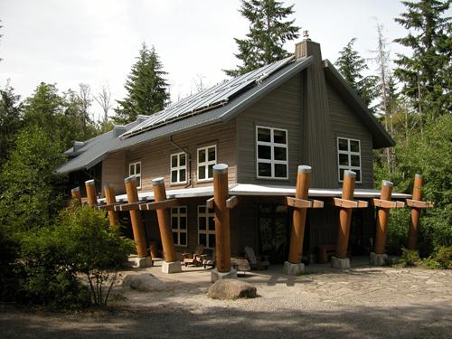
Bio-climatic Design: TEMPERATE
The summers are hot and humid, and the winters are cold. In much of the region the topography is generally flat, allowing cold winter winds to come in form the northwest and cool summer breezes to flow in from the southwest. The four seasons are almost equally long.
RULES:
BALANCE strategies between COLD and HOT-HUMID
maximize flexibility in order to be able to modify the envelope for varying climatic conditions
understand the natural benefits of SOLAR ANGLES that shade during the warm months and allow for heating during the cool months
IslandWood Residence, Seattle, WA
Notes:
Bio-climatic Design: TEMPERATE
This zone exists where the summers are hot and humid, and the winters are cold. In much of the region the topography is generally flat, allowing cold winter winds to come in form the northwest and cool summer breezes to flow in from the southwest. The four seasons are almost equally long.
RULES:
BALANCE strategies between COLD and HOT-HUMID
maximize flexibility in order to be able to modify the envelope for varying climatic conditions
understand the natural benefits of SOLAR ANGLES that shade during the warm months and allow for heating during the cool months

Slide 31
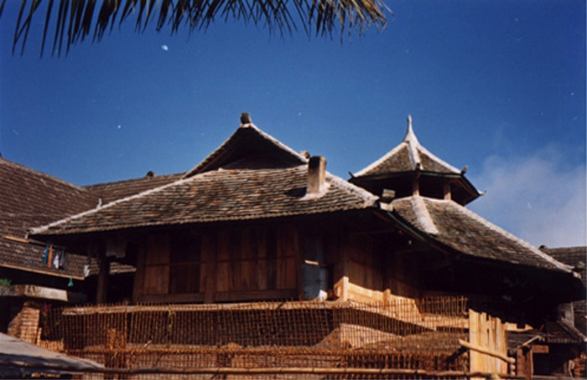
The Most Important Lesson
You SHOULD NOT design the same building for EVERY climate and let the MECHANICAL ENGINEERS just put larger equipment to solve the problem.
Use the lessons of traditional vernacular architecture to begin to solve the energy and GHG issues of today!
THIS IS THE KEY TO REDUCING THE IMPACT AND ENERGY REQUIRED FOR ALL PROJECTS.
Notes:
The Most Important Lesson
You SHOULD NOT design the same building for EVERY climate and let the MECHANICAL ENGINEERS just put larger equipment to solve the problem.
Use the lessons of traditional vernacular architecture to begin to solve the energy and GHG issues of today!
THIS IS THE KEY TO REDUCING THE IMPACT AND ENERGY REQUIRED FOR ALL PROJECTS.

Slide 32
Reduce, Renew, Offset
And, a paradigm shift from the recycling 3Rs…
Reduce - build less, protect natural ecosystems, build smarter, build efficiently
Renew - use renewable energy, restore native ecosystems, replenish natural building materials, use recycled and recyclable materials
Offset - compensate for the carbon you can't eliminate, focus on local offset projects
Net impact reduction of the project!
source: www.buildcarbonneutral.org
Notes:
Next, Reduce, Renew and Offset
Or, a paradigm shift from the recycling 3Rs of Reduce, Reuse and Recycle…
Reduce - build less, protect natural ecosystems, build smarter, and build efficiently
Renew - use renewable energy, restore native ecosystems, replenish natural building materials, and use recycled and recyclable materials
Offset - compensate for the carbon you can't eliminate and focus on local offset projects
This should result in a net impact reduction of the project!

Slide 33
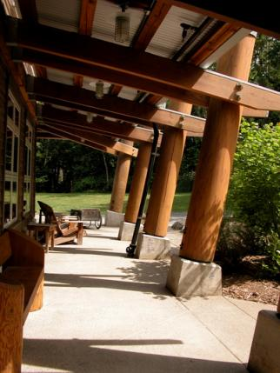
The Importance of Impact Reduction:
If the impact of the building is NOT reduced, it may be impossible to reduce the CO₂ to zero. Because:
Site and location matter.
Design for bio-regional site and climate
Orientation for passive heating, cooling
and daylighting
Brownfield or conserved ecosystem?
Urban, suburban or rural?
Disturbance is Impact.
When you move soil around you
release carbon
The buildings at IslandWood are located with a “solar meadow” to their south to take advantage of solar heating and daylighting.
7 Impacts source: www.buildcarbonneutral.org
Notes:
The Importance of Impact Reduction:
If the impact of the building is NOT reduced, it may be impossible to reduce the CO₂ to zero. Because:
Understand that Site and location matter.
you must Design for bio-regional site and climate
you must start with an Orientation that is suitable for passive heating, cooling
and daylighting
know if you are designing on a Brownfield or conserved ecosystem?
is the Urban, suburban or rural? As this will change the environmental condition and potential of the site
Understand that Disturbance is Impact.
When you move soil around you
release carbon

Slide 34
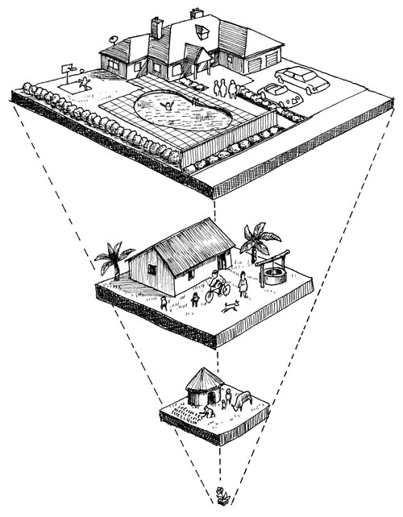
Smaller is better.
Simple!…less building results in less embodied carbon; i.e. less carbon from materials used in the project, less requirements for heating, cooling and electricity….
Re-examine the building program to see what is really required
How is the space to be used?
Can the program benefit from more inventive double uses of spaces?
Can you take advantage of outdoor or more seasonally used spaces?
How much building do you really need?
Inference of LIFESTYLE changes
Source: http://www.cycleoflife.ca/kids/education.htm
Calculating your “ecological footprint”
… can naturally extend to an understanding of your “carbon footprint”
Notes:
Smaller is better!!!
Simple!…less building results in less embodied carbon; i.e. less carbon from materials used in the project, less requirements for heating, cooling and electricity….
So you need to re-examine the building program to see what is really required. Think cutting back. If you don’t build it you don’t need to heat, cool or light it.
Ask “how is the space to be used?” Can it be used differently to save space and energy?
Can the program benefit from more inventive double uses of spaces?
Can you take advantage of outdoor or more seasonally used spaces? These will not need heating or cooling.
How much building do you really need?
This is an inference of LIFESTYLE changes that initially may be difficult to sell to both the client and the building occupants, but might be essential to arriving at a carbon neutral end product.
You can calculate your ecological and carbon footprint to better understand the impact that your personal lifestyle is making on the planet.

Slide 35
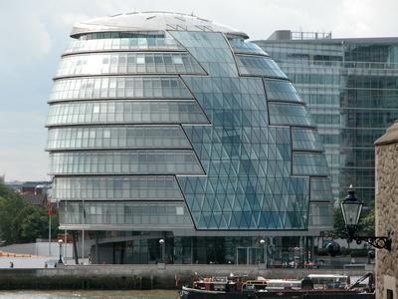
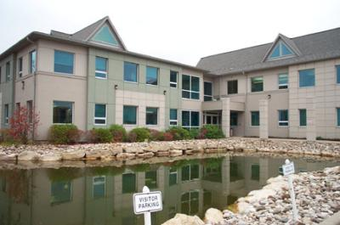
Material choice matters.
Material choice can reduce your building’s embodied carbon footprint.
Where did the material come from?
Is it local?
Did it require a lot of energy to extract it or to get it to your building?
Can it be replaced at the source?
Was it recycled or have significant post consumer recycled content?
Can it be recycled or reused easily; i.e. with minimal additional energy?
Is the material durable or will it need to be replaced (lifecycle analysis)?
Foster’s GLA – may claim to be high performance, but it uses many high energy materials.
Green on the Grand, Canada’s first C-2000 building chose to import special windows from a distance rather than employ shading devices to control solar gain and glare.
Notes:
Material choice matters.
Material choice can reduce your building’s embodied carbon footprint.
Where did the material come from?
Is it local?
Did it require a lot of energy to extract it or to get it to your building?
Can it be replaced at the source?
Was it recycled or have significant post consumer recycled content?
Can it be recycled or reused easily; i.e. with minimal additional energy?
Is the material durable or will it need to be replaced (lifecycle analysis)?
Foster’s GLA – may claim to be high performance, but it uses many high energy materials.
Green on the Grand, Canada’s first C-2000 building chose to import special windows from a distance rather than employ shading devices to control solar gain and glare.

Slide 36
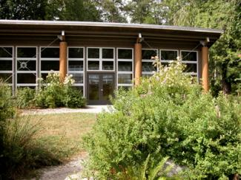
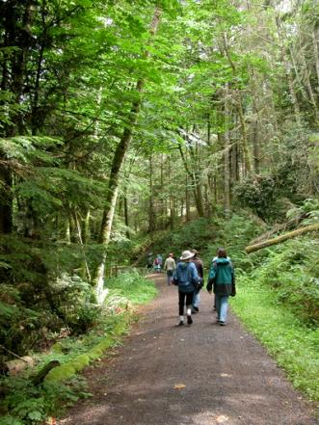
Natural ecosystems sequester carbon.
Carbon is naturally stored below ground and is released when soil is disturbed
Proper treatment of the landscape can keep this carbon in place (sequestration)
Proper treatment of the landscape can be designed to store/accumulate/sequester more carbon over time
Verify landscape design type with your eco-region – use of indigenous plant material requires less maintenance/water – healthy plants absorb more CO₂
Possible to use the natural ecosystems on your site to assist in lowering the carbon footprint of your project
The natural site is preserved at IslandWood, Bainbridge Island.
Notes:
Natural ecosystems sequester carbon.
Carbon is naturally stored below ground and is released when soil is disturbed
Proper treatment of the landscape can keep this carbon in place (this is called sequestration)
Proper treatment of the landscape can be designed to store/accumulate/sequester more carbon over time
You need to verify the landscape design type with your eco-region – use of indigenous plant material requires less maintenance/water – healthy plants absorb more CO₂
It is possible to use the natural ecosystems on your site to assist in lowering the carbon footprint of your project
The natural site is preserved at IslandWood, Bainbridge Island.

Slide 37
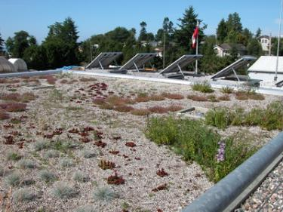
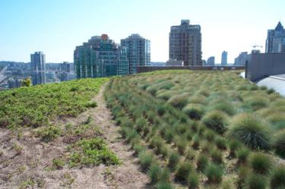
Buildings can help to sequester carbon.
The materials that you choose can help to reduce your carbon footprint.
Wood from certified renewable sources, wood harvested from your property, or wood salvaged from demolition and saved from the landfill can often be considered net carbon sinks.
Planting new trees can help to compensate for the carbon released during essential material transport
Incorporating green roofs and living walls can assist in carbon sequestration
Green roof at White Rock Operations Center, White Rock, B.C.
Green roof at Vancouver Public Library
Notes:
Buildings can help to sequester carbon.
The materials that you choose can help to reduce your carbon footprint.
Wood from certified renewable sources, wood harvested from your property, or wood salvaged from demolition and saved from the landfill can often be considered net carbon sinks.
Planting new trees can help to compensate for the carbon released during essential material transport
Incorporating green roofs and living walls can assist in carbon sequestration

Slide 38
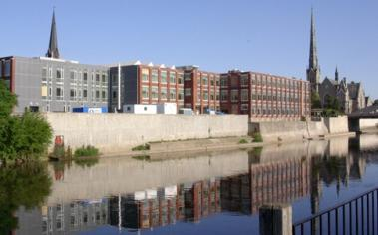
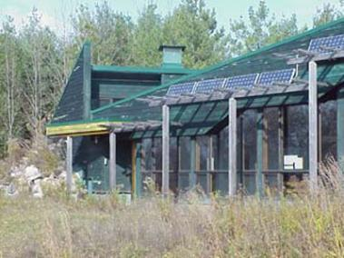
Reuse to reduce impact.
Reuse of a building, part of a building or elements reduces the carbon impact by avoidance of using new materials.
Make the changes necessary to improve the operational carbon footprint of an old building, before building new.
Is there an existing building or Brownfield site that suits your needs?
Can you adapt a building or site with minimal change?
Design for disassembly (Dfd) and eventual reuse to offset future carbon use
The School of Architecture at Waterloo is a reused factory on a remediated Brownfield site.
All of the wood cladding at the YMCA Environmental Learning Center, Paradise Lake, Ontario was salvaged from the demolition of an existing building.
Notes:
Reuse to reduce impact.
Reuse of a building, part of a building or elements reduces the carbon impact by avoidance of using new materials.
Make the changes necessary to improve the operational carbon footprint of an old building, before building new.
Is there an existing building or Brownfield site that suits your needs?
Can you adapt a building or site with minimal change?
Design for disassembly (Dfd) and eventual reuse to offset future carbon use
The School of Architecture at Waterloo is a reused factory on a remediated Brownfield site.
All of the wood cladding at the YMCA Environmental Learning Center, Paradise Lake, Ontario was salvaged from the demolition of an existing building.

Slide 39
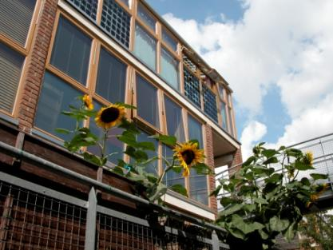
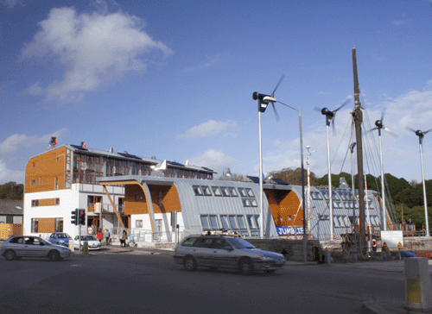
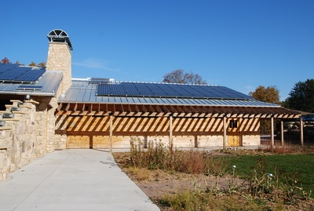
Towards Zero Energy \ Zero Carbon:
Early ZED
ZED
BEDZed
Carbon Neutral
Jubilee Wharf
Aldo Leopold Legacy Center
Notes:
Towards Zero Energy \ Zero Carbon:
We will now look at three building case studies. The first is BEDZed which is an early Zero Energy Design Building in the United Kingdom. The second is Jubilee Wharf which is a later Zero Energy Design building in the United Kingdom. The third is the Aldo Leopold Legacy Center which is a Carbon Neutral building in the United States of America.

Slide 40
Zero Energy Design
Notes:
Zero Energy Design

Slide 41
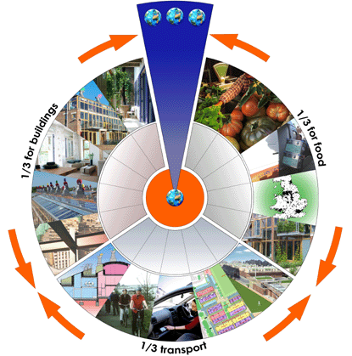
The ZEDfactory Philosophy…
Key to the necessary paradigm shift required to go ZED, is a re-visioning of priorities for design.
“Architects and engineers say
that reaching a zero-energy
goal necessarily requires a
much more integrated design
process than is typical for a
conventional building.”
Image credit: ZEDfactory
Current, unsustainable UK consumption
Notes:
ZEDfactory is the architectural firm that designed both BEDZed and Jubilee Wharf.
The ZEDfactory Philosophy…
The key to the necessary paradigm shift required to go ZED, is a re-visioning of priorities for design.
“Architects and engineers say
that reaching a zero-energy
goal necessarily requires a
much more integrated design
process than is typical for a
conventional building.”

Slide 42
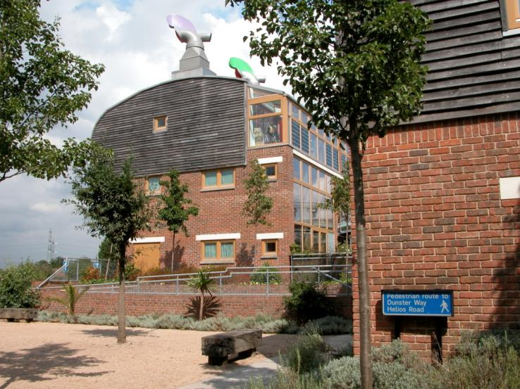
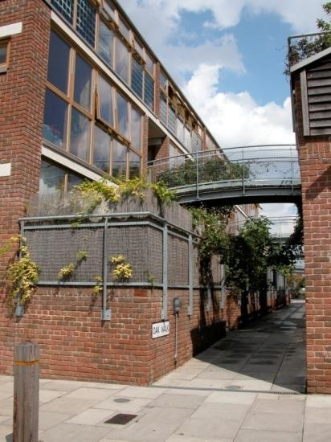
BedZED:
Beddington Zero Energy Development
BedZED, Hackbridge, England, was created as a partnership with the BioRegional Development Group, the Peabody Trust, Bill Dunster Architects, Arup, and Gardiner and Theobald. The 82 houses, 17 apartments, and 1,405 m² of workspace were built between 2000-02. An example of early ZED design.
Climate: temperate, inland
Notes:
BedZED:
Beddington Zero Energy Development
BedZED, Hackbridge, England, was created as a partnership with the BioRegional Development Group, the Peabody Trust, Bill Dunster Architects, Arup, and Gardiner and Theobald. The 82 houses, 17 apartments, and 1,405 m² of workspace were built between 2000-02. An example of early ZED design.
Climate: temperate, inland
Likely BEDZed is for most architects one of the first, if not THE first, Zero Energy Development that they may have come into contact with.
It was built in a bioclimatic zone that could be classified as temperate, so is very multi-seasonal and makes use of variability in the envelope to achieve comfort.

Slide 43
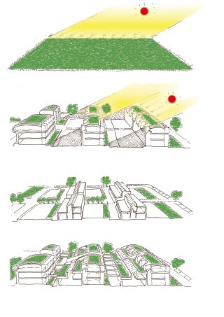
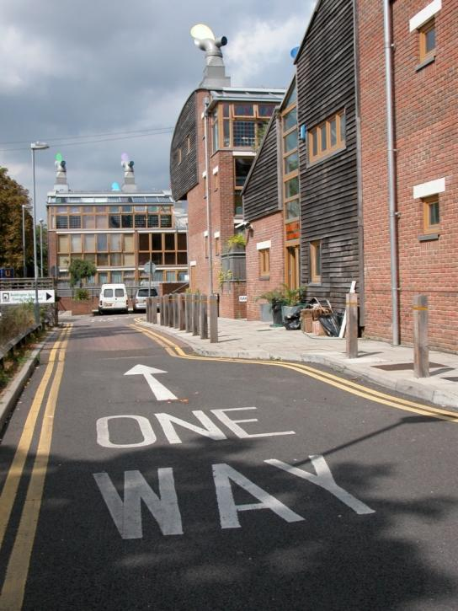
BedZED:
Beddington Zero Energy Development
Starts with basic sustainable principles of design:
ORIENTATION
very high environmental standards
high thermal insulation levels
triple glazed windows
sunlight / daylighting
solar energy (direct gain + PV)
reduction of energy consumption
natural ventilation
waste water recycling
strong emphasis on roof gardens
built from natural, recycled, or reclaimed materials
reduction in parking – pedestrian oriented
re-allocation of site/use distribution for community’s best interests
Source: Zedfactory
Notes:
BedZED:
Beddington Zero Energy Development
Starts with basic sustainable principles of design:
ORIENTATION
very high environmental standards
high thermal insulation levels
triple glazed windows
sunlight / daylighting
solar energy (direct gain + PV)
reduction of energy consumption
natural ventilation
waste water recycling
strong emphasis on roof gardens
built from natural, recycled, or reclaimed materials
reduction in parking – pedestrian oriented
re-allocation of site/use distribution for community’s best interests

Slide 44
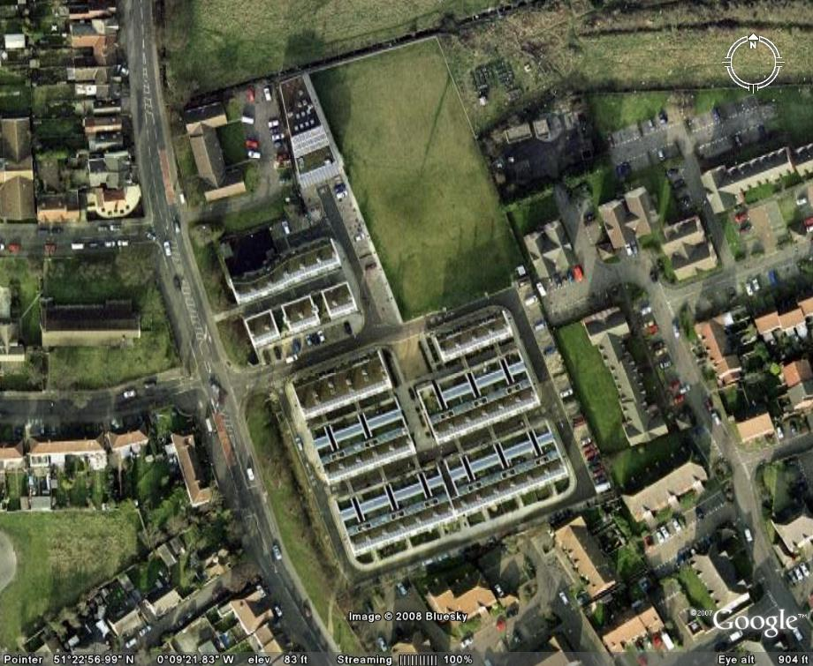
BedZED: Then goes for Zero Energy….
Density and General Site Strategies
#1.
The development uses a higher density than typical.
#2.
This separates parking from housing.
#3.
And consolidates significant green space.
Notes:
BedZED: Then goes for Zero Energy….
Density and General Site Strategies
#1.
The development uses a higher density than typical.
#2.
This separates parking from housing.
#3.
And consolidates significant green space.

Slide 45





BedZED:
Alternative Parking/Car Strategies
#1.
Designed to encourage alternatives to car use.
#2.
A green transport plan promotes walking, cycling, and use of public transport.
#3.
A car pool for residents has been established. BedZED’s target is a 50% reduction in fossil-fuel consumption by private car use over the next 10 years compared with a conventional development.
#4.
A “pedestrian first” policy with good lighting, drop curbs for prams (strollers) and wheelchairs, and a road layout that keeps vehicles to walking speed.
Notes:
BedZED:
Alternative Parking/Car Strategies
#1.
Was Designed to encourage alternatives to car use.
#2.
A green transport plan promotes walking, cycling, and use of public transport.
#3.
A car pool for residents has been established. BedZED’s target is a 50% reduction in fossil-fuel consumption by private car use over the next 10 years compared with a conventional development.
#4.
It has A “pedestrian first” policy with good lighting, drop curbs for prams (strollers) and wheelchairs, and a road layout that keeps vehicles to walking speed.

Slide 46




BedZED:
Landscape and Vegetation
#1.
Green space divided into large communal spaces + personal gardens/terraces.
#2.
Green space at grade assists in lowering overall overheating in summer.
#3.
Green space at the roof level is private, and also incorporates seedum roofs.
#4.
Vegetable and edible crops are encouraged.
Notes:
BedZED:
Landscape and Vegetation
#1.
The Green space is divided into large communal spaces + personal gardens/terraces.
#2.
The Green space at grade assists in lowering overall overheating in summer.
#3.
The Green space at the roof level is private, and also incorporates seedem roofs.
#4.
Vegetable and edible crops are encouraged.

Slide 47



BedZED:
Passive Solar Strategies
#1.
Uses passive solar techniques to maximize heat gain for cool months
#2.
Houses are arranged in south facing terraces to maximize direct solar gain
#3.
Glass is maximized on south face (minimized on north side to prevent losses).
Notes:
BedZED:
Passive Solar Strategies
#1.
BedZED Uses passive solar techniques to maximize heat gain for cool months
#2.
The Houses are arranged in south facing terraces to maximize direct solar gain
#3.
Glass is maximized on the south face for gain and minimized on north side to prevent losses.

Slide 48




BedZED:
Passive Cooling Strategies
#1.
Each terrace is backed by north facing offices, which reduces the tendency to overheat and the need for air conditioning.
#2.
Large quantities of operable windows encourage natural ventilation.
#3.
PV is used to shade windows.
#4.
Wind cowls direct ventilation flow.
No A/C is provided.
Notes:
BedZED:
Passive Cooling Strategies
#1.
Each terrace is backed by north facing offices, which reduces the tendency to overheat and the need for air conditioning.
#2.
Large quantities of operable windows encourage natural ventilation.
#3.
PV is used to shade windows.
#4.
Wind cowls direct ventilation flow.
No Air Conditioning is provided. The decision to eliminate this system guarantees less operational energy consumption in the project.

Slide 49


BedZED:
Non-fossil fuel heating for space and water
Once needs have been reduced passively…
#1.
A centralized heat and power plant (CHP) provides hot water, which is distributed around the site via a district heating system of super-insulated pipes.
#2.
The CHP plant at BedZED is powered by off-cuts from tree surgery waste that would otherwise go to landfill.
The target was for zero fossil fuel use.
Notes:
BedZED:
Non-fossil fuel heating for space and water
Once the energy needs have been reduced passively…
#1.
A centralized heat and power plant (CHP) provides hot water, which is distributed around the site via a district heating system of super-insulated pipes.
#2.
The CHP plant at BedZED is powered by off-cuts from tree surgery waste that would otherwise go to landfill.
This is not to say that using wood waste is necessarily good for the environment. Burning anything causes CO2 emissions. It is somewhat better as it is sourced from a waste product that is also renewable. There is some logic used here that infers that more trees will be planted to create wood to burn, therefore offsetting the carbon from the burnt wood waste.

Slide 50



BedZED:
Material choices
#1.
Embodied energy (a measure of the energy required to manufacture a product) was key in choosing materials.
#2.
They were sourced within a 35-mile radius of the site when possible, reducing transportation energy.
#3.
Recycled materials and high recycled content were key.
75 year minimum target design life.
Notes:
BedZED:
Material choices
#1.
Embodied energy (which is a measure of the energy required to manufacture a product) was key in choosing materials.
#2.
All products were sourced within a 35-mile radius of the site when possible, reducing transportation energy.
#3.
Recycled materials and high recycled content were key.
The target minimum design life was 75 years.

Slide 51



BedZED:
Generation of on Site Electricity
#1.
It was felt to be more efficient to generate electricity with the CHP facility.
#2.
PV panels were targeted at fueling electric vehicles.
#3.
PV was installed over 777m2 and was also used for shading.
Excess electricity is sold back to the grid.
Notes:
BedZED:
Generation of on Site Electricity
#1.
It was felt to be more efficient to generate electricity with the Combined Heat and Power facility.
#2.
PV panels were targeted at fueling electric vehicles.
#3.
PV was installed over 777m2 and was also used for shading.
Excess electricity is sold back to the grid.

Slide 52




BedZED:
Water Systems
Water use is carefully planned…
#1.
Rainwater is collected and used for irrigation and toilet flushing.
#2.
Black water is treated on site and cycled into the irrigation system.
#3.
Dual flush toilets reduce water consumption.
#4.
Shaped bathtubs reduce water requirement.
The target was to cut normal household use by 33%.
Notes:
BedZED:
Water Systems
Water use is carefully planned…
#1.
Rainwater is collected and used for irrigation and toilet flushing.
#2.
Black water is treated on site and cycled into the irrigation system.
#3.
Dual flush toilets reduce water consumption.
#4.
Shaped bathtubs reduce water requirement.
The target was to cut normal household use by 33%.

Slide 53

BedZED:
Waste Recycling
#1.
Waste recycling collection depots are located throughout the community.
#2.
Kitchens are outfitted with built in recycling storage.
#3.
On site composting.
The target was to reduce landfill waste by 66%.
Notes:
BedZED:
Waste Recycling
#1.
Waste recycling collection depots are located throughout the community.
#2.
Kitchens are outfitted with built in recycling storage.
#3.
There is also On site composting.
The target was to reduce landfill waste by 66%.

Slide 54



BedZED:
Integrated Design Process
KEY WORKING CONCEPT:
Such a complex design with delicately inter-layered, synergistic systemic requirements mandates use of the Integrated Design Process from the early concept stages of development.
Image credit: ARUP and Dunster
Zero emission design requires strict adherence to a philosophy of conservation and cooperation.
Notes:
BedZED:
Integrated Design Process
KEY WORKING CONCEPT:
Such a complex design with delicately inter-layered, synergistic systemic requirements mandates use of the Integrated Design Process from the early concept stages of development. ARUP Associates is a high end design firm that is famed for their implementation of this process.
Zero emission design requires strict adherence to a philosophy of conservation and cooperation.

Slide 55

The ZEDfactory Philosophy…
Post BEDZed, ZEDfactory has set a list of priorities that are now incorporated into most designs:
First consider the site, climate, solar angles
Use brownfields
Maximize density, while keeping green amenity space
Keep a loose fit to allow for change, adaptation over time
Design out the need to travel
Minimize thermal and electrical requirements as it is easier to save electricity than to generate it
Make an energy efficient envelope
Use efficient appliances
Use passive solar energy for heat and sun for daylighting
Use natural ventilation
Use wind cowls to assist natural ventilation
Generate maximum renewable energy from within the site boundaries
Incorporate wind turbines and PV
Allow for upgrade paths if not all systems can be installed
Use reclaimed or local materials
Notes:
The ZEDfactory Philosophy…
Post BEDZed, ZEDfactory has set a list of priorities that are now incorporated into most designs:
First consider the site, climate, solar angles
Use brownfields
Maximize density, while keeping green amenity space
Keep a loose fit to allow for change, adaptation over time
Design out the need to travel
Minimize thermal and electrical requirements as it is easier to save electricity than to generate it
Make an energy efficient envelope
Use efficient appliances
Use passive solar energy for heat and sun for daylighting
Use natural ventilation
Use wind cowls to assist natural ventilation
Generate maximum renewable energy from within the site boundaries
Incorporate wind turbines and PV
Allow for upgrade paths if not all systems can be installed
Use reclaimed or local materials
There is a very good book just published in 2008 on their work called the ZEDbook.

Slide 56



Jubilee Wharf: ZEDfactory
Architect: ZEDfactory
Location: Jubilee Wharf, Penryn, Cornwall
Client: Robotmother Ltd
Description: Mixed use with residential, workshops and nursery
Start / Completion: October 2004 - September 2006
Climate: temperate, coastal
Notes:
Jubilee Wharf: ZEDfactory
This is a more recent, somewhat smaller project by the same firm. It uses a similar methodology for design, with some minor modifications in the selection of systems. This coastal project uses wind and not PV for its electricity generation.
Architect: ZEDfactory
Location: Jubilee Wharf, Penryn, Cornwall
Client: Robotmother Ltd
Description: Mixed use with residential, workshops and nursery
Start / Completion: October 2004 - September 2006
Climate: temperate, coastal

Slide 57

Jubilee Wharf:
Integrated Design Process
The project begins with an integrated design approach that takes all of the key ZED concepts into account – from the beginning, starting with the sun, wind and climate.
Image credit: ZEDfactory
The IDP diagram provides the basis for decisions throughout the project. It reveals how the building has been zoned by use – intensive residential use on the left, and occasional use on the right. This makes better use of the systems and site.
Notes:
Jubilee Wharf:
Integrated Design Process
The IDP diagram provides the basis for decisions throughout the project. It reveals how the building has been zoned by use – intensive residential use on the left, and occasional use on the right. This makes better use of the systems and site.
The project begins with an integrated design approach that takes all of the key ZED concepts into account – from the beginning, starting with the sun, wind and climate.
Although ARUP was not the engineer for this project, you can see a similarity in the diagram of the integrated design process.

Slide 58


Jubilee Wharf:
Key Strategies List | Site and Community
Brownfield Site –
The site was previously occupied by a coal yard.
Community creation & revitalization - a hub for craft makers, quality childcare onsite, health & fitness classes, café for socializing.
Pedestrian and public transit oriented - good public transport links, located in central Penryn for easy pedestrian access.
Image credits: ZEDfactory
Notes:
Jubilee Wharf:
Key Strategies List | Site and Community
Brownfield Site –
The site was previously occupied by a coal yard.
Community creation & revitalization was a goal – the building was to become a hub for craft makers, quality childcare onsite, health & fitness classes, café for socializing.
The project was Pedestrian and public transit oriented – There are good public transport links, and it is located in central Penryn for easy pedestrian access.

Slide 59

Jubilee Wharf:
Key Strategies List | Envelope
Super Insulation –
300mm insulation reduces energy consumption to less than half a conventional building. This level of efficiency is necessary to reduce consumption and make fossil fuel avoidance possible.
Thermal Mass –
The interior surfaces are made from concrete block, concrete and plaster so that heat is stored efficiently.
Air Tightness –
The interior surfaces are parged with plaster, making sure to seal all cracks between joining materials.
Image credit: ZEDfactory
Notes:
Jubilee Wharf:
Key Strategies List for the Building Envelope
This list can become the basis for improving energy efficiency for any and all cool to cold climate buildings!
Super Insulation –
300mm insulation reduces energy consumption to less than half a conventional building. This level of efficiency is necessary to reduce consumption and make fossil fuel avoidance possible.
Thermal Mass –
The interior surfaces are made from concrete block, concrete and plaster so that heat is stored efficiently.
Air Tightness –
The interior surfaces are parged with plaster, making sure to seal all cracks between joining materials.

Slide 60

Jubilee Wharf:
Key Strategies List | Reclaimed Materials
Using local & reclaimed materials - old floorboards, granite, Cornish cedar cladding and larch soffits, and some unused windows from BedZed
For example:
The ceiling of the Yoga space is made of reclaimed
floorboards from a Victorian house. The boards have not been
changed but simply treated and cut to
length.
Image credit: ZEDfactory
Notes:
Jubilee Wharf:
Key Strategies List | Reclaimed Materials
Using local & reclaimed materials is important to lower embodied and associated transportation energy - old floorboards, granite, Cornish cedar cladding and larch soffits, and some unused windows from BedZed.
For example:
The ceiling of the Yoga space is made of reclaimed
floorboards from a Victorian house. The boards have not been
changed but simply treated and cut to
length.

Slide 61


Jubilee Wharf:
Key Strategies List | Healthy Materials
Healthy materials - low VOC paints, low formaldehyde floor coverings, natural fibers & surfaces, PVC only where unavoidable – with emphasis on creating a healthy environment.
Notes:
Jubilee Wharf:
Key Strategies List | Healthy Materials
Healthy materials were chosen, such as low VOC paints, low formaldehyde floor coverings, natural fibers & surfaces, PVC only where unavoidable – with emphasis on creating a healthy environment.

Slide 62


Jubilee Wharf:
Key Strategies List | Energy and Systems
Passive solar heating –
The sun space faces south and is used as a buffer space. In cold months the thermal mass heats up. In hot months the space can be closed off to keep the interior cool. It also shades the interior space.
Daylighting –
Window placement makes use of natural light.
Image credits: ZEDfactory
Notes:
Jubilee Wharf:
Key Strategies List | Energy and Systems
Passive solar heating –
The sun space faces south and is used as a buffer space. In cold months the thermal mass heats up. In hot months the space can be closed off to keep the interior cool. It also shades the interior space.
Daylighting –
Window placement makes use of natural light.

Slide 63

Jubilee Wharf:
Key Strategies List | Energy and Systems
Natural ventilation –
Wind cowls ventilate without the need for electric fans.
Being passive it uses no electricity.
This displacement ventilation provides fresh air at low level and extracts air at the high level when the temperature of the air in the room has risen.
The cowl turns to face the wind drawing fresh air in via a heat exchanger which warms the incoming air with the outgoing air.
The heat exchanger is 70 - 80% efficient and minimizes heat loss from the building while providing a constant supply of fresh air.
Image credit: ZEDfactory
Notes:
Jubilee Wharf:
Key Strategies List | Energy and Systems
Natural ventilation –
Wind cowls ventilate without the need for electric fans.
Being passive it uses no electricity.
This displacement ventilation provides fresh air at low level and extracts air at the high level when the temperature of the air in the room has risen.
The cowl turns to face the wind drawing fresh air in via a heat exchanger which warms the incoming air with the outgoing air.
The heat exchanger is 70 - 80% efficient and minimizes heat loss from the building while providing a constant supply of fresh air.

Slide 64

Jubilee Wharf:
Key Strategies List | Energy and Systems
Solar panels –
The project uses evacuated tubes for water heating – one panel per residence.
Photovoltaics –
Photovoltaic cells were not included in the original budget but provisions have been made for them to be fitted later.
Reduced water consumption –
Low flush toilets, aerated taps, grade “A” consumption appliances.
Image credits: ZEDfactory
Notes:
Jubilee Wharf:
Key Strategies List | Energy and Systems
Solar panels –
The project uses evacuated tubes for water heating – one panel per residence.
Photovoltaics –
Photovoltaic cells were not included in the original budget but provisions have been made for them to be fitted later.
Reduced water consumption –
Low flush toilets, aerated taps, and grade “A” consumption appliances help to reduce water use.

Slide 65



Jubilee Wharf:
Key Strategies List | Energy and Systems
Biomass heating –
Under floor heating and hot water from a 75kW wood pellet boiler.
Onsite micro generation –
4 x 6kW Proven wind turbines provide most of the electricity – giving back to the grid or drawing from as required.
Image credits: ZEDfactory
Notes:
Jubilee Wharf:
Key Strategies List | Energy and Systems
Biomass heating –
The project uses Under floor heating and hot water from a 75kW wood pellet boiler.
Onsite micro generation –
4 x 6kW Proven wind turbines provide most of the electricity – giving back to the grid or drawing from as required.

Slide 66
Looking at the Potential for Carbon Neutral in LEEDTM
Notes:
Looking at the Potential for Carbon Neutral in LEEDTM

Slide 67

What is LEED?
The Leadership in Energy and Environmental Design (LEED™) Green Building Rating System is an assessment tool that is currently being promoted throughout North America and the world for the evaluation and promotion of sustainable design.
The goal of LEED™ is to initiate and promote practices, which limit the negative impact of buildings on the environment and occupants.
Notes:
What is LEED?
The Leadership in Energy and Environmental Design (LEED™) Green Building Rating System is an assessment tool that is currently being promoted throughout North America and the world for the evaluation and promotion of sustainable design.
The goal of LEED™ is to initiate and promote practices, which limit the negative impact of buildings on the environment and occupants. The design guideline is intended to prevent exaggerated or false claims of sustainability and to provide a standard of measurement of and between buildings. It creates a working definition of “green building”, LEED promotes integrated, whole-building integrated design practices (IDP).

Slide 68
The Idea of LEEDTM
Scores are tallied for different aspects of efficiency and design in appropriate categories.
For instance, LEED assesses in detail:
1. Site Planning
2. Water Management
3. Energy Management
4. Material Use
5. Indoor
Environmental
Air Quality
6. Innovation &
Design Process
LEED was designed to holistically look at sustainable building and transform the market. It is a voluntary system. Assessment is based upon credits earned.
LEADERSHIP in
ENERGY and
ENVIRONMENTAL
DESIGN
A leading-edge system for certifying
DESIGN, CONSTRUCTION, & OPERATIONS
of the greenest buildings in the world
Notes:
The Idea of LEED
LEED was designed to holistically look at sustainable building and transform the North American market. Unlike a Building Code which is required by law to be used, it is a completely voluntary system. The assessment is based upon credits earned in 6 categories.
As it is voluntary it was designed to be attractive to potential commercial clients and owners. The LEED “brand” is now known across the country and is seen as a selling feature for buildings.
LEED stands for – Leadership in Energy and Environmental Design and is the leading green building rating system in the both Canada and the United States.
As LEED seems to have become the basis for Sustainable Design in North America, we need to look at it very closely to see how we can USE LEED to leverage our buildings into a state of Carbon Neutrality.

Slide 69


Sustainable Sites: 20% : 14/70 points
deals primarily with issues of site selection, site access and site design (materials, density, drainage). The prerequisite concerns erosion and sedimentation control on site. There are eight credits offering a total of 14 potential points. The development of sustainable site design is seen as a critical starting point for an attitude towards the entire building design in the Integrated Design Process.

Slide 71

Water Efficiency: 7% : 5/70 points
is the smallest section comprising only three credits, worth 5 points. This section deals with landscaping, wastewater treatment and water use reduction. Items such as Living Machines™, use of the Waterloo Biofilter™, waterless urinals and composting toilets can be rewarded with points in this category.

Slide 73

Energy and Atmosphere: 25% : 17/70 points
includes three prerequisites – fundamental building systems commissioning, minimum energy performance, and CFC reduction in HVAC&R equipment. The prerequisites are followed by six credits for energy performance, renewable energy and additional building monitoring, with a potential value of eight points.

Slide 75
Energy and Atmosphere: 25% : 17/70 points cont’d
Prior to the adoption of LEED, energy efficiency was the only motivation to improving design strategies! It did succeed in effecting:
increased levels of insulation,
higher efficiency ratings on appliances and heating/cooling systems
tighter building envelopes
Within the holistic sustainable design framework provided by LEED, the relative importance of these issues has been revised to represent only 25% of the potential credits.

Slide 76

Materials and Resources: 20% : 14/70 points
with 14 points generated in seven credits, this section has only one prerequisite: storage and collection of recyclables. The credits focus on building reuse; waste management; reused, recycled or certified materials; as well as local or regional materials.
LEED Canada has introduced a new credit in this category to recognize the importance of building durably.

Slide 77
Credit 8: Durable Building
“Minimize materials use and construction waste over a building’s life resulting from premature failure of the building and its constituent components and assemblies”
promotes the incorporation of materials based upon a Life Cycle Assessment viewpoint
credit references the Guideline on Durability in Buildings CSA S478-95 (R2001)
If components cannot be proven to last for the design service life of the building, then they are to be specified and constructed with disassembly in mind
demonstrate the predicted service life of chosen components or assemblies by documenting demonstrated effectiveness or modelling deterioration
submittals require documentation of the training of the building envelope designer in the area of building science

Slide 78
Just added in LEED Canada V1, Credit 8: Durability, making the total a score out of 70.

Slide 79

Indoor Environmental Quality: 22% : 15/70 points
is the largest category with two prerequisites, IAQ performance and environmental tobacco smoke control, eight credits and a total of 15 points. The credits in the indoor environment quality cover many issues of air quality, including ventilation and carbon dioxide monitoring, low-emitting materials, construction IAQ, controllability of systems, operable windows, thermal comfort and daylight and view access. This category places high emphasis on occupant comfort and well-being – issues that are not addressed in other mandatory code requirements – this category falling outside issues of life safety, structural integrity and minimum energy requirements.
(Indoor Environmental Quality is not addressed in the Building Code to any extent, so many commercial and institutional buildings ignore this requirement completely)

Slide 81

Innovation and Design Process: 7% : 5/70 points
allows a building to obtain as many as four design innovation points, as well as one additional point for including a LEED accredited professional in the design process. The design innovation points may be awarded for achievements such as lifecycle analysis, community development or education of occupants. Substantially exceeding one of the earlier credits, may also merit an innovation point.

Slide 82
This is likely the trickiest set of credits to get… and the ones that involve the greatest commitment of effort (aside from Credit 2 which is a no-brainer!)

Slide 83

Innovation and Design Process
York University Computer Science Building: A critical part of the success of this project was the involvement of the ENTIRE design team from the outset of the project. Working with the mechanical engineer allowed the Architects to lay out the building to properly zone the uses so to have heat generating process on the cool side of the building, etc.

Slide 84


The realization of the shape of the building and the relationships between the spaces was not remarkably dissimilar from the early IDP sketches generated by the team.

Slide 85

LEED-NC® Certification Process
A three step process:
  Step 1: Project Registration
      LEED Letter Templates, CIR access, and on-line project listing
  Step 2: Technical Support
      Reference Package
      Credit Inquiries and Rulings (CIR)
  Step 3: Building Certification
      Upon documentation submittal and USGBC review
Notes:
LEED is a registered trademark of USGBC. Only buildings certified by USGBC under the LEED Green Building Rating System may refer to themselves as LEED buildings. The certification process involves the following:
Register the Project to initiate a relationship with USGBC and receive orientation materials. Registration during pre-design phase is highly recommended.
Technical Support comes in the form of the Reference Guide and Credit Rulings. In some cases, the design team may encounter questions about the application of a LEED prerequisite or credit to the specifics of their project. The project contact should first thoroughly consult the Reference Guide. If questions remain, the contact should use the following credit interpretation procedure:
The project contact reviews the intent of the credit or prerequisite in question to self-evaluate whether their project meets this intent.
The project contact reviews the LEED Credit Rulings Page for a previously logged credit interpretation request (CIR) that may assist in answering their particular question. All LEED project contacts have access to this page.
If no similar or relevant credit interpretation has been logged, then the project contact may submit an on-line CIR to the USGBC.
Within two to five weeks, the USGBC Credit Ruling Committee posts its decision on the Credit Rulings Page.
Apply for certification. Application review can take anywhere from six weeks to several months. There are several opportunities for response and appeal throughout the review stages (administrative, preliminary technical, and final technical reviews).

Slide 86

Comparisons are the key to understanding the relative effectiveness of certain design strategies.
Notes:
This is a graph that shows the comparative energy use of a series of office buildings constructed in Vancouver, Canada. At the time of the construction of all of theses buildings, ASHRAE 90.1 was considered to be the typical target for performance. You can see how much lower the consumption can be if a building really works at improving its performance.
Comparisons are the key to understanding the relative effectiveness of certain design strategies.

Slide 87
Why Was LEED® Created?
Facilitate positive results for the environment, occupant health and financial return
Define “green” by providing a standard for measurement
Prevent “greenwashing” (false or exaggerated claims)
Promote whole-building, integrated design processes
  Use as a design guideline
  Recognize leaders
  Stimulate green competition
  Establish market value with recognizable national “brand”
  Raise consumer awareness
  Transform the marketplace!
Notes:
Why Was LEED® Created?
Facilitate positive results for the environment, occupant health and financial return
Define “green” by providing a standard for measurement
Prevent “greenwashing” (false or exaggerated claims)
Promote whole-building, integrated design processes
Use as a design guideline
To Recognize leaders
To Stimulate green competition
To Establish market value with recognizable national “brand”
To Raise consumer awareness
To Transform the marketplace!

Slide 88

Buildings are accredited by the number of points gained:
26 to 32 point is LEED certified;
33 to 38 points is LEED Silver;
39 to 51 is LEED Gold, and;
LEED Platinum is awarded to projects with 52 or more points.
Notes:
LEED Rewards
The LEED assessment system is comprised of a checklist system that is subdivided into categories and credits.
In the Canadian LEED system for New Construction there are 70 possible points to be earned. Buildings are awarded based upon their level of certification. The highest level is Platinum, and is given for buildings that achieve from 52 to 70 out of a possible 70 points. Gold is given for 39 to 51 points. Silver is given for 33 to 38 points. Bronze or Certified is given for buildings that achieve 26 to 32 points. There are a number of municipalities and governments that have made LEED Silver or Gold certification a requirement for all new government buildings.
The United States has just recently changed their LEED System with LEED 2009. The credit system is changed from what is shown above.

Slide 89
Comparing Carbon Neutral to LEEDTM
LEEDTM is a holistic assessment tool that looks at the overall sustainable nature of buildings within a prescribed rating system to provide a basis for comparison – with the hopes of changing the market
Projects are ranked from Certified to Platinum on the basis of credits achieved in the areas of Sustainable Sites, Energy Efficiency, Materials and Resources, Water Efficiency, Indoor Environmental Quality and Innovation in Design Process
LEEDTM does not presently assess the Carbon value of a building, its materials, use of energy or operation
A high LEEDTM rating can be used as the basis for considering extending performance to Zero Carbon.
Notes:
Comparing Carbon Neutral to LEEDTM
LEEDTM is a holistic assessment tool that looks at the overall sustainable nature of buildings within a prescribed rating system to provide a basis for comparison – with the hopes of changing the market.
The projects are ranked from Certified to Platinum on the basis of credits achieved in the areas of Sustainable Sites, Energy Efficiency, Materials and Resources, Water Efficiency, Indoor Environmental Quality and Innovation in Design Process.
LEEDTM (Canada Version 1) does not presently assess the Carbon value of a building, its materials, use of energy or operation. There is talk of beginning to include some carbon calculations, but this is a long way from being implemented.
However, a high LEEDTM rating can be used as the basis for considering extending performance to Zero Carbon.

Slide 90
LEED does not go far enough!
LEED is a good start for holistic sustainable design
It is encouraging owners and developers to create better buildings
BUT you can get a GOLD plaque and still have a building that is high in CARBON and uses a lot of energy
We need to go for certain points to begin to look for Carbon Neutral Design!
Notes:
LEED does not go far enough!
LEED is a good start for holistic sustainable design
It is encouraging owners and developers to create better buildings
BUT you can get a GOLD plaque and still have a building that is high in CARBON and uses a lot of energy
We need to go for certain points to begin to look for Carbon Neutral Design!

Slide 91


Only 25% of the LEED credits are devoted to energy.
Of those, 10/70 are for optimization.
Maximum reduction is 60%.
Most LEED buildings earn less than 5 of these credits…..
And the first aim of Carbon Neutral Design is to achieve 100% reduction…
Scorecard for National Works Yard in Vancouver, LEEDTM Gold
Notes:
The KEY difference between the objectives of LEED and those of carbon neutrality is the emphasis on energy credits. In LEED only 25% of the credits are devoted to Energy. Of those only 10 out of the total 70 are for optimization of the energy, and the maximum reduction target is 60%. Sadly a survey of LEED buildings would indicate that in the LEED Gold and Platinum categories most buildings earn less than 5 of these credits. This would indicate that even high scoring “green” buildings are not focusing their efforts towards energy efficiency. The aim of a carbon neutral design is to achieve 100% reduction of the requirements to use fossil fuels for energy.
Pictured is the LEED scorecard for the National Works Yard in Vancouver showing the Energy and Atmosphere score. This building scored quite high in the EA category. But you can see that it did not manage to score any points for the use of renewable energy. So even with Optimized Performance at close to 50%, would still be requiring significant use of regular energy to heat and cool the building.

Slide 92


Aldo Leopold Legacy Center
Baraboo, Wisconsin
A high LEEDTM rating can be used as the basis for considering extending performance to Zero Carbon.
The Kubala Washatko Architects
LEEDTM Platinum 2007
LEEDTM Platinum - Carbon Neutral
Technical information from Prof. Michael Utzinger, University of Wisconsin-Milwaukee
Notes:
Aldo Leopold Legacy Center in Baraboo, Wisconsin was designed by Kubala Washatko Architects and awarded LEED Platinum in 2007. It is also a carbon neutral building.
This section of the presentation will demonstrate how a high LEEDTM rating can be used as the basis for considering extending performance to Zero Carbon.
The technical information in this part of the presentation is from Prof. Michael Utzinger, University of Wisconsin-Milwaukee. Professor Utzinger was involved in the design of the energy systems in this building to achieve the carbon neutral balance.
Diagrammatic images are courtesy of Professor James Wasley of the University of Wisconsin-Milwaukee and investigative work carried out by his students for the Carbon Neutral Design Project.
www.aia.org/carbonneutraldesignproject

Slide 93

Location of the Case Study
Aldo Leopold Legacy Center
Climate:
7789ºF Heating Degree Days (4309ºC Degree Days)
822ºF Cooling Degree Days (439ºC Degree Days)
Notes:
Location of the Case Study
The Aldo Leopold Legacy Center is located in the mid western United States. It gets very cold during the winter and snows. It is fairly warm and humid during the summer months.
Climate:
7789ºF Heating Degree Days (4309ºC Degree Days)
822ºF Cooling Degree Days (439ºC Degree Days)

Slide 94
Leopold Approach to Carbon Neutral Design
  Design a Net Zero (Operating Energy) Building
  Apply Carbon Balance to Building Operation
  (Ignore Carbon Emissions due to
  Construction)
  Include Carbon Sequestration in Forests
  Managed by Aldo Leopold Foundation
  Design to LEEDTM Platinum (as well)
  with 2 unique starting points…
Notes:
The Leopold Approach to Carbon Neutral Design
The designers of the Aldo Leopold Centre went into the project with the following clear goals:
Design a Net Zero Building in terms of Operating Energy
Apply a Carbon Balance to Building Operation (Ignoring Carbon Emissions due to Construction)
Include Carbon Sequestration in Forests that are managed by Aldo Leopold Foundation
Design to LEEDTM Platinum (as well)
with 2 unique starting points…

Slide 95


#1 - Net Zero Energy Design
Establish solar budget:
3,000 photovoltaic array;
50,000 kWh per year
Set maximum building
energy demand to fall
within solar budget:
8,600 Sq. Ft. building;
5.7 kWh per SF per year
Renewables + Site Generation
A $US250,000 PV array was included at the outset of the project budget and the building was designed to operate within the amount of electricity that this would generate.
Notes:
#1 – Net Zero Energy Design
So, a $US250,000 PV array was included at the outset of the project budget and the building was designed to operate within the amount of electricity that this would generate. In a way, the entire building was sized and designed based on the initial decision to set aside $250,000 to purchase this array.
The sold red shows the PV array as it sits on the south facing roof slope. You can see that it pretty well covers the entire roof. The little orange rectangle is the solar hot water unit.
This approach fits into the “renewables and site energy” area of CN design.

Slide 96

#2 - Site Harvested Lumber:
Embodied Carbon in Building Materials
The building was designed around the size and quantity of lumber that could be sustainably harvested from the Leopold Forest.
Notes:
#2 - Site Harvested Lumber:
The building was designed around the size and quantity of lumber that could be sustainably harvested from the Leopold Forest. This addressed the issue of embodied carbon in the building materials as well as minimizing transportation associated carbon emissions.
The lumber had to be harvested when the ground was frozen to minimize damage to the forest floor. The lumber was milled on site, sorted and sized. The structural engineer then assessed the product and designed the structural system for the building based on the dimensions and quantity of material.
As you can see in the photo, some of the timbers were left with a rough finish, which not only cut down on labour and energy, but also fit in with the rural character of the building.

Slide 97

Climate Analysis
Notes:
A complete climate analysis was conducted prior to commencing the design.

Slide 98

Site Analysis
Notes:
The solar aspects of the site were studied in order to maximize the solar potential for heating the building and powering the PhotoVoltaics.

Slide 99


Architectural Design Strategies
Start with bioclimatic design
Program Thermal Zones
All perimeter zones (no interior zones – skin load dominated building)
Daylight all occupied zones
Natural ventilation in all occupied zones
Double code insulation levels
Passive solar heating
Shade windows during summer
Passive Heating
Passive Cooling
Notes:
The following Architectural Design Strategies were used:
- Start with bioclimatic design (Wisconsin is pretty cold with heating degree days at 7789ºF and cooling degree days at 822ºF)
Side note: Heating and Cooling Degree days are used to measure the normal summative deviation of the temperature of a climate from 18C or 68F. The higher the number, the more severe the climate.
Program the Thermal Zones of the building
Design for all perimeter zones with no interior zones. This makes it a skin load dominated building which puts emphasis on the design of the envelope for heating, cooling and ventilation as most rooms are outside rooms.
Daylight all occupied zones.
Natural ventilation should be available in all occupied zones.
Double the code required insulation levels in all of the exterior walls to make them more resistant to heat transfer.
Use Passive solar heating to heat the building to the maximum amount possible.
Shade the windows during summer to cut down on overheating.

Slide 100

Thermal Zones ~ Perimeter Zones
Keep the buildings thin to allow for maximum daylight and use of solar for passive heating.
Notes:
The buildings were kept thin to allow for maximum daylight and use of solar for passive heating.

Slide 101


Passive Solar Heating
The concrete floor in the hall is used with direct gain to store heat
Large doors are opened to allow transfer to occupied spaces
Daytime
Nighttime
Notes:
Passive Solar Heating
The concrete floor in the hall is used with direct gain to store heat
Large doors are opened to allow transfer to occupied spaces.

Slide 102



Passive Cooling:
Shade Windows During Summer
Summer sun
May 9, 2007
3:45 pm CDT
Summer sun
Winter sun
Winter sun
Basic first tier principle of HEAT AVOIDANCE.
Notes:
Passive Cooling used the basic principle of HEAT AVOIDANCE. Simple roof overhangs are used to shade the windows from the summer sun.

Slide 103


Natural Ventilation
Natural ventilation strategy based on NO A/C provision for the building
Operable windows
Flow through strategy
Insect screens to keep out pests
Notes:
Natural Ventilation
The Natural ventilation strategy was based on NO A/C provision for the building.
- The project has operable windows
- The project uses a flow through strategy
- There are insect screens to keep out pests (mostly mosquitoes, moths and wasps)

Slide 104
HVAC Strategies
Ventilate only to Occupant outdoor air requirements (2/3 ACH)
100% Outdoor air (no recirculation)
Earth tube air pretreatment
Demand Control Ventilation (600 to 2,500 cfm)
Separate ventilation from heating and cooling
Radiant floor slabs for heating and cooling
Use ground as heat source & sink (ground source heat pumps)
Storage tank as thermal capacitor between heat pumps & load
Seasonal change-over system
Solar heated service hot water
Notes:
HVAC Strategies
Ventilate only to Occupant outdoor air requirements (2/3 air changes per hour)
100% Outdoor air (no recirculation)
Earth tubes were used for air pretreatment
Demand Control Ventilation (600 to 2,500 cfm)
Separate ventilation from heating and cooling
Radiant floor slabs for heating and cooling
Use ground as heat source & sink (ground source heat pumps)
Storage tank as thermal capacitor between heat pumps & load
Seasonal change-over system
Solar heated service hot water

Slide 105


Earth Duct for Air Pretreatment
Installation of large earth ducts to preheat and precool the air.
Notes:
These are the large earth ducts that are used to pre heat or pre cool the air.

Slide 106



Radiant Heating and Cooling
Concrete floor slabs are used for heating and cooling.
Diagram of radiant cooling system.
Diagram showing radiant heating system.
Notes:
These diagrams show the radiant heating and cooling systems that work with the concrete floor slabs. Although concrete is very high in embodied energy, it is a very valuable material in Carbon Neutral Design for its use as THERMAL MASS.
The project uses geothermal exchange to assist with heating and cooling through the floor slabs of the building.

Slide 107


Ground Source Heat Pumps
Super insulate hot water runs to minimize heat losses.
Notes:
Super insulation on the piping reduces losses. It is critical to build excellently and to prevent energy losses as renewable energy is more difficult to come by.

Slide 108


Daylight All Occupied Zones
Electric lights are only ON when there is insufficient daylight.
Notes:
A thin building plan allows you to light all perimeter zones with daylight and avoid the use of electrical lighting. It is important to also use light level and occupant sensors with this system.

Slide 109



Three Season Hall
A large room designed NOT to be used in the winter when the weather is too severe to allow heating by a combination of passive + fireplace
Notes:
This large room is only used in the spring, summer and fall when heating is not really required. They have a wood burning fireplace for when it gets chilly.

Slide 110

Forest Management &
Sustainable Harvest
Before Harvest
After Harvest
Notes:
The Aldo Leopold Center used sustainable practices when they were harvesting their wood. The harvest would actually make the forest healthier than before.

Slide 111

Aldo Leopold Center LEEDTM Analysis
12/14 Sustainable Sites
5/5 Water Efficiency
17/17 Energy and Atmosphere
7/13 Materials and Resources
15/15 Indoor Environmental Quality
5/5 Innovation and Design Process
61/69 Total
For more detailed info on the Leopold Center, visit
http://www.aldoleopold.org/legacycenter/carbonneutral.html
and
http://leedcasestudies.usgbc.org/overview.cfm?ProjectID=946
Notes:
Aldo Leopold Center LEEDTM Analysis
The LEED score for the building is as follows:
12/14 Sustainable Sites
5/5 Water Efficiency
17/17 Energy and Atmosphere
7/13 Materials and Resources
15/15 Indoor Environmental Quality
5/5 Innovation and Design Process
61/69 Total
This is one of the highest LEED scores to date. It is one of the ONLY buildings to ever score ALL 17/17 Energy and Atmosphere points.
Interestingly, if you just look at the architectural design of the building, you might peg it as being roughly the same as Islandwood….
For more detailed info on the Leopold Center, visit
http://www.aldoleopold.org/legacycenter/carbonneutral.html
and
http://leedcasestudies.usgbc.org/overview.cfm?ProjectID=946

Slide 112
Operating Energy of Building
Landscape
+ Site
Disturbance vs. sequestration
80% of the problem!
Embodied Carbon in Building Materials
Renewables + Site Generation
People, “Use” + Transportation
Counting Carbon costs….
+ purchased offsets
Notes:
The colour code represented in this slide will be used to talk about the carbon potential of the LEED points earned.

Slide 113
Sustainable Sites, 12 of 14 possible points
  SS Prerequisite 1, Erosion & Sedimentation Control
  SS Credit 1, Site Selection
  SS Credit 3, Brownfield Redevelopment
  SS Credit 4.2, Alternative Transportation, Bicycle Storage & Changing Rooms
  SS Credit 4.3, Alternative Transportation, Alternative Fuel Refueling Stations
  SS Credit 4.4, Alternative Transportation, Parking Capacity
  SS Credit 5.1, Reduced Site Disturbance, Protect or Restore Open Space
  SS Credit 5.2, Reduced Site Disturbance, Development Footprint
  SS Credit 6.1, Stormwater Management, Rate and Quantity
  SS Credit 6.2, Stormwater Management, Treatment
  SS Credit 7.1, Landscape & Exterior Design to Reduce Heat Islands, Non-Roof
  SS Credit 7.2, Landscape & Exterior Design to Reduce Heat Islands, Roof
  SS Credit 8, Light Pollution Reduction
Landscape
+ Site
People, “Use” + Transportation
Landscape
+ Site
Operating energy
Notes:
Aldo Leopold in the category Sustainable Sites, scored 12 of 14 possible points
These were:
SS Prerequisite 1, Erosion & Sedimentation Control
SS Credit 1, Site Selection
SS Credit 3, Brownfield Redevelopment
SS Credit 4.2, Alternative Transportation, Bicycle Storage & Changing Rooms
SS Credit 4.3, Alternative Transportation, Alternative Fuel Refueling Stations
SS Credit 4.4, Alternative Transportation, Parking Capacity
SS Credit 5.1, Reduced Site Disturbance, Protect or Restore Open Space
SS Credit 5.2, Reduced Site Disturbance, Development Footprint
SS Credit 6.1, Stormwater Management, Rate and Quantity
SS Credit 6.2, Stormwater Management, Treatment
SS Credit 7.1, Landscape & Exterior Design to Reduce Heat Islands, Non-Roof
SS Credit 7.2, Landscape & Exterior Design to Reduce Heat Islands, Roof
SS Credit 8, Light Pollution Reduction
The credits for Brownfield development and reduced site disturbance contributed to CN design in terms of “landscape and site” requirements.
The credits for Alternative Transportation contributed to gains in the “people, use and transportation” aspect of CN design. Interestingly the original Centre was located about 30 miles down the road. Everyone could walk or bicycle to work. As the new building was remote to the workers, the designers felt it necessary to design the carbon balance of the project to be able to offset this additional transportation cost to the environment.
The credits for Heat Island have the net benefit of creating a cooler microclimate and reducing the A/C load. This reduces the power that will be required if conventional Air Conditioning systems are used, and if using passive means, make it easier to achieve comfort levels for the occupants.

Slide 114
Energy and Atmosphere, 17 of 17 possible points
  EA Prerequisite 1, Fundamental Building Systems Commissioning
  EA Prerequisite 2, Minimum Energy Performance
  EA Prerequisite 3, CFC Reduction in HVAC&R Equipment
  EA Credit 1.1a, Optimize Energy Performance, 15% New 5% Existing
  EA Credit 1.1b, Optimize Energy Performance, 20% New 10% Existing
  EA Credit 1.2a, Optimize Energy Performance, 25% New 15% Existing
  EA Credit 1.2b, Optimize Energy Performance, 30% New 20% Existing
  EA Credit 1.3a, Optimize Energy Performance, 35% New 25% Existing
  EA Credit 1.3b, Optimize Energy Performance, 40% New 30% Existing
  EA Credit 1.4a, Optimize Energy Performance, 45% New 35% Existing
  EA Credit 1.4b, Optimize Energy Performance, 50% New 40% Existing
  EA Credit 1.5a, Optimize Energy Performance, 55% New 45% Existing
  EA Credit 1.5b, Optimize Energy Performance, 60% New 50% Existing
  EA Credit 2.1, Renewable Energy, 5%
  EA Credit 2.2, Renewable Energy, 10%
  EA Credit 2.3, Renewable Energy, 20%
  EA Credit 3, Additional Commissioning
  EA Credit 4, Ozone Depletion
  EA Credit 5, Measurement and Verification
  EA Credit 6, Green Power
Operating energy
Renewables + Site Generation
Notes:
The Aldo Leopold Legacy Centre scored 17/17 in terms of possible Energy and Atmosphere credits.
These were:
EA Prerequisite 1, Fundamental Building Systems Commissioning
EA Prerequisite 2, Minimum Energy Performance
EA Prerequisite 3, CFC Reduction in HVAC&R Equipment
EA Credit 1.1a, Optimize Energy Performance, 15% New 5% Existing
EA Credit 1.1b, Optimize Energy Performance, 20% New 10% Existing
EA Credit 1.2a, Optimize Energy Performance, 25% New 15% Existing
EA Credit 1.2b, Optimize Energy Performance, 30% New 20% Existing
EA Credit 1.3a, Optimize Energy Performance, 35% New 25% Existing
EA Credit 1.3b, Optimize Energy Performance, 40% New 30% Existing
EA Credit 1.4a, Optimize Energy Performance, 45% New 35% Existing
EA Credit 1.4b, Optimize Energy Performance, 50% New 40% Existing
EA Credit 1.5a, Optimize Energy Performance, 55% New 45% Existing
EA Credit 1.5b, Optimize Energy Performance, 60% New 50% Existing
EA Credit 2.1, Renewable Energy, 5%
EA Credit 2.2, Renewable Energy, 10%
EA Credit 2.3, Renewable Energy, 20%
EA Credit 3, Additional Commissioning
EA Credit 4, Ozone Depletion
EA Credit 5, Measurement and Verification
EA Credit 6, Green Power
All of the Optimization credits contribute towards the “operating energy” aspect of Carbon Neutral Design.
The renewable energy and green power credits contribute to the “renewables and site generation” aspect of the design.
Innovation credits were scored for exceeding the maximum potential in both the Optimize Energy and Renewable Energy credit areas.

Slide 115

Materials and Resources, 7 of 13 possible points
  MR Prerequisite 1, Storage & Collection of Recyclables
  MR Credit 2.1, Construction Waste Management, Divert 50%
  MR Credit 2.2, Construction Waste Management, Divert 75%
  MR Credit 4.1, Recycled Content: 5% (post-consumer + 1/2 post-industrial)
  MR Credit 4.2, Recycled Content: 10% (post-consumer + 1/2 post-industrial)
  MR Credit 5.1, Local/Regional Materials, 20% Manufactured Locally
  MR Credit 5.2, Local/Regional Materials, of 20% Above, 50% Harvested Locally
  MR Credit 7, Certified Wood
Embodied Carbon in Building Materials
Many of these credits will impact embodied carbon but it is not currently part of the architecture2030 operating energy calculation.
Notes:
In the Materials and Resources Category, the Aldo Leopold Legacy Centre scored 7 out of 13.
The credits earned were:
MR Prerequisite 1, Storage & Collection of Recyclables
MR Credit 2.1, Construction Waste Management, Divert 50%
MR Credit 2.2, Construction Waste Management, Divert 75%
MR Credit 4.1, Recycled Content: 5% (post-consumer + 1/2 post-industrial)
MR Credit 4.2, Recycled Content: 10% (post-consumer + 1/2 post-industrial)
MR Credit 5.1, Local/Regional Materials, 20% Manufactured Locally
MR Credit 5.2, Local/Regional Materials, of 20% Above, 50% Harvested Locally
MR Credit 7, Certified Wood
Many of these credits will impact embodied carbon (which includes transportation) but it is not currently part of the calculation.

Slide 116
Indoor Environmental Quality, 15 of 15 possible points
  EQ Prerequisite 1, Minimum IAQ Performance
  EQ Prerequisite 2, Environmental Tobacco Smoke (ETS) Control
  EQ Credit 1, Carbon Dioxide (CO2) Monitoring
  EQ Credit 2, Increase Ventilation Effectiveness
  EQ Credit 3.1, Construction IAQ Management Plan, During Construction
  EQ Credit 3.2, Construction IAQ Management Plan, Before Occupancy
  EQ Credit 4.1, Low-Emitting Materials, Adhesives & Sealants
  EQ Credit 4.2, Low-Emitting Materials, Paints
  EQ Credit 4.3, Low-Emitting Materials, Carpet
  EQ Credit 4.4, Low-Emitting Materials, Composite Wood
  EQ Credit 5, Indoor Chemical & Pollutant Source Control
  EQ Credit 6.1, Controllability of Systems, Perimeter
  EQ Credit 6.2, Controllability of Systems, Non-Perimeter
  EQ Credit 7.1, Thermal Comfort, Comply with ASHRAE 55-1992
  EQ Credit 7.2, Thermal Comfort, Permanent Monitoring System
  EQ Credit 8.1, Daylight & Views, Daylight 75% of Spaces
  EQ Credit 8.2, Daylight & Views, Views for 90% of Spaces
Operating energy
Notes:
For Indoor Environmental Quality, the Aldo Leopold Legacy Centre scored 15 of 15 possible points.
These were:
EQ Prerequisite 1, Minimum IAQ Performance
EQ Prerequisite 2, Environmental Tobacco Smoke (ETS) Control
EQ Credit 1, Carbon Dioxide (CO2) Monitoring
EQ Credit 2, Increase Ventilation Effectiveness
EQ Credit 3.1, Construction IAQ Management Plan, During Construction
EQ Credit 3.2, Construction IAQ Management Plan, Before Occupancy
EQ Credit 4.1, Low-Emitting Materials, Adhesives & Sealants
EQ Credit 4.2, Low-Emitting Materials, Paints
EQ Credit 4.3, Low-Emitting Materials, Carpet
EQ Credit 4.4, Low-Emitting Materials, Composite Wood
EQ Credit 5, Indoor Chemical & Pollutant Source Control
EQ Credit 6.1, Controllability of Systems, Perimeter
EQ Credit 6.2, Controllability of Systems, Non-Perimeter
EQ Credit 7.1, Thermal Comfort, Comply with ASHRAE 55-1992
EQ Credit 7.2, Thermal Comfort, Permanent Monitoring System
EQ Credit 8.1, Daylight & Views, Daylight 75% of Spaces
EQ Credit 8.2, Daylight & Views, Views for 90% of Spaces
Again, only the Daylighting credits feed directly into “operating energy”. In this building there are controls on the lights to ensure that they are not on when they are not required.

Slide 117

Innovation and Design Process, 5 of 5 possible points
  ID Credit 1.1, Innovation in Design "Exemplary Performance, EAc6"
  ID Credit 1.2, Innovation in Design "Exemplary Performance, EAc2"
  ID Credit 1.3, Innovation in Design "Carbon Neutral Building Operation"
  ID Credit 1.4, Innovation in Design "Exemplary Performance, MRc5.1"
  ID Credit 2, LEED® Accredited Professional
Notes:
For Innovation and Design Process, the Leopold Legacy Centre scored 5 out of 5 possible points.
ID Credit 1.1, Innovation in Design "Exemplary Performance, EAc6"
ID Credit 1.2, Innovation in Design "Exemplary Performance, EAc2"
ID Credit 1.3, Innovation in Design "Carbon Neutral Building Operation"
ID Credit 1.4, Innovation in Design "Exemplary Performance, MRc5.1"
ID Credit 2, LEED® Accredited Professional
Four credits were scored for exemplary performance in energy (optimization), energy (renewables) and materials. The building also scored for achieving carbon neutrality.
Pictured is a group of architectural educators having a detailed tour of the building.

Slide 118
Carbon Emissions Accounting
Scope 1: Direct Emissions
  Stationary Combustion (boilers, wood stoves)
  Organizational Vehicles
Scope 2: Indirect Emissions
(electricity generation)
Scope 3: Indirect Emissions
(organizational activities)
  Commuting to Work
  Business Travel
Notes:
Professor Utzinger of the University of Wisconsin-Milwaukee helped to create a three Scope system for Carbon Emissions accounting for the Operational Energy of the Aldo Leopold Center.
Scope 1: Direct Emissions refers to
Stationary Combustion (boilers, wood stoves), and
Organizational Vehicles
Scope 2: Indirect Emissions refers to the energy associated with
(electricity generation)
Scope 3: Indirect Emissions refers to
(organizational activities) which include the energy associated with
Commuting to Work
Business Travel

Slide 119
Scope 1:
Direct Greenhouse Gas Emissions
 | Fuel | Amount | CO₂ Emissions (metric tons)
Direct combustion | Wood | 2 cords | 6.7
Vehicles | Gas | 1,490 gallons | 13.2
Total emissions |  |  | 19.9
Notes:
Scope 1: deals with
Direct Greenhouse Gas Emissions that result from the burning of fuels – fossil or otherwise.
Although architecture2030 is targeting the burning of fossil fuels, greenhouse gases are also emitted when you burn biofuels. Some bio waste products that are burned, emit some toxic substances into the atmosphere.
In the case of Leopold, they are burning wood to heat the 3 season hall in the cool months, and gasoline for the service vehicles that they use to maintain the site.
Notice that there is no burning of fuel to heat or cool the buildings that are in service for the entire year.

Slide 120
Scope 2: Indirect Greenhouse Gas
Emissions (Electricity)
Electricity Source | Amount (kWh/year) | CO₂ Emissions (metric tons)
Green power contract | 33,400 | 10.6 (offset)
Site solar generation | 32,300 | 10.2 (offset)
Net carbon offset |  | 20.8 (offset)
Notes:
Scope 2: deals with Indirect Greenhouse Gas Emissions that are associated with the Electricity used in the project.
In the case of Leopold these are all of benefit to the overall accounting as both the Green Power contract and the generation of solar on the site count to offset the wood and the gasoline burned.

Slide 121
Scope 3: Indirect Greenhouse Gas
Emissions (Organizational Activities)
Activity | Amount | CO₂ Emissions (metric tons)
Employee commuting | 1,800 gallons of gas | 16.0
Business travel | 36,000 air miles | 6.0
Solid waste removal | 5,200 pounds | 3.4
Total emissions |  | 25.4
Notes:
Scope 3: Indirect Greenhouse Gas
Emissions (Organizational Activities)
Because the Leopold Foundation, by creating this new building, was asking its employees to travel much further to work, they felt that they had to offset their commuting as well as these other organizational activities.
This is not part of architecture2030’s Operating Energy requirement.

Slide 122
Carbon Sequestration
Carbon Absorbed by Managed Forest
Managed Forest Area | Carbon Sequestration Rate | CO₂ Emissions
35 acres | 0.25 IP tons of carbon per acre | 29.1 metric tons (offset)
Notes:
Carbon Sequestration
Carbon Absorbed by Managed Forest
The Leopold Center is in a very unique situation as it is located in a very large forest reserve. So not only could they harvest their wood from the forest to save embodied carbon in the creation of the building, but they can also use their forest management to include 29.1 metric tons of offset for the project.

Slide 123
Carbon Balance Summary
 | Source | CO₂ Emissions (metric tons)
Scope 1 | Direct emissions (2 cords of wood, 1,490 gal gas for vehicles) | 19.9
Scope 2 | Indirect emissions: electricity (pv, green power contract) | 20.8 (offset)
Scope 3 | Indirect emissions: organizational activities (commuting, travel + garbage) | 25.4
Carbon sequestered | Managed forest | 29.1 (offset)
Net carbon offset | (projected at time of calculations) | 4.6 (offset)
Notes:
Carbon Balance Summary
The carbon balance summary for the PREDICTED performance of the building is an offset of 4.6 metric tons. As of the end of the first year of operation this prediction was not being met. However, the team was still at work to refine the operation of the building and anticipates being able to arrive at this level of performance.

Slide 124
Conclusion…
LEEDTM can be used as a spring point to begin to consider Carbon Neutrality, but requires
the fuller engagement of passive design than is normally the practice
A wider comfort zone
Emphasis on credits in Energy and Atmosphere
Specific carbon accounting protocols and reporting
For MUCH more information please visit….
Notes:
Conclusion
The Aldo Leopold Center is a LEED Platinum Building that has exceeded the intention of LEED in many areas in order to achieve a Carbon Neutral Status.
This shows us that LEEDTM can be used as a spring point to begin to consider Carbon Neutrality, but requires
- the fuller engagement of passive design than is normally the practice
- A wider comfort zone
- Emphasis on credits in Energy and Atmosphere
- Specific carbon accounting protocols and reporting
For MUCH more information please visit….

Slide 125
Calculating Carbon
Notes:
Calculating Carbon

Slide 126
How much Carbon – numeric validation?
Zero Carbon requires designers to numerically validate the effectiveness of their approaches.
Carbon Footprint calculators are available online to look at your personal carbon emissions
Carbon Estimators are available online to begin to assess the impact of buildings
Carbon Calculators are available for purchase that will work with BIM systems and provide a fairly accurate feedback mechanism
Carbon can be calculated by other methods, more project specific
Notes:
How much Carbon – numeric validation?
Zero Carbon requires designers to numerically validate the effectiveness of their approaches.
Carbon Footprint calculators are available online to look at your personal carbon emissions
Carbon Estimators are available online to begin to assess the impact of buildings
Carbon Calculators are available for purchase that will work with BIM systems and provide a fairly accurate feedback mechanism
Carbon can be calculated by other methods, more project specific

Slide 127


Personal Footprint Calculators:
These provide an educational starting point to understand the impact of actions and preferences.
They are region/country specific.
http://footprint.wwf.org.uk/
Notes:
Personal Footprint Calculators:
These provide an educational starting point to understand the impact of actions and preferences.
They are region/country specific.
This one is produced by the World Wildlife Foundation out of the United Kingtom.

Slide 128

www.carbonfootprint.com
Notes:
You can see in the headings of this footprint calculator that all types of transportation types are examined.

Slide 129

www.zerofootprint.net
Notes:
This is one that is being used by my University. Here we can compare our use to other people in various cities in Toronto (my city) and Canada.

Slide 130

www.myfootprint.org
Notes:
The calculator includes data for comparison for many countries all over the world.

Slide 131

Estimating Carbon in Construction:
BuildCarbonNeutral: focuses on reducing impact and estimates EMBODIED carbon in BUILDINGS and SITE
www.buildcarbonneutral.org
Notes:
The next calculator is used for Estimating Carbon in Construction:
BuildCarbonNeutral: focuses on reducing impact and estimates EMBODIED carbon in BUILDINGS and SITE.
This is a FREE online calculator. It is only accurate to within 25%, but still begins to give you an idea of what harm your building and landscaping is doing to the environment.

Slide 132

A simple input screen that is intended to quickly give you a rough idea of the carbon associated with a building and its interaction/ impact on the site in terms of eco region and disturbance.
Notes:
This is a close up view of the input screen.
It is a simple input screen that is intended to quickly give you a rough idea of the carbon associated with a building and its interaction/ impact on the site in terms of eco region and disturbance.

Slide 133

estimates the embodied carbon and subsequent carbon amounts released during construction.
the measurements account for building materials, processes and carbon released due to ecosystem degradation or sequestered through landscape installation or restoration.
the Calculator's estimation demonstrates the role of the immediate landscape in the site carbon footprint and how it should be considered in the whole site design.
Notes:
The calcuator
estimates the embodied carbon and subsequent carbon amounts released during construction.
the measurements account for building materials, processes and carbon released due to ecosystem degradation or sequestered through landscape installation or restoration.
the Calculator's estimation demonstrates the role of the immediate landscape in the site carbon footprint and how it should be considered in the whole site design.

Slide 134

Sample:
3,000 sf house
Notes:
This is the output screen for a large house.

Slide 135

Sample
10,000 sf Office
Notes:
This is the output screen for a small office building.

Slide 136

Calculating Carbon in Operating Energy:
Green Building Studio: works with BIM (now owned by Autodesk so requires a fee)
www.greenbuildingstudio.com
Notes:
Calculating Carbon in Operating Energy:
Green Building Studio is a tool that works with BIM and is a purchase product.
It can use the information from Revit to process a range of energy calculations for the project.

Slide 137

Zero tons or less indicates a building that CAN achieve Carbon Neutrality.
Notes:
The software calculates the Carbon Neutral Potential of the building.
Zero tons or less indicates a building that CAN achieve Carbon Neutrality.

Slide 138

Output suggests areas of improvement/potential
Notes:
The output screens suggest areas of improvement in the project.

Slide 139

Ability to run Design Alternatives and compare results.
Notes:
The software has the ability to run design alternatives and compare results.
It must be noted that much effort is required to input the data, so major changes in the design will be very time consuming. There are other types of software that are more useful in seeing the passive design success and energy potential of the project at its early stages.

Slide 140
The Carbon Neutral Design Project Web Site
Notes:
The Carbon Neutral Design Project Web Site

Slide 141

The Carbon Neutral Design Project
Curriculum materials project
Society of Building Science Educators www.sbse.org
Funded by the American Institute of Architects
Web site dedicated to
- explaining carbon neutral design
- examination of building case studies
- exploration of carbon calculation tools/software
- exposition of teaching materials at the University level
http://www.aia.org/carbonneutraldesignproject
Notes:
The Carbon Neutral Design Project is
A Curriculum materials project that was carried out by the
Society of Building Science Educators www.sbse.org
It was funded by the American Institute of Architects
The Web site is dedicated to
- explaining carbon neutral design
- examination of building case studies
- exploration of carbon calculation tools/software
- exposition of teaching materials at the University level
http://www.aia.org/carbonneutraldesignproject

Slide 142

http://www.aia.org/carbonneutraldesignproject
Notes:
I am the person who is creating the web site. It is about 75% complete. All of the information contained on the site is free for public use.
The site contains teaching materials, detailed case studies, and a review of software that is currently available.

Slide 143

Notes:
There are many helpful pages on the CND web site that provide both an overview of available software, as well as some opinions as to which are the best ones to use. This page is a survey of available energy and climate analysis tools.s

Slide 144
Remaining “Wicked Problems”
Notes:
Remaining “Wicked Problems”
The study of Carbon Neutral Design is new and the means to design these buildings is far from complete. There are some very difficult problems that have yet to be solved.

Slide 145
#1 – Building Size and Shape
Most carbon neutral or ZED buildings to date are small
No ZED buildings at a large scale to examine or emulate
Buildings must be designed with a thin plan to allow for daylighting
Tall buildings will have limited roof area for the installation of PV arrays
Solar potential of wall areas needs to be studied
Notes:
#1 – Building Size and Shape
Most carbon neutral or ZED buildings to date are small. In fact there are only 8 documented Zero Energy Buildings in the United States, the largest of which is 13,000 square feet.
There are simply no ZED buildings at a large scale to examine or emulate.
Buildings must be designed with a thin plan to allow for daylighting.
Tall buildings will have limited roof area for the installation of PV arrays.
Therefore, the Solar potential of wall areas needs to be studied as tall buildings will have a lot of wall area.

Slide 146
#2 - Location
Most current ZED buildings have been constructed in rural areas
Rural areas have a higher potential for solar harvesting, wind harvesting, installation of renewables, fresh air, carbon sequestration through use of the property/green space
Urban areas will have severe issues with overshadowing and other limits on the installation of renewables
Urban areas have limited site area
Notes:
#2 – Location
Most current ZED buildings have been constructed in rural areas.
Rural areas have a higher potential for solar harvesting, wind harvesting, installation of renewables, fresh air, carbon sequestration through use of the property/green space than urban areas.
Urban areas will have severe issues with overshadowing and other limits on the installation of renewables.
Urban areas have limited site area.

Slide 147
#3 – Natural Ventilation
A key way to reduce the energy required to power a building is via the elimination of A/C
Not all buildings can tolerate the resulting humidity or fluctuations in interior environment that can result from no A/C
Urban environments can be too “dirty” for natural ventilation
Urban environments can be too noisy for natural ventilation
Notes:
#3 – Natural Ventilation
A key way to reduce the energy required to power a building is via the elimination of A/C.
Not all buildings can tolerate the resulting humidity or fluctuations in interior environment that can result from no A/C.
Urban environments can be too “dirty” for natural ventilation.
Urban environments can be too noisy for natural ventilation.

Slide 148
#4 – Severe climates
Severe climates will require more energy to heat and cool buildings
Northern climates have limited solar potential for both daylighting and passive heating
Extreme Hot-humid climates may require additional energy to bring interior environments to a state of reasonable comfort
Notes:
#4 – Severe climates
Severe climates will require more energy to heat and cool buildings. Carbon neutral design is much easier to accomplish in temperate or mild climates.
Northern climates have limited solar potential for both daylighting and passive heating, so this makes it difficult to radically reduce electricity costs for lighting.
Extreme Hot-humid climates may require additional energy to bring interior environments to a state of reasonable comfort.

Slide 149
#5 – Fee structures
The bottom line in reduction is to consider building less
Fees are normally based as a percentage of construction cost
Disincentive to reduce scope of building as it reduces income
Need to find a way to link fees to energy savings
Need to have additional fees to properly engineer the synchronized systems of carbon neutral buildings
Notes:
#5 – Fee structures
The bottom line in reduction is to consider building less,
Fees are normally based as a percentage of construction cost,
There is then a disincentive to reduce the scope of building as it reduces income.
So we need to find a way to link fees to energy savings.
And we need to have additional fees to properly engineer the synchronized systems of carbon neutral buildings.

Slide 150


#6 – Integrated Design
Carbon Neutral cannot be done without the highest level of early and continued cooperation amongst the client, architect and engineers
Notes:
#6 – Integrated Design
Carbon Neutral cannot be done without the highest level of early and continued cooperation amongst the client, architect and engineers.
This is not always possible with all architectural practices, clients and engineering consultants.

Slide 151
Thank you!
Notes:
Thank you!

Slide 152
Contact Information
Terri Meyer Boake, BES, BArch, MArch, LEED AP
Associate Director, School of Architecture, University of Waterloo | President Society of Building Science Educators
tboake@uwaterloo.ca
http://www.architecture.uwaterloo.ca/faculty_projects/terri/
LEED Documents (version 2)
http://www.architecture.uwaterloo.ca/faculty_projects/terri/follow.html
Carbon Neutral Design Project Web Site:
http://www.aia.org/carbonneutraldesignproject
Notes:
Contact Information
Terri Meyer Boake, BES, BArch, MArch, LEED AP
Associate Director, School of Architecture, University of Waterloo | President Society of Building Science Educators
tboake@uwaterloo.ca
My website:
http://www.architecture.uwaterloo.ca/faculty_projects/terri/
Carbon Neutral Design Project Web Site:
http://www.aia.org/carbonneutraldesignproject

